Slide 1
The Gallbladder and Biliary System
Part 2
Chapter 6 pages 195-209
Chapter 19 pages 632-635

Slide 2
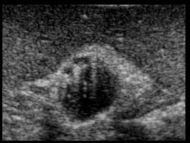
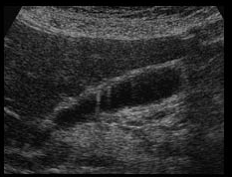
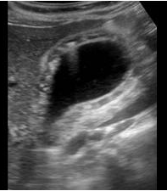
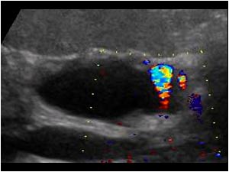
Adenomyomatosis
Aka adenomatous hyperplasia
A form of hyperplastic cholecystoses
More common in females
Present with RUQ pain or are asymptomatic
Sonographic findings
Focal or diffuse wall thickening
Small, round, anechoic spaces in GB wall
Echogenic foci in the GB wall
Display acoustic shadowing or comet tail artifacts
Display twinkle artifact on color Doppler

Slide 3
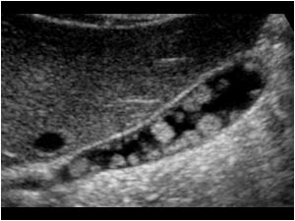
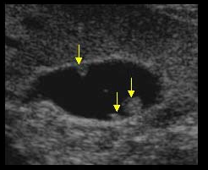
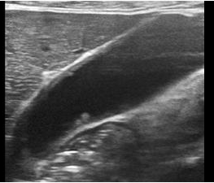
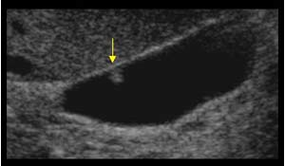
Cholesterol Polyps
Focal form of GB cholesterolosis
The most common polypoid GB lesion
More common in females
Usually asymptomatic
Sonographic findings
Non-shadowing, fixed, echogenic mass(es) projecting into lumen of GB
Can be single or multiple
Usually measure between 2 – 10 mm

Slide 4
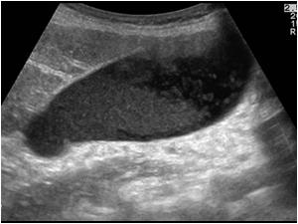
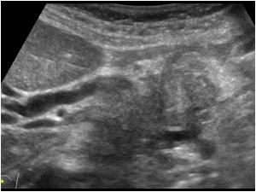
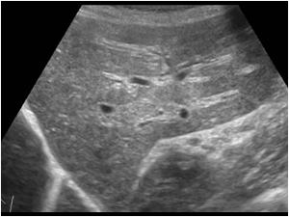
Courvoisier GB
Enlarged, distended, palpable, and nontender GB in a jaundiced patient
Due to prolonged, complete obstruction of the distal CBD
Present with a palpable RUQ mass
Sonographic findings
Distended GB
Dilated CBD and intrahepatic ducts
GB returns to normal when obstructing lesion is removed

Slide 5
Hydropic GB
Aka hypdrops of the GB or mucocele
Abnormal accumulation of fluid within GB
Most common cause is stone obstructing GB neck or cystic duct
Present with RUQ pain, N/V, palpable mass, or asymptomatic
Sonographic findings
Markedly dilated GB with thin wall
Possible stone in neck or cystic duct

Slide 6
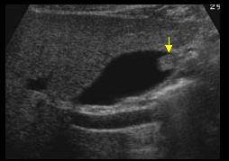
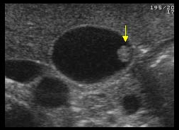
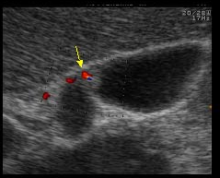
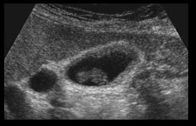
GB Adenoma
Benign epithelial tumor of the GB
Typically less than 2 cm in size
Low malignant potential (especially in masses smaller than 1 cm)
Asymptomatic
Sonographic findings
Non-shadowing, fixed, echogenic mass projecting into lumen of GB
Typically located in fundus

Slide 7
GB Carcinoma
Primary malignancy of the GB
Adenocarcinoma is the most common
Rare, but the 5th most common CA of the digestive system
More common in elderly females
Risk factors
Chronic cholecystitis and cholelithiasis
Rapidly growing polyps
Porcelain GB
Clinical presentation
Asymptomatic in early stages or symptoms of cholecystitis and cholelithiasis
Jaundice, malaise, or weight loss in later stages

Slide 8
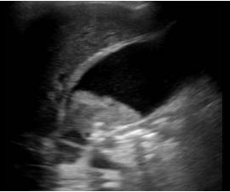
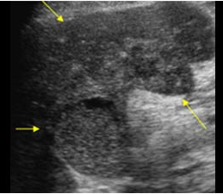
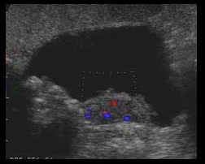
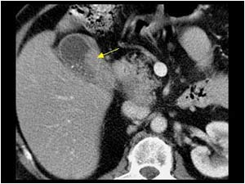
GB Carcinoma
Sonographic findings
Heterogeneous, irregular-shaped intraluminal mass
Focal or diffuse wall thickening
May see tumor invasion into liver
ascites
Can metastasize to liver, lymph nodes, and CHD
Treatment involves surgical removal of GB

Slide 9
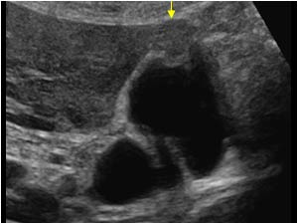
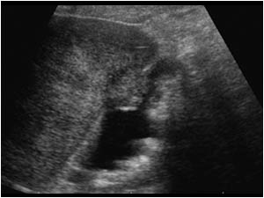
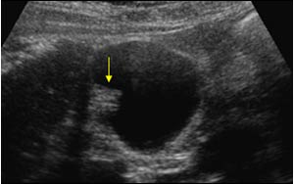
Mets to the GB
Malignant tumor invasion into the GB from an outside primary source
Melanoma is the most common
Poor prognosis
Sonographic findings
Hyperechoic, non-shadowing, polypoid lesions
Usually multiple
Usually larger than 10 mm
Focal wall thickening

Slide 10
Biliary Tree Obstruction
Dilatation of the bile ducts caused by a direct interference with the flow of bile
intrahepatic
extrahepatic
Dilatation occurs proximal to the obstruction
Present with RUQ pain and jaundice
Elevated bilirubin and ALP
Sonographic findings
“parallel channel sign” or “double-barreled shotgun sign”
intrahepatic anechoic tubular structures with stellate branching pattern

Slide 11
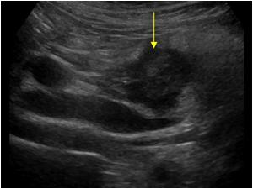

Slide 12
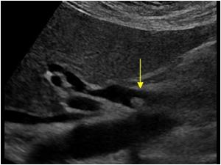
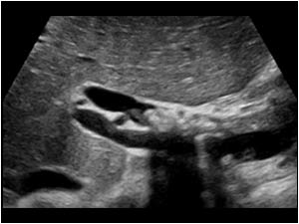
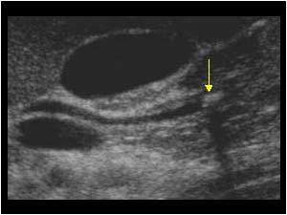
Choledocholithiasis
Bile duct stones
The most common pathology of the biliary tract
Can occur after cholecystectomy
Asymptomatic unless obstruction occurs
Clinical symptoms include RUQ pain and possible jaundice
Sonographic findings
intraductal hyperechoic focus with posterior shadowing
dilated duct proximal to obstructing stone

Slide 13
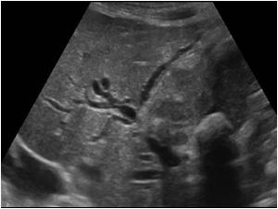
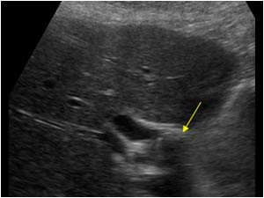
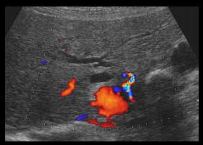
Mirizzi Syndrome
Inflammation and obstruction of the CHD caused by an impacted stone in the cystic duct
sequelae of jaundice, pain, fever, and recurrent cholangitis
Sonographic findings
hyperechoic focus with distal shadowing impacted in cystic duct
dilated CHD, cystic duct, and intrahepatic ducts
thickening of the duct walls

Slide 14
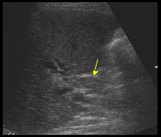
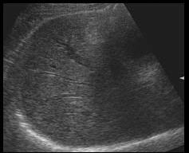
Hemobilia
Blood within the biliary tree
may extend into GB
Most commonly caused by iatrogenic biliary trauma
May present with pain
Sonographic findings
fluid with low-level internal echoes in acute stage
clotted blood will have varying echogenicity and may be mobile

Slide 15
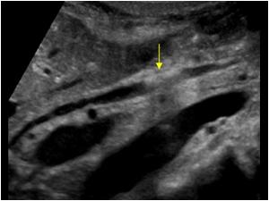
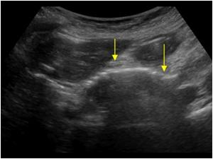
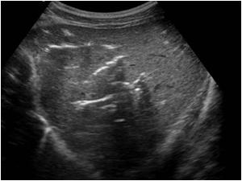
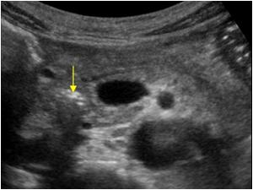
Pneumobilia
Air (gas) within the biliary tree
Risk factors
biliary intervention
emphysematous cholecystitis
biliary/ GI fistula
Sonographic findings
non-dependent, hyperechoic linear structures within the biliary tree
dirty shadowing and ring-down artifact
movement of air bubbles may be seen with change in patient position

Slide 16
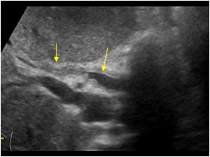
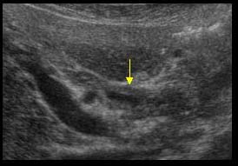
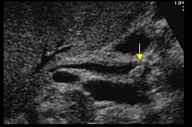
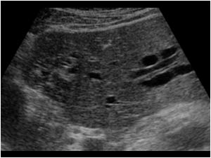
Cholangitis
Inflammation of bile ducts
Types
acute bacterial
recurrent pyogenic
HIV cholangiopathy
sclerosing
Present clinically with fever, RUQ pain, and jaundice
Elevated bilirubin, ALP, AST, ALT
Sonographic findings
dilated ducts with thickened duct walls
may have intraductal sludge and/or stones

Slide 17
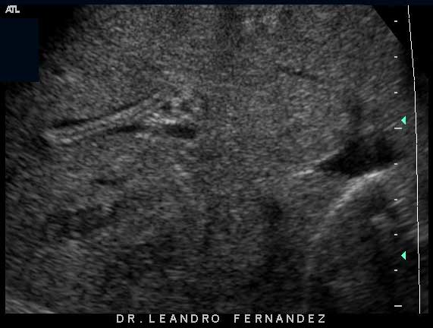
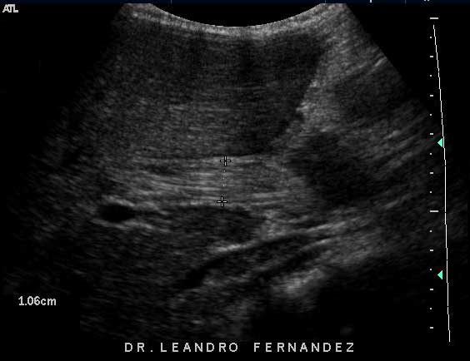
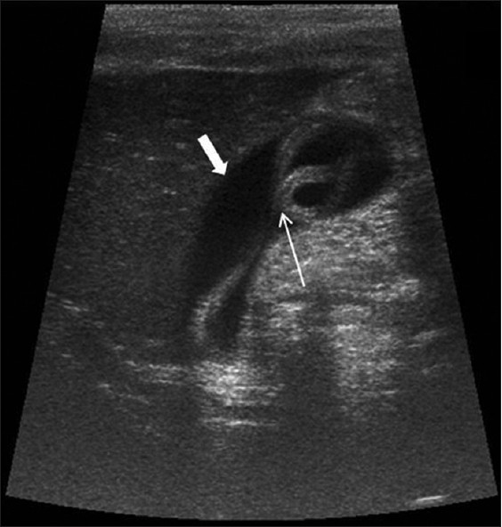
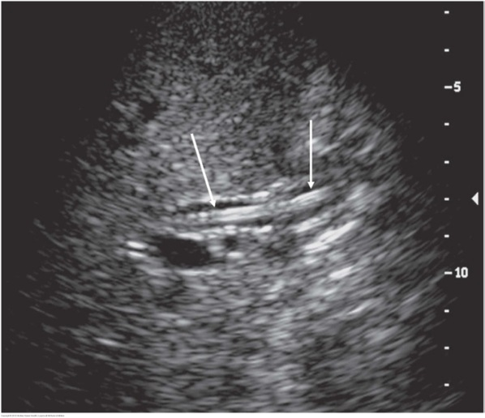
Ascariasis
Infection of the bile duct caused by a parasitic roundworm
Fecal-oral route of transmission
Most common in children
Worm travels from small bowel to biliary tree through ampulla of Vater
Usually asymptomatic
Sonographic findings
intraductal, parallel, echogenic lines in any portion of the ductal system or GB
movement of the worm may be seen

Slide 18
Cholangiocarcinoma
Primary malignancy of the biliary tree
Uncommon
Frequency increases with age
Affects both sexes equally
Risk factors
PSC
biliary stones
chronic biliary inflammation
Types - defined by location of tumor
intrahepatic - arise within hepatic parenchyma
hilar (Klatskin’s) - located at porta hepatis
distal - arising in distal extrahepatic ducts
Elevated ALP and bilirubin
Present clinically with fatigue, RUQ pain, anorexia, weight loss, jaundice, palpable mass
Sonographic findings
biliary dilatation
non-union of the right and left biliary ducts
intraductal polypoid mass
may see tumor extension into adjacent vasculature
Poor prognosis
surgical resection if detected early
palliative treatment if detected late

Slide 19
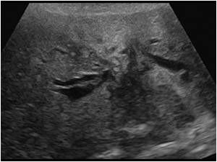
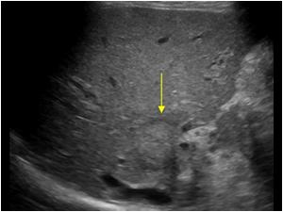
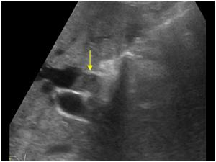

Slide 20
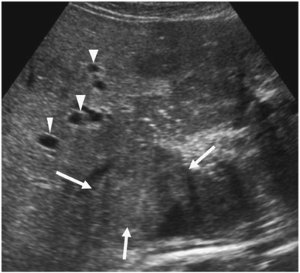
Rhabdomyosarcoma
The most common pediatric biliary tract malignancy
Usually arise in the porta hepatis
Patients present with obstructive jaundice
Sonographically, a mass in the porta hepatis and intrahepatic ductal dilatation

Slide 21
Mets to the Biliary Tree
Malignant tumor invasion into the biliary tree from an outside primary source
most commonly breast, colon, and melanoma
Affect both intra- and extrahepatic ducts
Multiple masses with varied sonographic appearances

Slide 22
The Postcholecystectomy Patient
Post-operative fluid collections may be seen in GB fossa
Echogenic foci representing surgical clips may be seen
Normal CBD can measure up to 11 mm
Retained ductal stones may be seen

