Slide 1
The Gallbladder and Biliary System
Part 1
Chapter 6 pages 171-195
Chapter 19 pages 627-632

Slide 2
Anatomy of the Biliary Tree
Intrahepatic bile ducts
Course with the portal venous and hepatic arterial branches as part of the portal triads
Join to form the right and left main hepatic ducts
Extrahepatic bile ducts
Right and left hepatic ducts emerge from liver at porta hepatis and form the CHD
Cystic duct joins the CHD and forms the CBD
CBD courses posterior to the 1st portion of duodenum to the pancreatic head
CBD joins with main pancreatic duct at ampulla of Vater and enters 2nd portion of duodenum

Slide 3
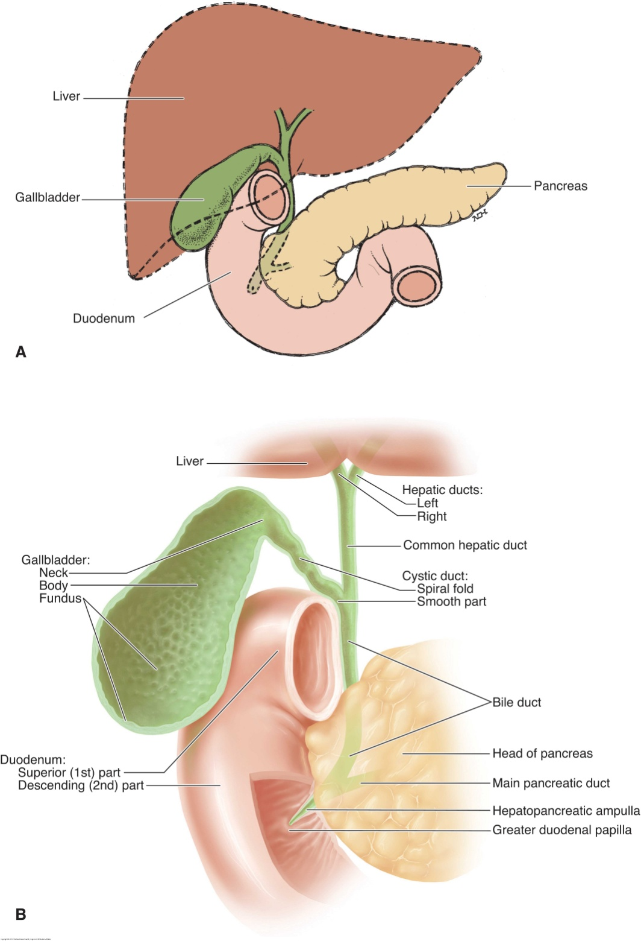

Slide 4
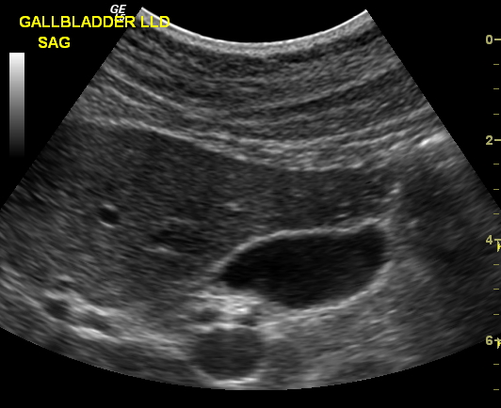

Slide 5
Anatomy of the Gallbladder
Pear- or teardrop-shaped sac
Located in the main lobar fissure between the right and left hepatic lobes
Lies under the visceral surface of the liver
Divided into a neck, body, and fundus
Several variations exist
Shapes
Positions
Folds
Septations

Slide 6
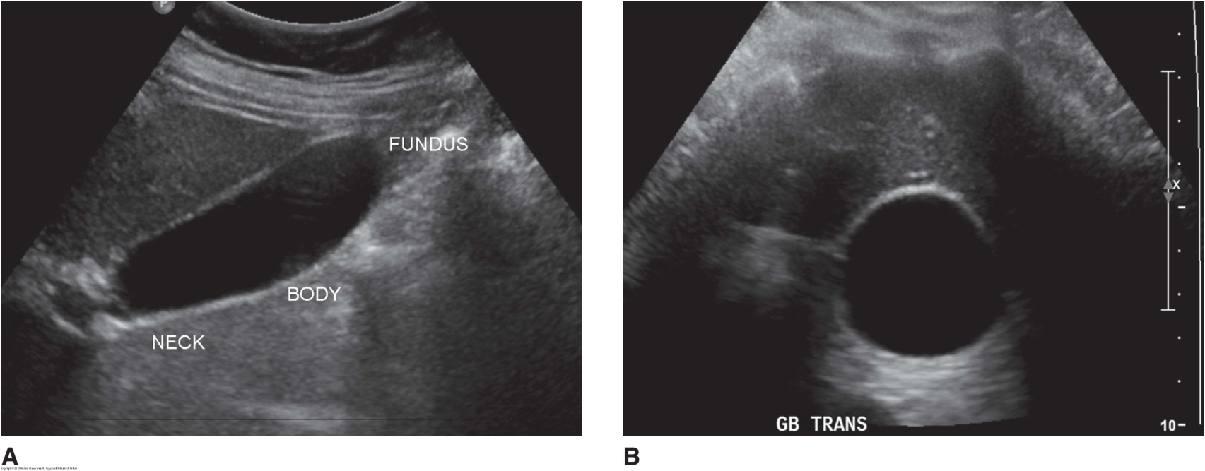
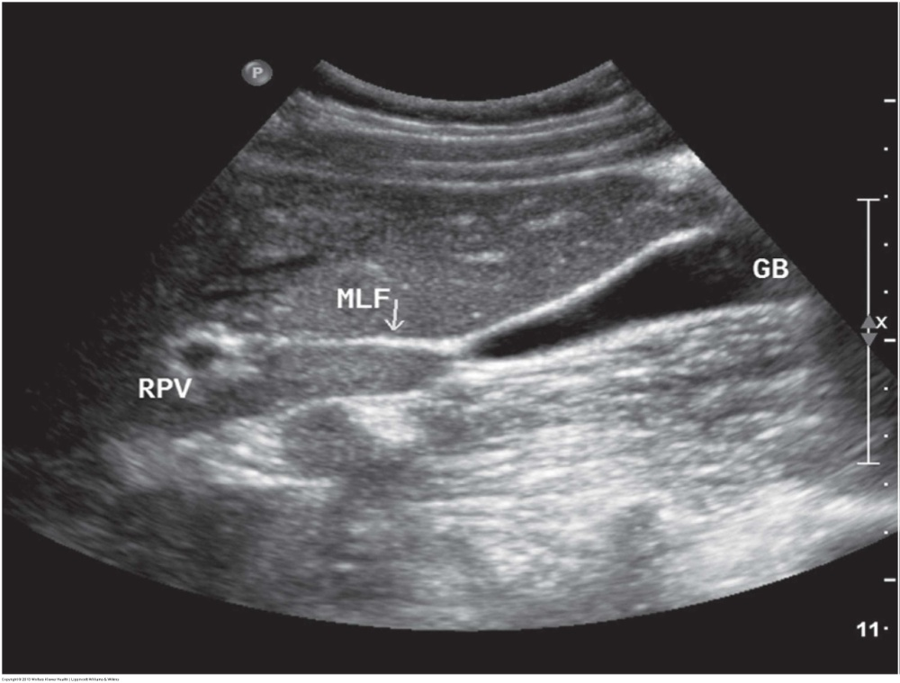

Slide 8
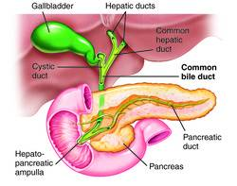
Physiology
Biliary ducts transport bile to the GB and duodenum
GB concentrates and stores bile until needed for digestion and regulates biliary pressure
Small intestine secretes CCK into blood stream when a person eats
CCK causes GB walls to contract and the sphincter of Oddi to relax
Bile is released into cystic duct
Bile emulsifies ingested fat and aids in fat absorption

Slide 9
Lab Values
WBC
Bilirubin
Alk Phos
ALT
AST
PT

Slide 10
Indications for Exam
RUQ pain
Positive Murphy’s sign
Pain radiating to right shoulder or scapula
Nausea
Vomiting
Loss of appetite
Intolerance to fatty foods and dairy products
Jaundice

Slide 11
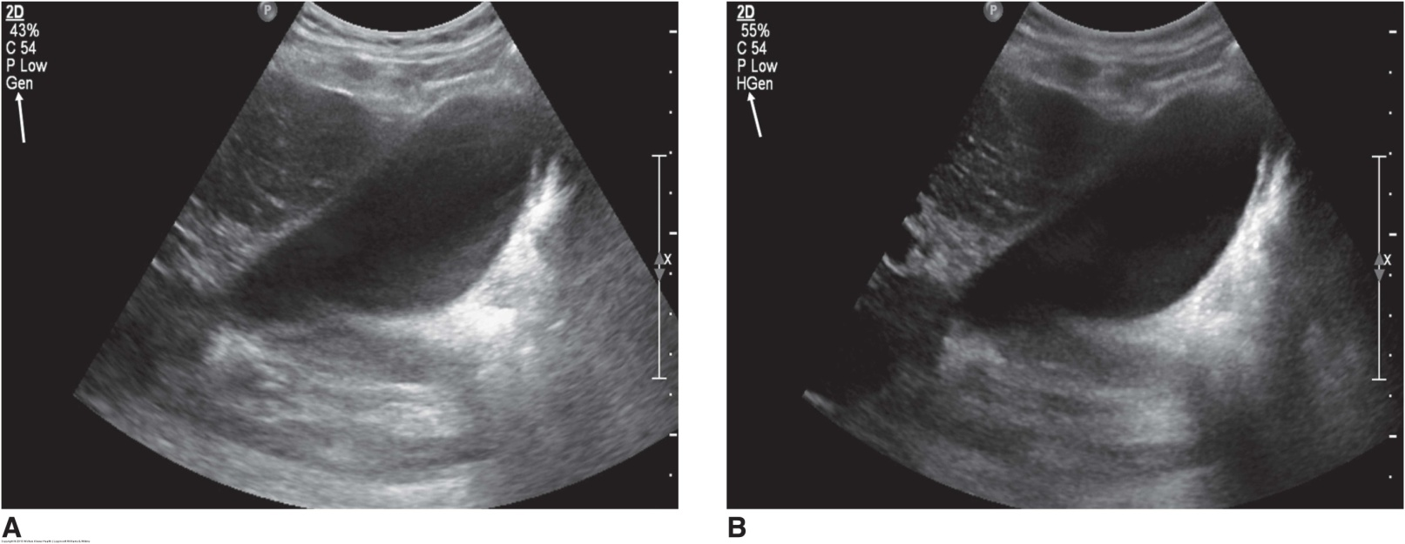
Sonographic Examination
NPO for 6-8 hours
3.5-5.5 MHz transducer
Proper gain and TGC settings
Harmonics
Focal zone
Supine, LLD, and RLD positions

Slide 12
Biliary Atresia
Congenital obliteration of bile ducts and possibly the GB
The most common type of obstructive biliary disease in infants and young children
More common in males
Patients present with persistent jaundice and elevated bilirubin
Triangular cord sign seen on sonography
Treated surgically

Slide 13
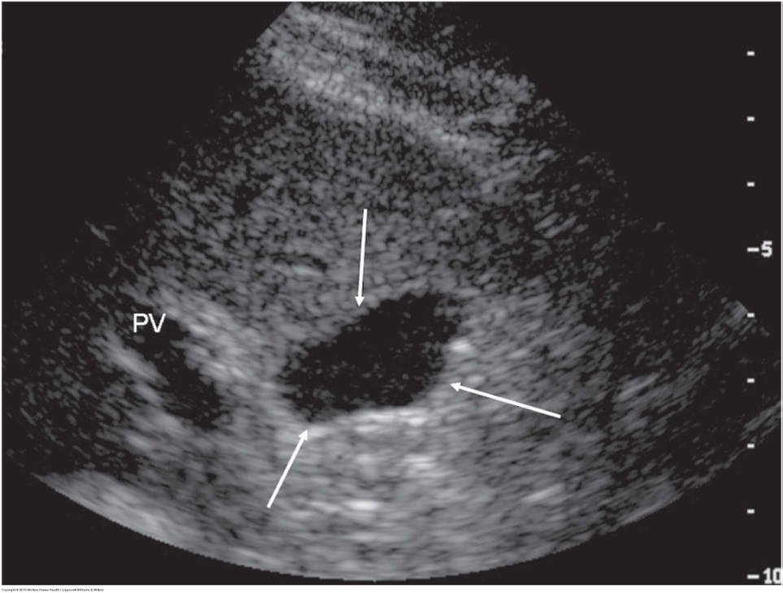
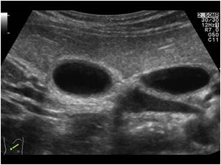
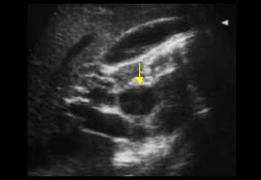
Choledochal Cysts
Congenital dilatation of a bile duct
4 types
Type I (fusiform dilatation of the CBD) is the most common
More common in females
Present with intermittent jaundice, pain, failure to thrive, and possible palpable mass
Localized cystic mass separate from the GB in region of porta hepatis or intrahepatically
Surgical management recommended due to malignant potential

Slide 14
Caroli’s Disease
Rare congenital disease of the intrahepatic biliary tree
Affects both sexes equally
Patients present with pain, fever, and intermittent jaundice
Saccular dilatation of intrahepatic ducts
Usually diffuse but can be focal
May contain stones and/or sludge
Surgical management recommended due to malignant potential

Slide 15
Biliary Sludge
Highly concentrated bile within the GB
Can produce pain or can be asymptomatic
Can be a precursor to gallstones
Can resolve spontaneously
Non-shadowing, low-amplitude echoes that layer dependently in GB
May demonstrate fluid-fluid level
Moves with patient positioning
Must be distinguished from artifact

Slide 16
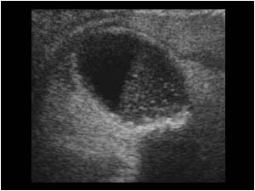
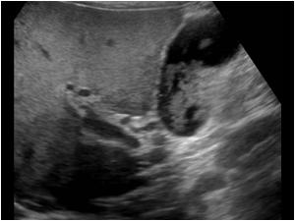
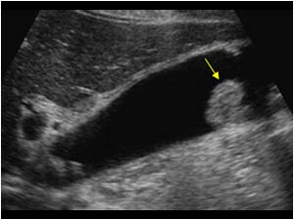
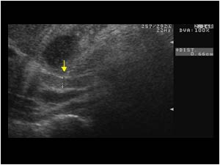
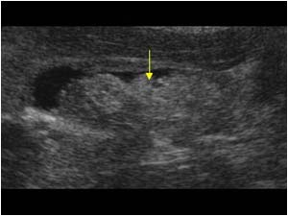
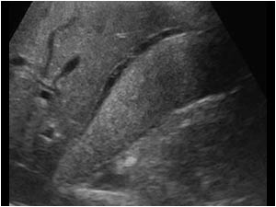

Slide 17
Cholelithiasis (Gallstones)
Extremely common in US
More common in females (“the 6 F’s”)
Other associated risks include
Pregnancy/ fecundity
Increasing age
Diabetes
Obesity
Majority of patients are asymptomatic
Symptoms include RUQ pain and N/V
Elevated ALP, AST, ALT
Sonographic appearance
Mobile, gravity-dependent, echogenic foci within the GB lumen that casts a posterior shadow
Majority of gallstones cast a “clean” shadow
Must be distinguished from polyps, air in biliary tree, surgical clips, sludgeballs, bowel
Stone can be impacted in GB neck
Treated with surgery (cholecystectomy)

Slide 18
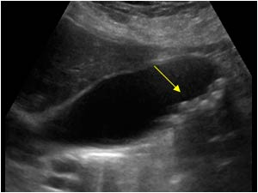
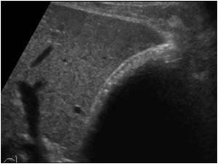
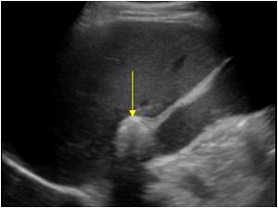
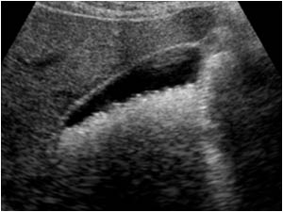
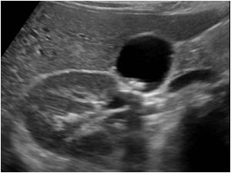
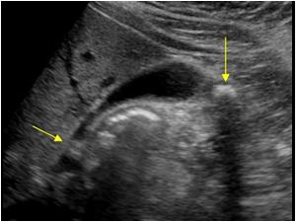

Slide 19
Acute Cholecystitis
Inflammation of the gallbladder
Usually caused by gallstones impacted in the neck or cystic duct
Present clinically with RUQ pain/ tenderness and fever
Elevated WBC, ALP, bilirubin
Sonographic findings
GB wall thickening
Pericholecystic fluid
Gallstones (sludge may be present)
GB distention
Hyperemic GB wall

Slide 20
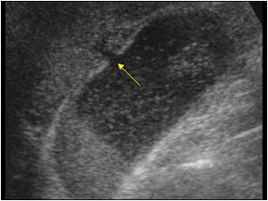
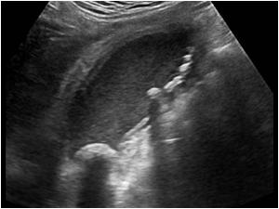
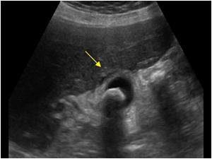
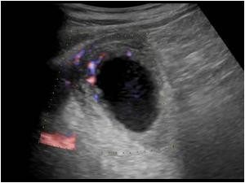

Slide 21
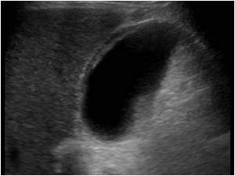
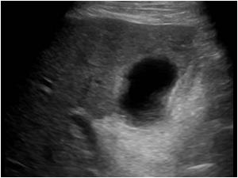
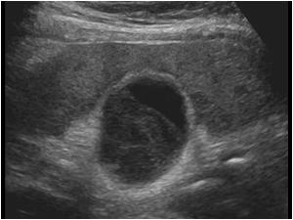
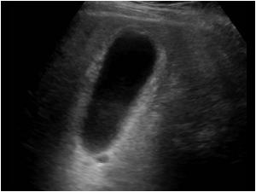
Acalculus Cholecystitis
Inflammation of GB in the absence of cholelithiasis
Often occurs in critically ill patients or elderly males with atherosclerosis
Symptoms
RUQ pain
Positive Murphy’s sign
Sonographic findings
GB distention
Wall thickening
Pericholecystic fluid
Sludge

Slide 22
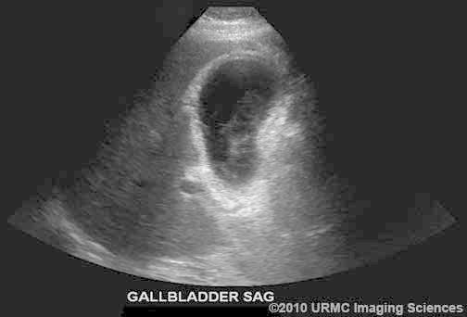
Complicated Cholecystitis
Empyema
GB Perforation
Gangrenous Cholecystitis
Emphysematous Cholecystitis

Slide 23
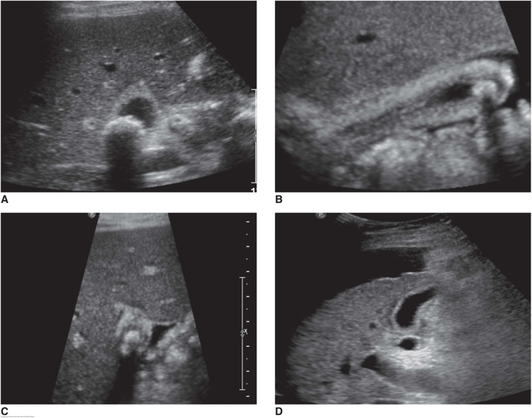
Chronic Cholecystitis
Recurrent inflammatory changes in GB
Associated with long term presence of gallstones
Present with intermittent RUQ pain and intermittent N/V
Elevated AST, ALT, ALP
Sonographic findings
Gallstones
GB wall thickening
Contracted GB

Slide 24
Non-Inflammatory Causes of GB Wall Thickening
Diffuse | Focal
Ascites | Adenomyomatosis
Acute hepatitis | Polyps
CHF | Papillary adenomas
Renal disease | GB CA
AIDS | Metastatic wall masses
Pancreatitis
Cirrhosis

Slide 25
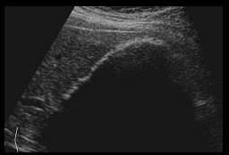
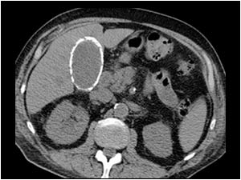
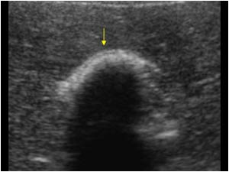
Porcelain GB
Calcification of GB wall
A rare manifestation of chronic cholecystitis
More common in females
Associated with increased incidence of GB CA
Sonographic findings
Hyperechoic semilunar structure with posterior shadowing
May simulate GB full of stones

