Slide 1
The Kidneys
Chapter 10 pages 271-310
Chapter 20 pages 677-692

Slide 2
Embryology
Kidneys begin to form as early as the 3rd week of development
3 pairs of kidneys early on:
Pronephros – degenerate rapidly
Mesonephros – provide partial function while the permanent kidneys continue to develop; eventually become the mesonephric ducts
Mesonephric (Wolffian) duct becomes the male epididymis, ductus deferens, and ejaculatory duct
Mesonephric duct becomes the paramesonephric (Mullerian) duct in females, eventually turning into the uterus and vagina
Metanephros – become the permanent kidneys
Kidneys begin in the pelvis and migrate up during fetal development

Slide 3
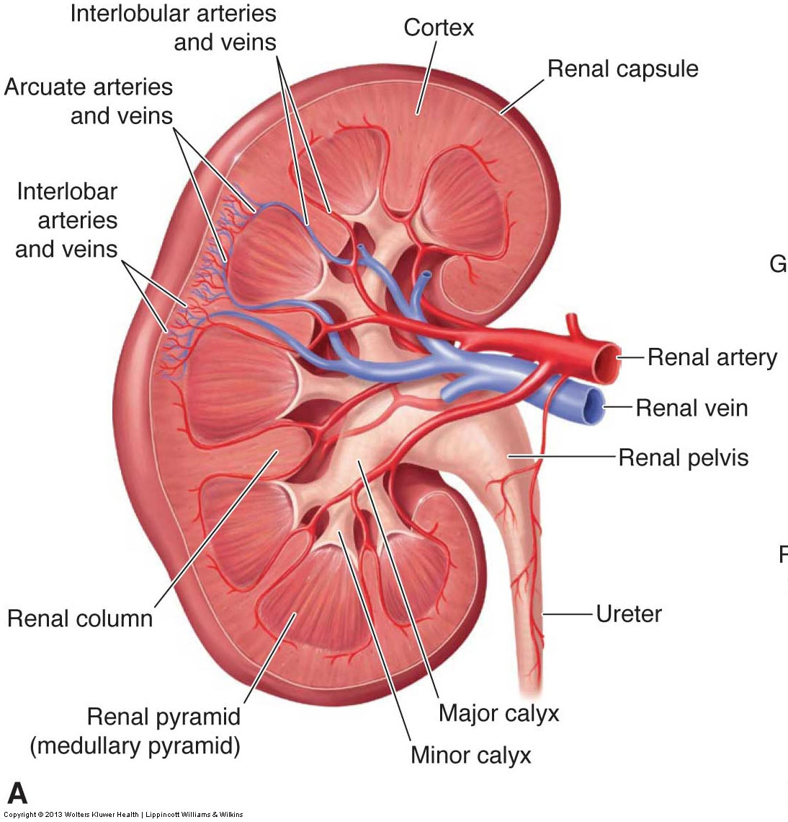
Anatomy
Interlobar
Interlobular
Cortex
Medulla
Sinus
Renal pelvis
Vasculature
Layers of supportive tissue
Fibrous renal capsule
Perirenal fat
Renal fascia aka Gerota fascia
Pararenal fat

Slide 4
Anatomic Variants
Dromedary hump – bulge on the lateral border of the kidney with similar echogenicity to surrounding cortex
Junctional parenchymal defect – wedge-shaped hyperechoic defect in the anterior aspect of kidney extending inward in between pyramids
Hypertrophied column of Bertin – column of Bertin is enlarged due to increased tissue and mimics a mass; contiguous with renal cortex with similar echogenicity
Extrarenal pelvis – pelvis outside of the normal renal pelvis; located partially or entirely outside the kidney

Slide 5
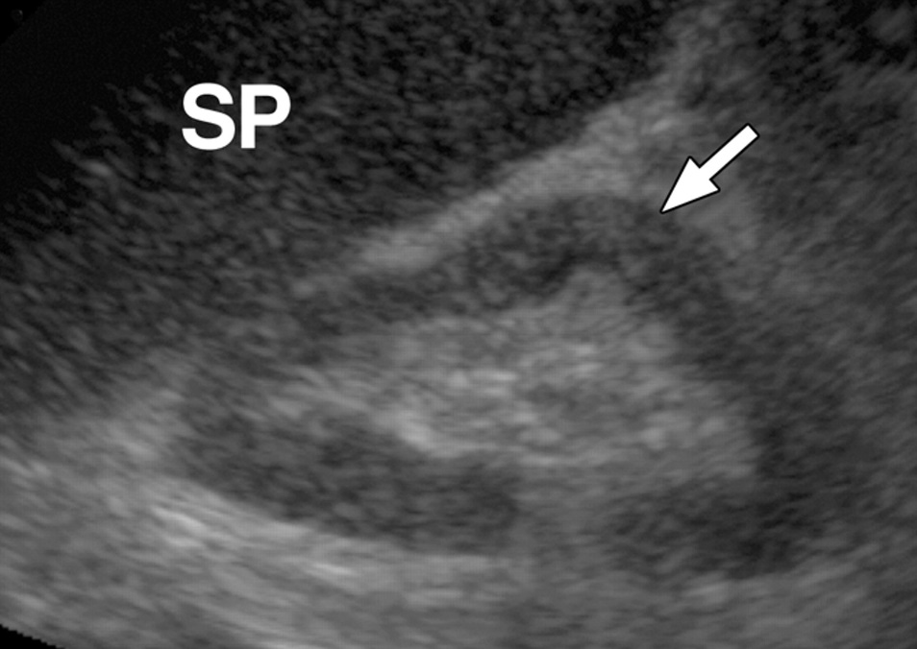

Slide 6
Physiology
Nephrons are the structural and functional units of the kidney
Functions include:
Controlling blood concentration and volume by removing selected amounts of water and solutes
Helping to regulate blood pH
Removing toxic wastes from the blood
Approximately 1,100-1,200 mL of blood passes through the kidneys every minute
Kidneys process about 180 L of blood-derived fluid daily
99% is filtered and returned to circulation
1% is eliminated from the body as urine

Slide 7
Lab Values
Serum (blood) tests
Creatinine – elevates when the kidneys are not functioning properly
Urea nitrogen (BUN) – serves as a measure of kidney function, but also elevates for other reasons
Urinalysis
Presence of blood (hematuria) – can be caused by stones and masses
Presence of protein (proteinuria) – sign of CKD
Presence of bacteria – sign of UTI

Slide 8
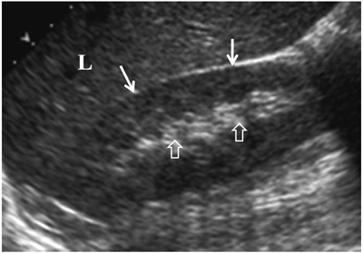
Sonographic Appearance

Slide 9
Congenital Anomalies
Agenesis – complete absence of renal tissue; adrenal gland will elongate and fill the renal fossa
Hypoplasia – a normally formed but small kidney; compensatory hypertrophy of the contralateral kidney occurs
Duplicated collecting system – the most common genitourinary anomaly; with complete duplication, there are 2 pelvicaliceal systems and 2 ureters that enter the bladder through separate orifices
Renal ectopia
Simple ectopia – most common location for an ectopic kidney is in the ipsilateral pelvis
Crossed ectopia – both kidneys are located on one side of the spine, and the ectopic kidney is usually fused to the normal orthotopic kidney
Horseshoe kidney – the most common renal anomaly; kidneys are fused together (usually at the lower poles) by an isthmus of renal tissue extending across the midline

Slide 10
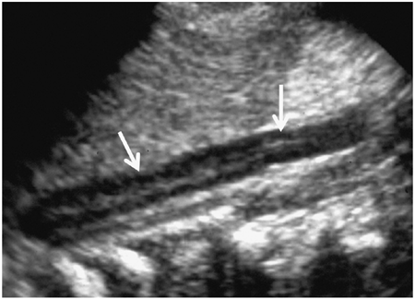
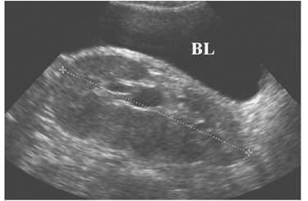
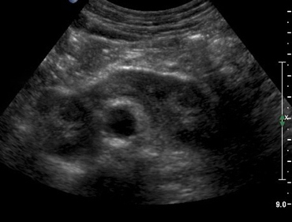

Slide 11
Adult Polycystic Kidney Disease
Aka autosomal dominant polycystic kidney disease
Relatively common, accounting for 8-10% of patients requiring dialysis or transplant
Usually manifests in the 4th decade
Cysts enlarge with age and renal function decreases
Symptoms include abdominal and lumbar pain, hematuria, and hypertension
Complications include infection and renal calculi
Death usually occurs 10 years after onset of symptoms
Sonographically, bilateral enlarged kidneys with numerous discrete cysts in the cortical regions

Slide 12
Infantile Polycystic Kidney Disease
Aka autosomal recessive polycystic kidney disease
Patients present at birth with symmetrically enlarged, echogenic kidneys
Cysts are very small and not seen sonographically
Associated with hepatic abnormalities
Patients who survive the neonatal period end up with more severe hepatic disease (cirrhosis and portal hypertension)

Slide 13
Multicystic Dysplastic Kidney
Typically unilateral (bilateral is incompatible with life)
Develops from a complete ureteral obstruction in utero
Patients may present with a palpable mass at birth
Sonographically, an enlarged kidney with multiple cysts of various size
Must be distinguished from hydronephrosis

Slide 14
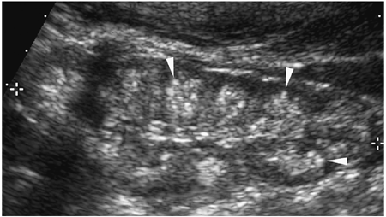
Medullary Cystic Disease
Medullary Sponge Kidney
Uremic Medullary Cystic Disease
Relatively common and occurs in adults
Renal function is usually normal, so it is often detected incidentally
Bilateral medullary pyramids appear highly echogenic without shadowing
Aka nephronophthisis
Rare, progressive hereditary disorder that presents in children or young adults
Small kidneys, with multiple tiny cysts confined to the medulla

Slide 15
Cortical Cysts
Simple cysts
Complex cysts
Hemorrhagic cyst
Infected cyst
Septated or multilocular cyst
Calcification(s) in cysts
Calcified wall
Milk of calcium

Slide 17
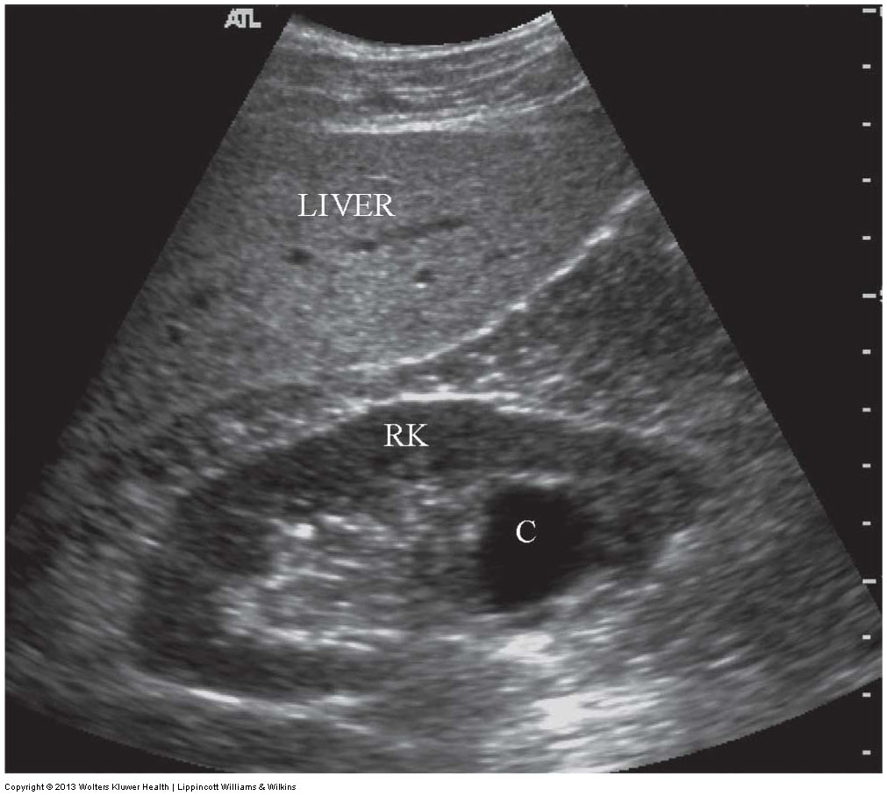
Parapelvic and Peripelvic Cysts
Cysts within the renal sinus
Parapelvic
Originate from renal parenchyma and protrude into the renal sinus
Generally solitary and large
Peripelvic
True sinus cysts
Usually small, multiple, and often irregular in outline
Both are anechoic avascular fluid collections
Fluid collections do not connect as with hydro

Slide 18
Cysts Associated with Systemic Disease
Tuberous Sclerosis
Von Hippel-Lindau Disease
Multisystem disorder associated with renal cyst formation and neoplasms
Most patients have multiple bilateral angiomyolipomas
Some patients have renal cysts
Multisystem disorder associated with a variety of visceral cysts and neoplasms
Renal cysts develop early on
Some patients develop RCC
Pancreatic, CNS, and orbital masses are common

Slide 19
Benign Solid Masses
Adenoma – the most common benign kidney tumor in adults
Usually small (<1 cm)
More common in males
Counterpart to RCC, so treated as malignant
Angiomyolipoma
Unilateral solitary mass not associated with tuberous sclerosis is more common in women
Multiple bilateral masses occur in 80% of patients with tuberous sclerosis
Classic sonographic appearance is a markedly hyperechoic mass
Oncocytoma
Large masses ranging from 0.3 – 26 cm in diameter
Difficult to distinguish from RCC so treated as malignant
Mesoblastic nephroma – the most common neonatal abdominal mass
Aka fetal renal hamartoma,, mesenchymal hamartoma of infancy, benign Wilms tumor
Can be unilateral or bilateral
Because it has malignant potential, treated as malignant

Slide 20
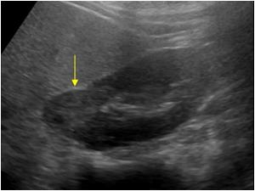

Slide 21
Renal Cell Carcinoma
Aka hypernephroma or adenocarcinoma
The most common malignant renal tumor in adults
More common in men over age 50
Patients present with costovertebral angle pain, a palpable mass, and hematuria
Spreads to perinephric fat, renal vein and regional lymph nodes, then other organs like lungs, bone, opposite kidney, liver, adrenal, and brain
Sonographic appearance varies – can be hyper- or hypoechoic and can be hetero- or homogeneous depending on the degree of hemorrhage, necrosis, and cystic degeneration

Slide 23
Wilms Tumor
Aka nephroblastoma
The most common malignant renal tumor in children
Peak age for diagnosis is 3-4 years
Patients usually present with a palpable mass
Frequently invade the renal vein and IVC, and mets to the liver and lung may occur
Varied sonographic appearances

Slide 24
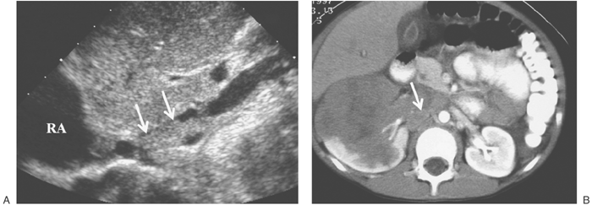

Slide 25
Nephroblastomatosis
A precursor to Wilms tumor
Can be diffuse or focal

Slide 26
Urothelial Carcinomas
Malignant tumors of the lining of the renal pelvis, calyces, ureter, and bladder
Account for 8-10% of all renal cancers
Patients present with hematuria due to the location of the mass
2 types:
Transitional cell carcinoma (TCC) – much more common than SCC
Often too small to be detected sonographically
When larger, appears as a non-specific solid mass in the renal sinus
Squamous cell carcinoma (SCC)
Highly malignant, with early mets and a poor prognosis
Associated with renal calculi and infection

Slide 27
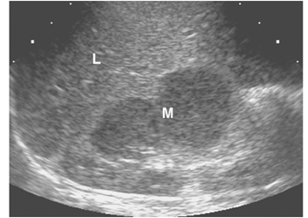
Metastatic Renal Tumors
Kidneys are frequent sites of metastases from other organs
Most common primary sources are breast and lung
RCC can also metastasize to the contralateral kidney
Other malignancies that can involve the kidneys include:
Lymphoma – more commonly non-Hodgkin
Leukemia – acute lymphoblastic leukemia is the most common malignancy of childhood and can affect the kidneys

Slide 28
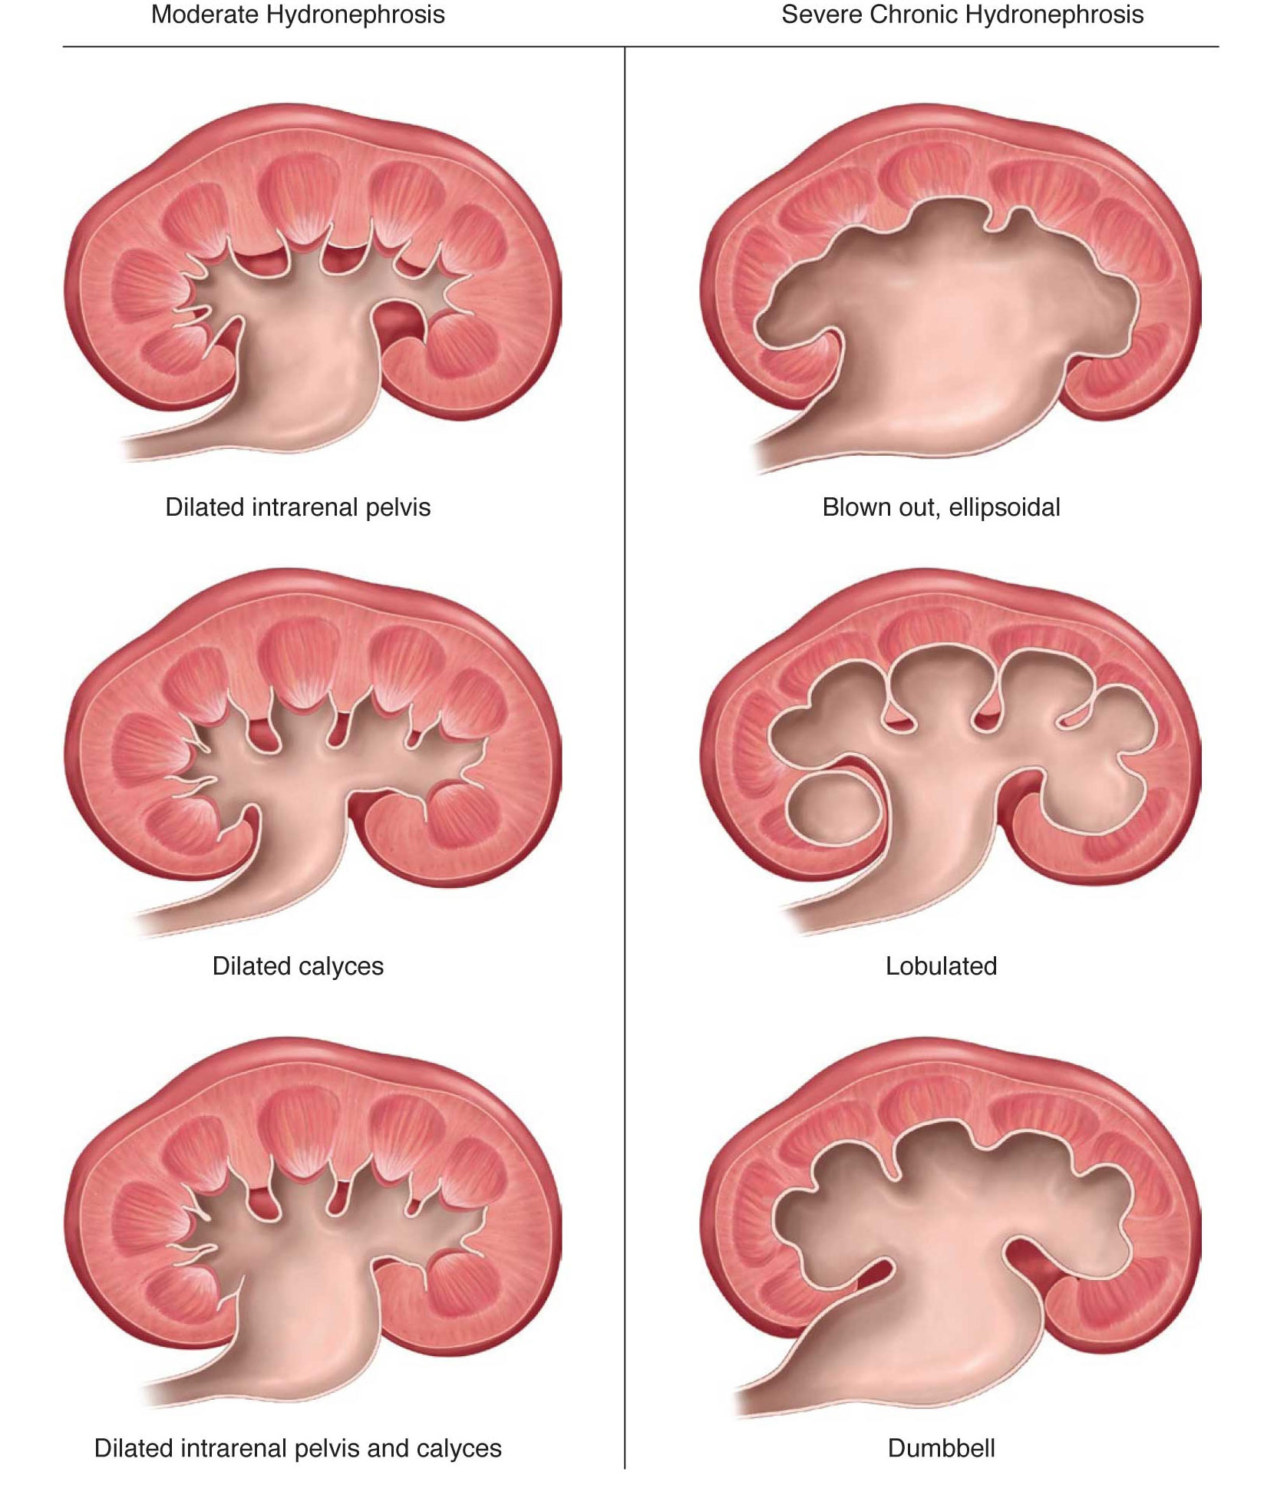
Hydronephrosis
Urine dilatation of the renal pelvis, calyceal structures, and infundibula
Various causes that can be classified as intrinsic or extrinsic
Appears sonographically as splaying, spreading, or ballooning of the central echo complex
Should always attempt to determine the cause and extent
Is it unilateral or bilateral?
Is the ureter dilated?
Is the bladder distended?
Is the urethra dilated?
Is there a stone or mass causing obstruction? Where is it located?
Is the dilatation causing cortical thinning?

Slide 29
