Slide 1
The adrenal glands
Chapter 13
Chapter 20 pages 675-684

Slide 2
embryology
Cortex
Composed of 2 zones during fetal development
After birth, the thicker inner zone involutes, and the thinner outer zone continues to develop into the adult adrenal cortex
By the age of 3 years, the cortex differentiates into 3 zones (zona glomerulosa, fasciculata, and reticularis)
Medulla
Sympathetic neurons of the ANS differentiate into endocrine cells and form the adrenal medulla

Slide 3
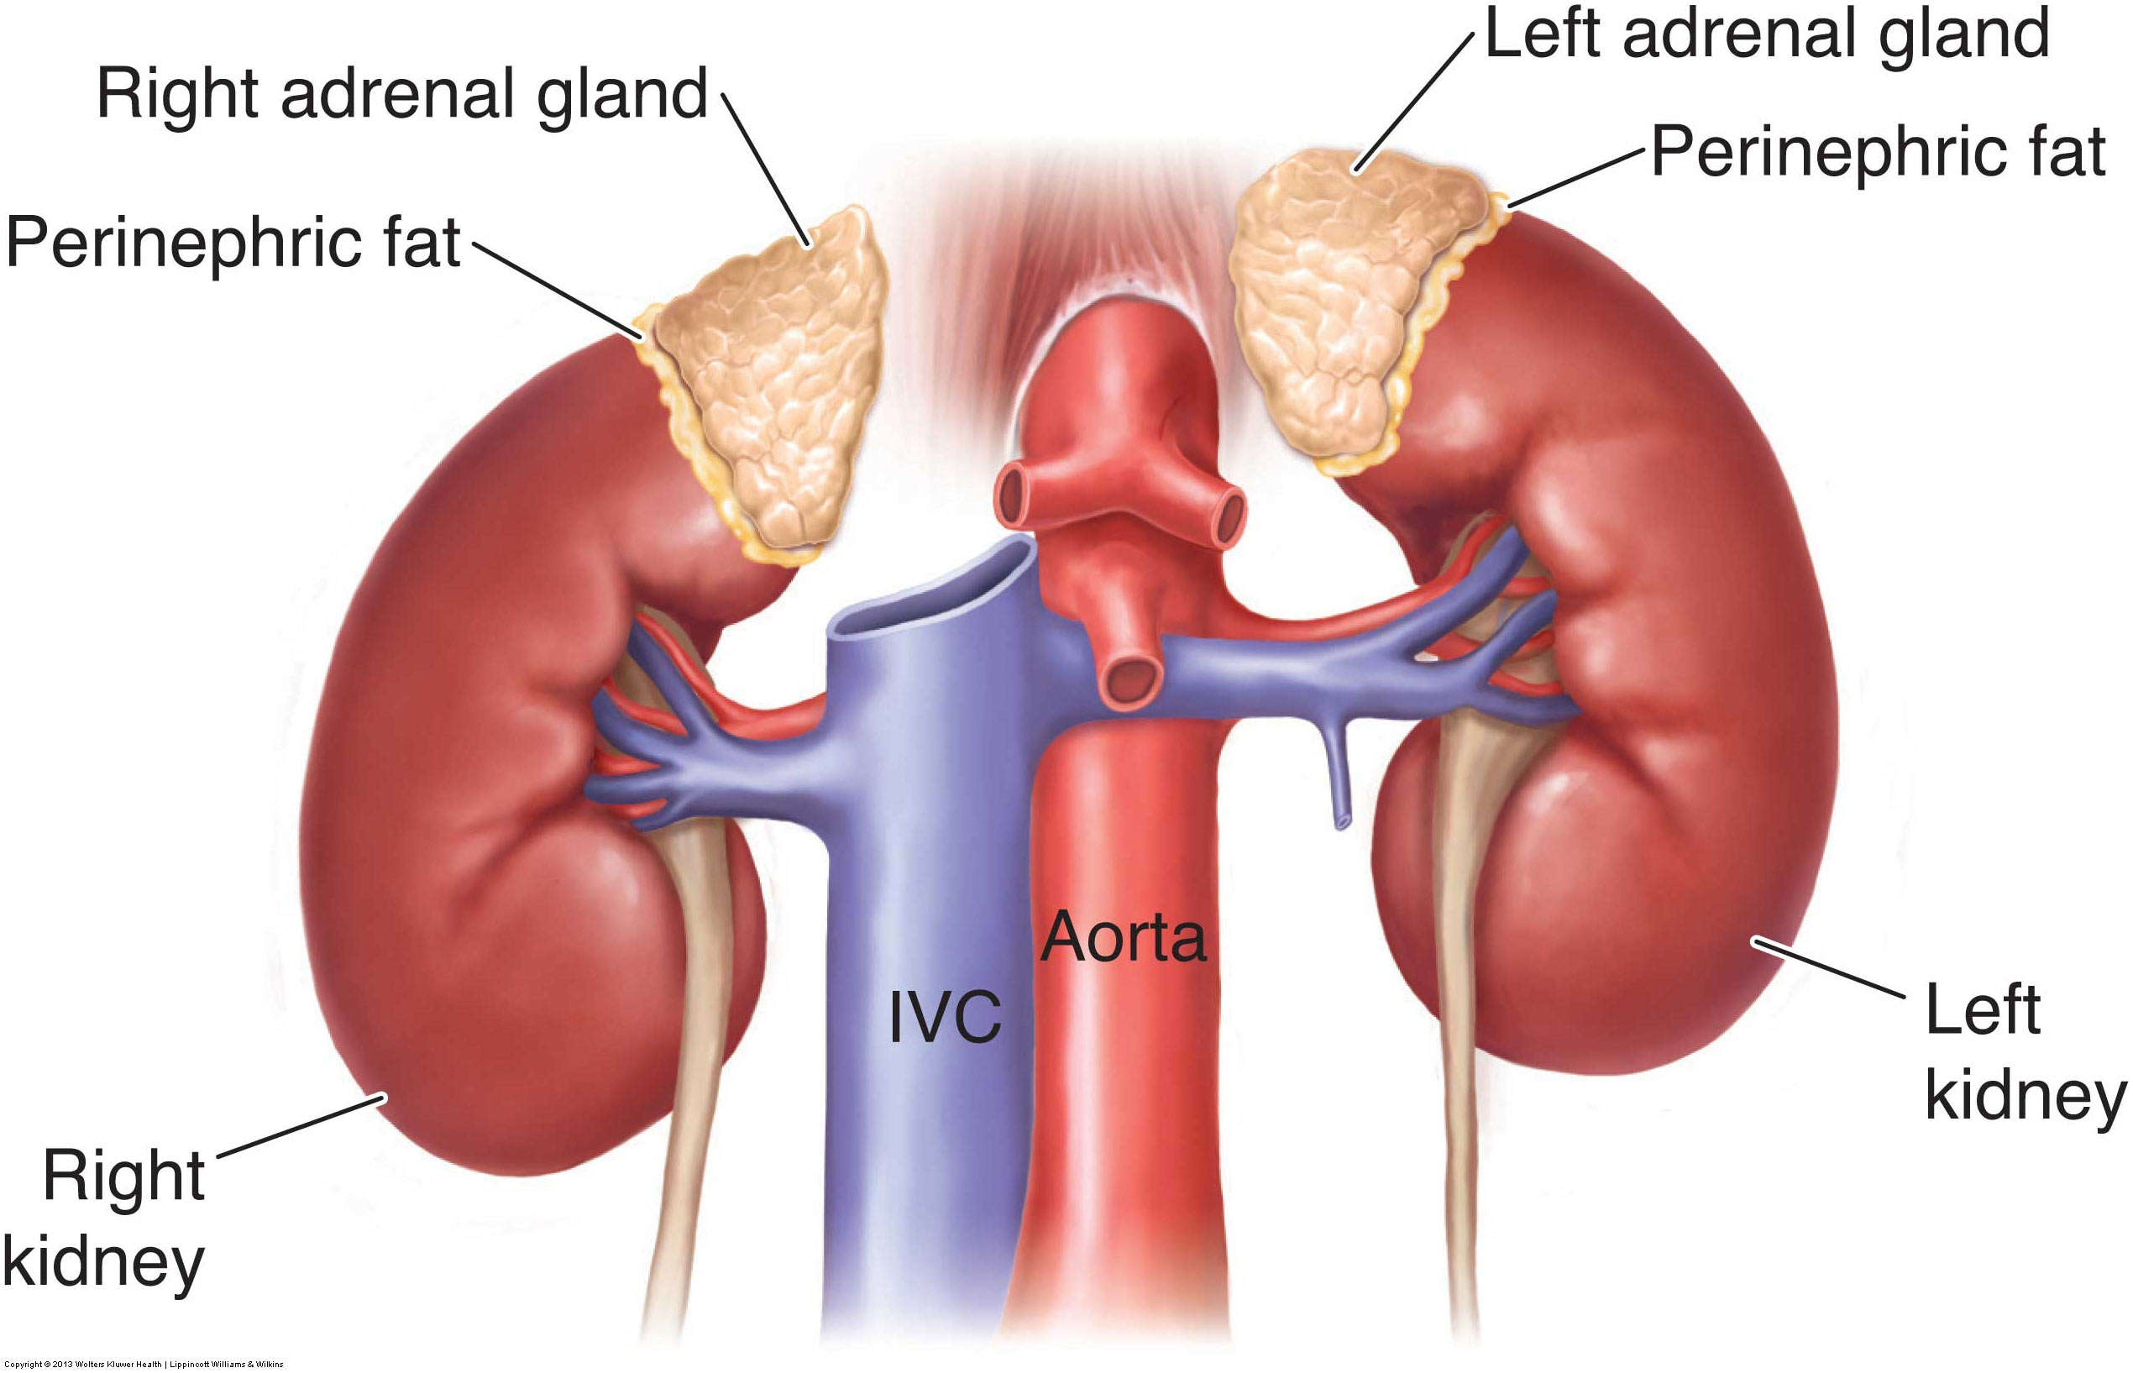
anatomy
Retroperitoneal organs that lie anterior, medial, and superior to the kidneys
Surrounded by perinephric fat, which separates the gland from the kidney
Contained within Gerota fascia
Right adrenal gland
Located posterior and lateral to the IVC, medial to the right lobe of the liver, lateral to the right crus of the diaphragm, and anterosuperior to the upper pole of the right kidney
Triangular or pyramidal shaped
Left adrenal gland
Located lateral to the aorta and left crus of the diaphragm, medial to the spleen, posterior to the splenic vessels and pancreatic tail, and anteromedial to the upper pole of the left kidney
Crescent or semilunar shaped

Slide 4
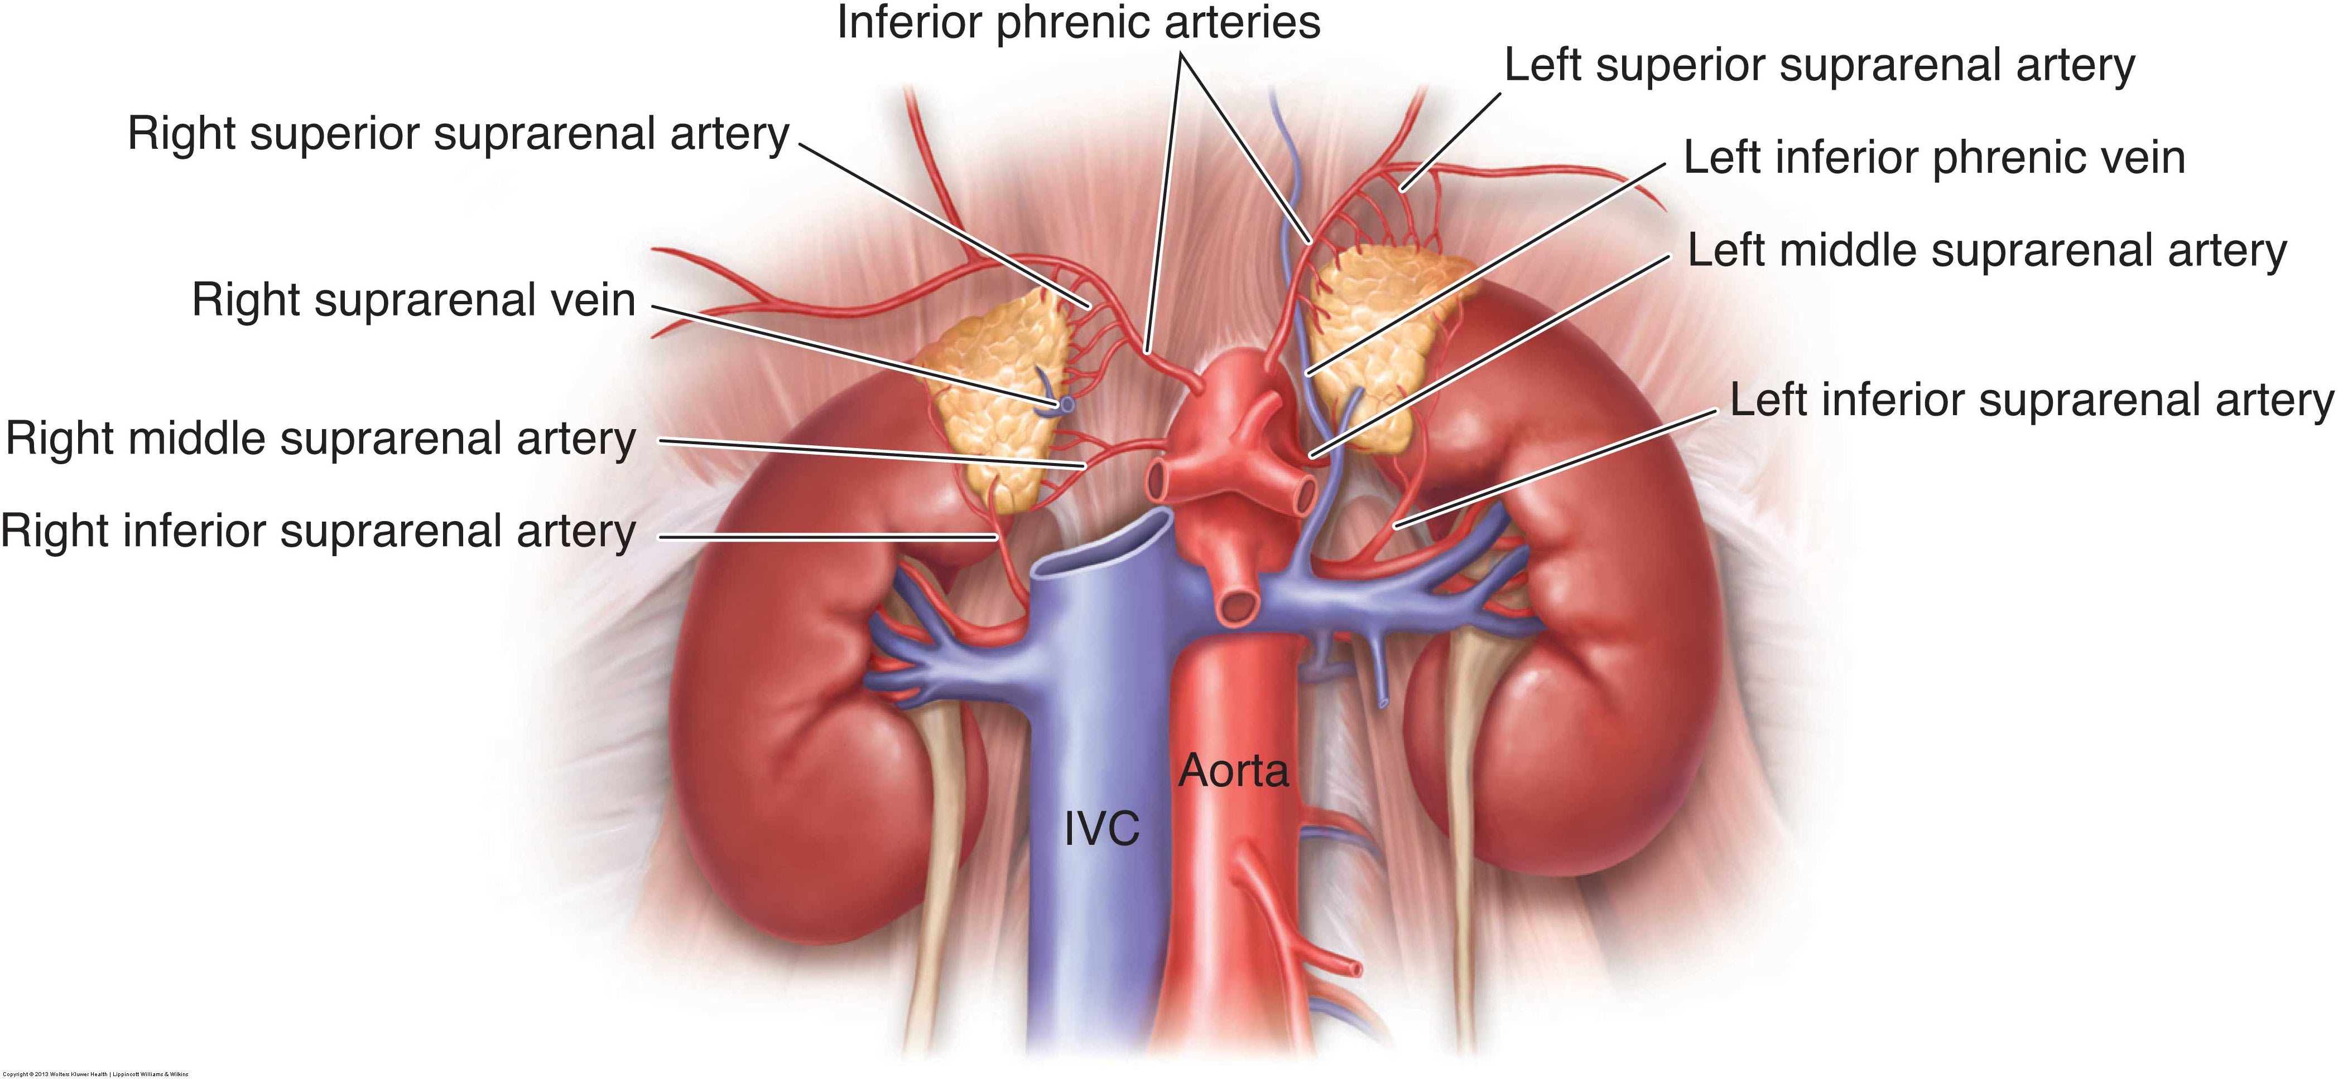
vasculature
Among the most vascular organs in the body
Arterial supply to each adrenal comes from 3 arteries
Superior suprarenal artery (a branch off of the inferior phrenic artery)
Middle suprarenal artery (a branch off of the abdominal aorta)
Inferior suprarenal artery (a branch off of the renal artery)
Venous drainage from each adrenal is through a central vein that exits at the hilum
Right suprarenal vein empties directly into the posterior aspect of the IVC
Left suprarenal vein empties into the left renal vein

Slide 5
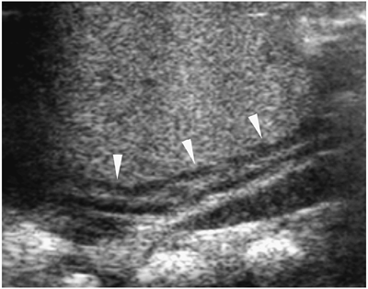
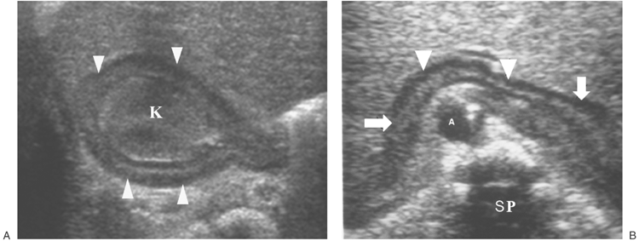
Congenital anomalies
Agenesis/ hypoplasia
Adrenal hypertrophy with renal agenesis
Fusion anomalies
Circumrenal adrenal gland
Horseshoe adrenal gland
Accessory glands aka adrenal rests

Slide 6
physiology
Cortex
3 specialized zones
Zona glomerulosa produces aldosterone (a mineralocorticoid)
Zona fasciculata produces cortisol (a glucocortisoid)
Zona reticularis produces estrogens and androgens (gonadocorticoids)
Hormone secretion controlled by a negative feedback mechanism
Hypothalamus secretes CRH in response to low blood concentrations of adrenal hormones, which triggers the pituitary to release ACTH to stimulate adrenal hormone activity
Referred to as the HPA axis (hypothalamic-pituitary-adrenal)
Increased concentration of adrenal hormones inhibits CRH and ACTH secretion
Medulla
Secretes epinephrine and norepinephrine (catecholamines)
Release of hormones stimulated through the sympathetic nervous system
Fight-or-flight response
Anticipation of stress or pain leads to an increased output of epinephrine and norepinephrine to help the body react to the stimulus

Slide 7
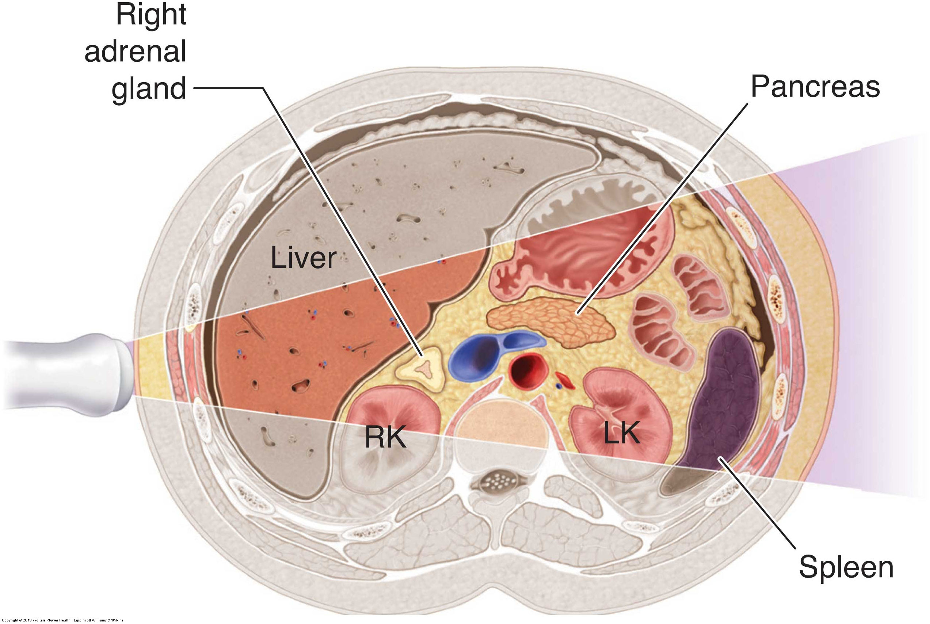
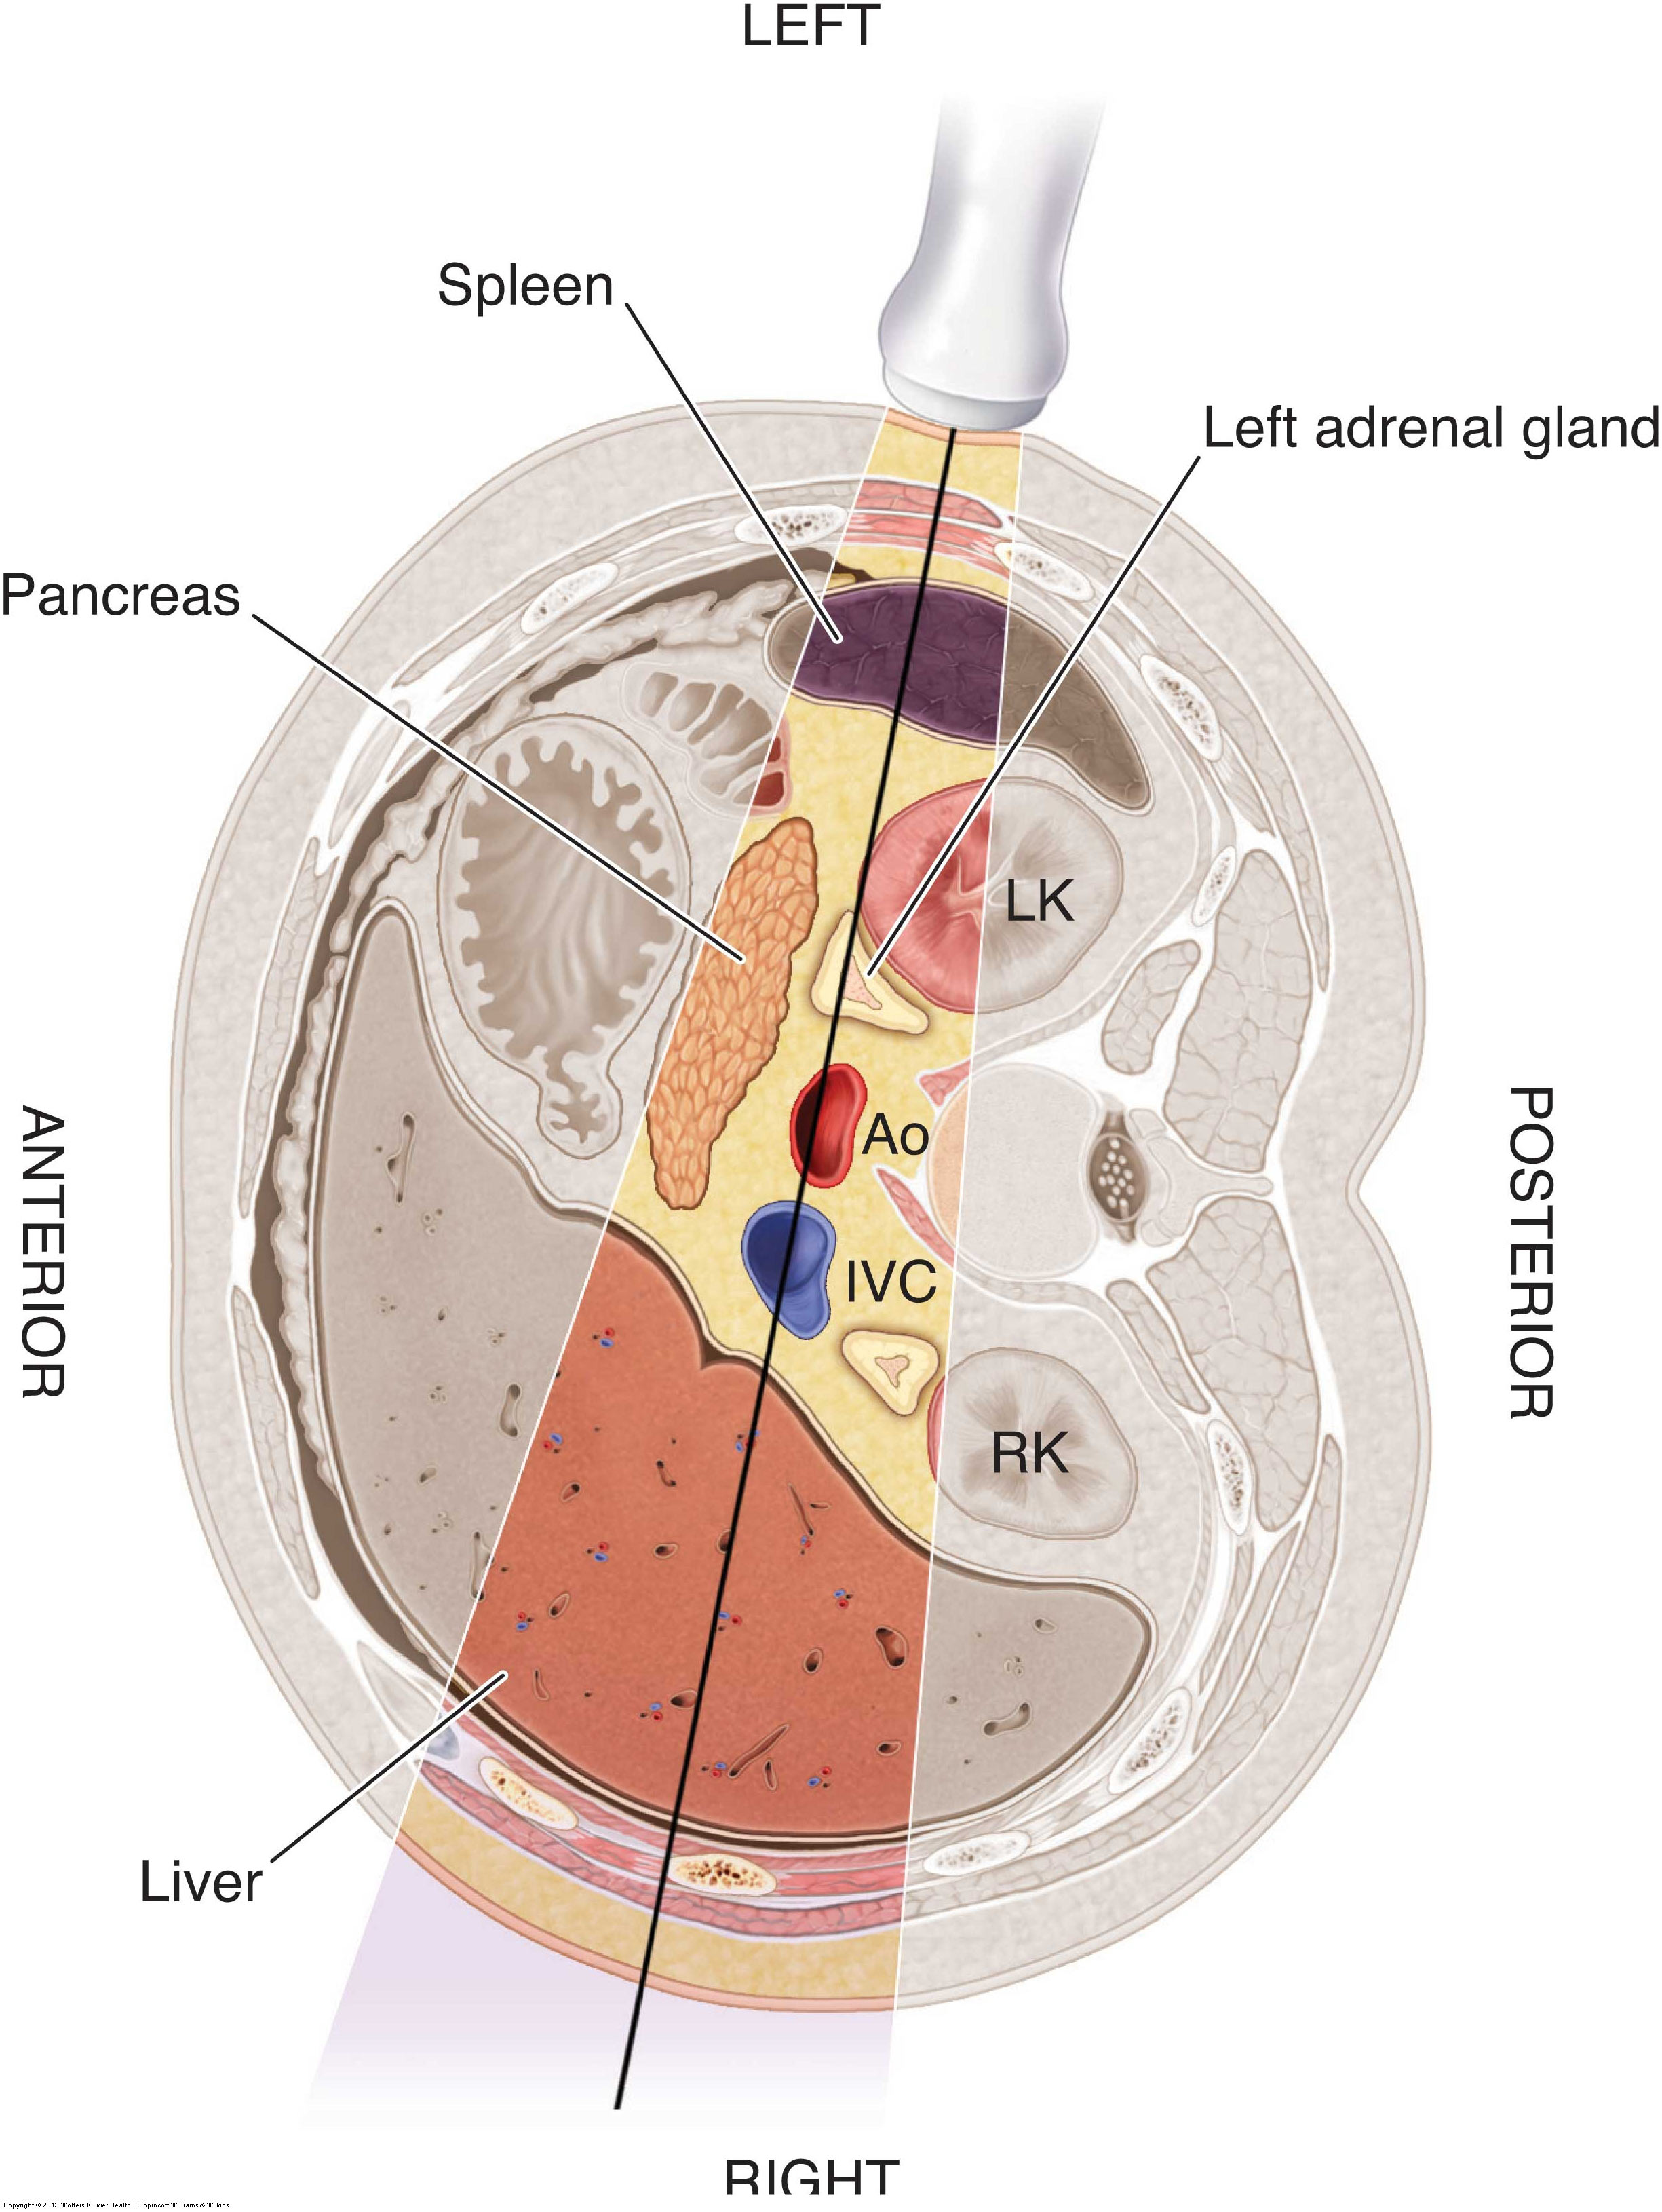
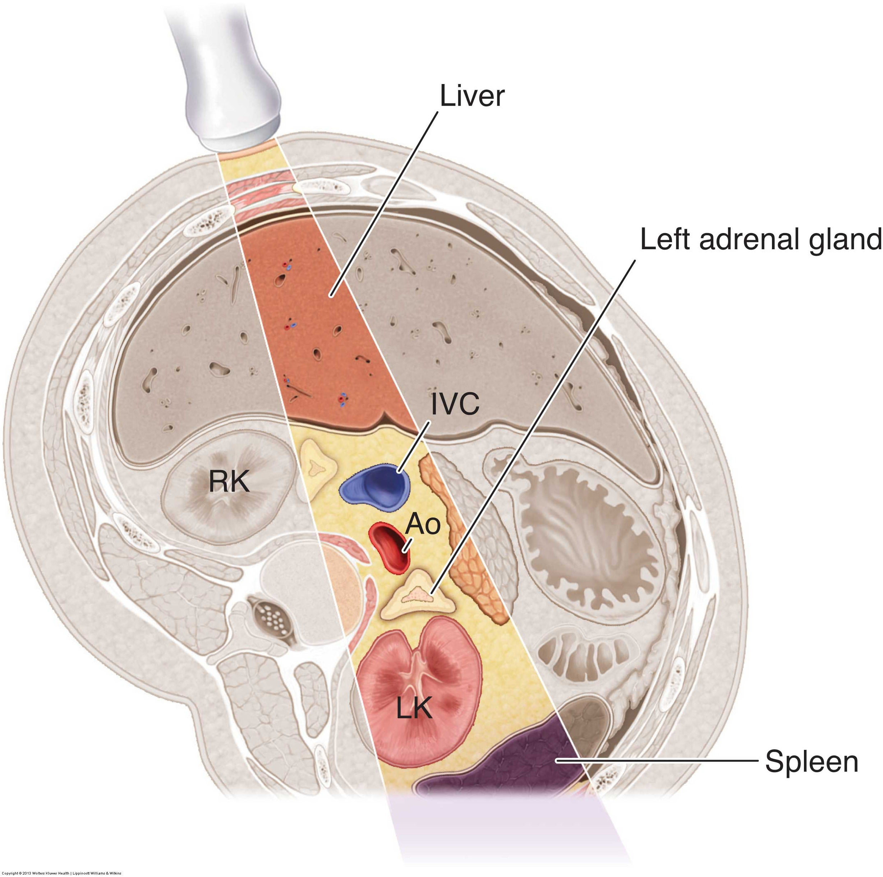
Sonographic evaluation
Much easier to see in neonates than older children and adults
Proportionally larger than adult adrenal glands
Sparsity of perirenal fat
Closer to the skin surface
Right adrenal
Use the liver and possibly right kidney as acoustic windows, scanning intercostally (supine or LLD)
Left adrenal
Use the spleen or left kidney as acoustic windows, scanning intercostally (RLD or right anterior oblique)
OR, use the liver, IVC, and aorta as acoustic windows, scanning intercostally from the right side with the patient left posterior oblique (the cava-suprarenal line position) – this has a higher success rate than the conventional approach

Slide 8
Normal sonographic appearance
In adults and older children, the cortex and medulla are sonographically indistinguishable with the gland appearing homogeneous and hypoechoic surrounded by echogenic fat
In newborns, the cortex is relatively thick, and the hypoechoic cortex can be seen surrounding the central echogenic medulla
After birth, the fetal zone of the cortex undergoes involution, gradually shrinking, and taking on a more typical adult appearance by 1 year of age

Slide 9
cysts
Relatively infrequent and usually asymptomatic
May be secondary to hemorrhage or degeneration of adenomas
Sonographically, a rounded, fluid-filled mass with thin, smooth walls
May be unilocular or multilocular, small or large
May have calcified wall (eggshell calcification) – these are associated with malignancy
Must be distinguished from renal cysts, hepatic or splenic cysts, or pancreatic pseudocysts
FNA can confirm diagnosis

Slide 10
hemorrhage
Occurs primarily in term neonates secondary to birth trauma or perinatal anoxia
Most frequently identified between the 2nd and 7th days of life
Occurs more frequently on the right side
Clinical findings include a palpable mass, anemia, and jaundice
Sonographic appearance varies depending on the age of the hemorrhage
Must be distinguished from neuroblastoma
Can occur in older children or adults due to trauma, anticoagulant therapy, septicemia, or adrenal vein thrombosis

Slide 11
Hypoadrenalism
Chronic primary aka Addison disease
The most common form of hypoadrenalism
Atrophy of the glands leads to insufficient secretion of adrenocortical hormones
Underproduction of adrenal hormones leads to an increase in ACTH production
Chronic secondary
A problem with the hypothalamus or pituitary reduces output of ACTH, which leads to insufficient secretion of adrenocortical hormones
Acute aka Waterhouse-Friderichsen Syndrome
Widespread septicemia leads to hemorrhagic destruction of the adrenal glands

Slide 12
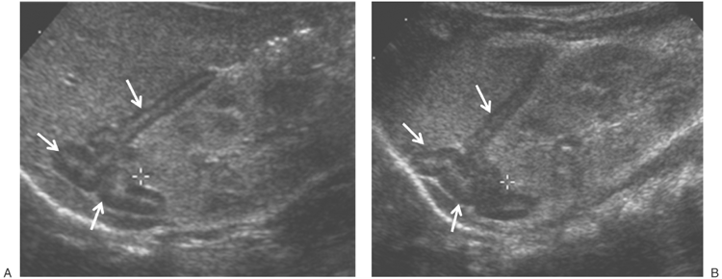
hyperadrenalism
Hypercortisolism aka Cushing syndrome
Hypersecretion of cortisol from the adrenal cortex
Can be ACTH dependent (i.e., problem with pituitary or other non-adrenal organ) or ACTH independent (caused by an adrenocortical neoplasm)
Hyperaldosteronism aka Conn syndrome
Hypersecretion of aldosterone from the adrenal cortex
Rare, but usually the result of a benign aldosterone-producing adrenal adenoma
Congenital adrenal hyperplasia aka adrenogenital syndrome
A congenital deficiency of enzymes involved in steroidogenesis, leading to increased levels of ACTH, adrenal hyperplasia, and excessive production of androgens
Causes virilization

Slide 13
Adrenal tumors
cortical
medullary
Adenoma
Myelolipoma
Adenocarcinoma
Neuroblastoma
Pheochromocytoma
Metastatic disease

Slide 14
adenoma
The most common benign adrenal tumor
Can be functioning or non-functioning
Increase in size with ACTH administration
Sonographically, a homogeneous, hypoechoic mass

Slide 15
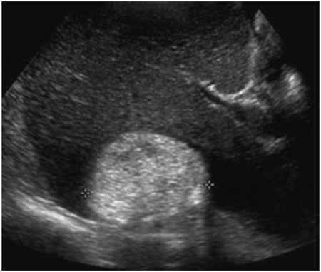
myelolipoma
Rare, benign tumor
Usually hormonally inactive and therefore asymptomatic
Sonographically, a well-defined, markedly hyperechoic mass

Slide 16
adenocarcinoma
Rare malignant tumor, accounting for only 2% of cancers in the world
Can be functioning or non-functioning
Are usually functioning – those that are non-functioning are highly malignant
Sonographically, may be hypoechoic or heterogeneous, and invasion to surrounding vessels and nodes may be seen

Slide 17
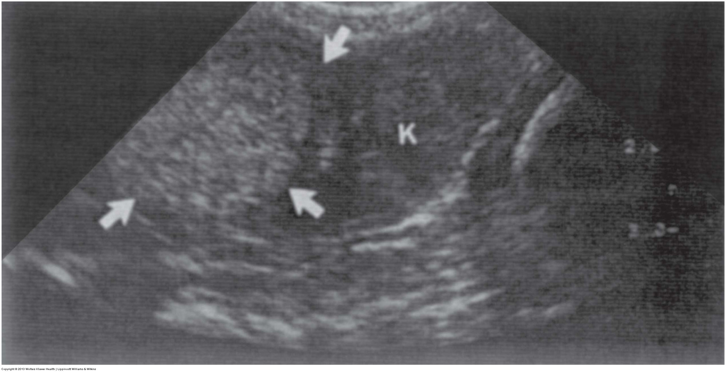
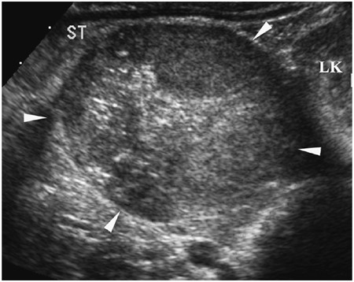
neuroblastoma
The most common solid, extracranial malignant tumor in children, accounting for 8-10% of all childhood cancers
Highly malignant
Median age of diagnosis is 22 months
Patients present with a palpable mass, and many have advanced disease by the time of diagnosis
Prognosis depends on patient age and extent of disease at time of diagnosis
Better in neonates and young infants than in older infants or children
Early tumor detection is crucial to improve outcome
Sonographic appearance
Echogenic, hyperechoic to surrounding tissue
Can be homogeneous or heterogeneous, containing calcifications or hypoechoic areas secondary to hemorrhage or necrosis

Slide 18
Pheochromocytoma
A catecholamine-secreting tumor
Can be benign or malignant
Rare, but occur at a higher frequency in patients with HTN, MEN syndromes, and other hereditary syndromes
Clinical symptoms include HTN, headaches, sweating, and tachycardia
Sonographic appearance
Highly variable echogenicity and echotexture
Usually large, averaging 5-6 cm in size
Highly vascular

Slide 19
Metastatic disease
Adrenals are the 4th most common site of mets after lungs, liver, and bones
Primaries include lung, breast, lymphoma, GI tract, thyroid, pancreas, and kidney
Metastatic involvement tends to be bilateral
Usually hypoechoic, but can be heterogeneous due to hemorrhage or necrosis

