Slide 1
Abdominal Wall, Diaphragm, and Non-Cardiac Chest
Chapter 2
Chapter 25 pages 763-765

Slide 2
Anterolateral Abdominal Wall Layers
Skin
Superficial fascia/ subcutaneous tissue
Muscles and their aponeuroses
Deep fascia
Extraperitoneal fat
Parietal peritoneum

Slide 3
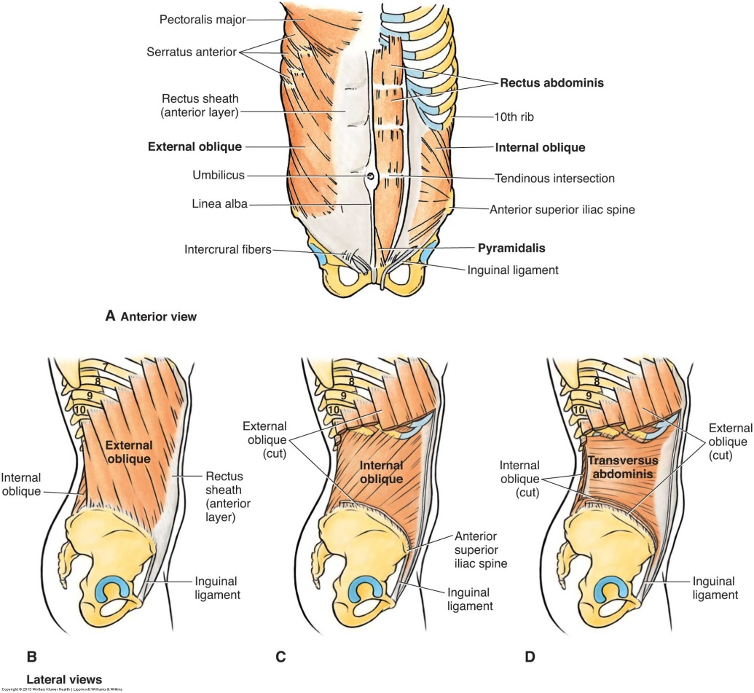
Anterolateral Abdominal Wall Muscles
Rectus abdominus
Pyramidalis
External obliques
Internal obliques
Transversus abdominus

Slide 4
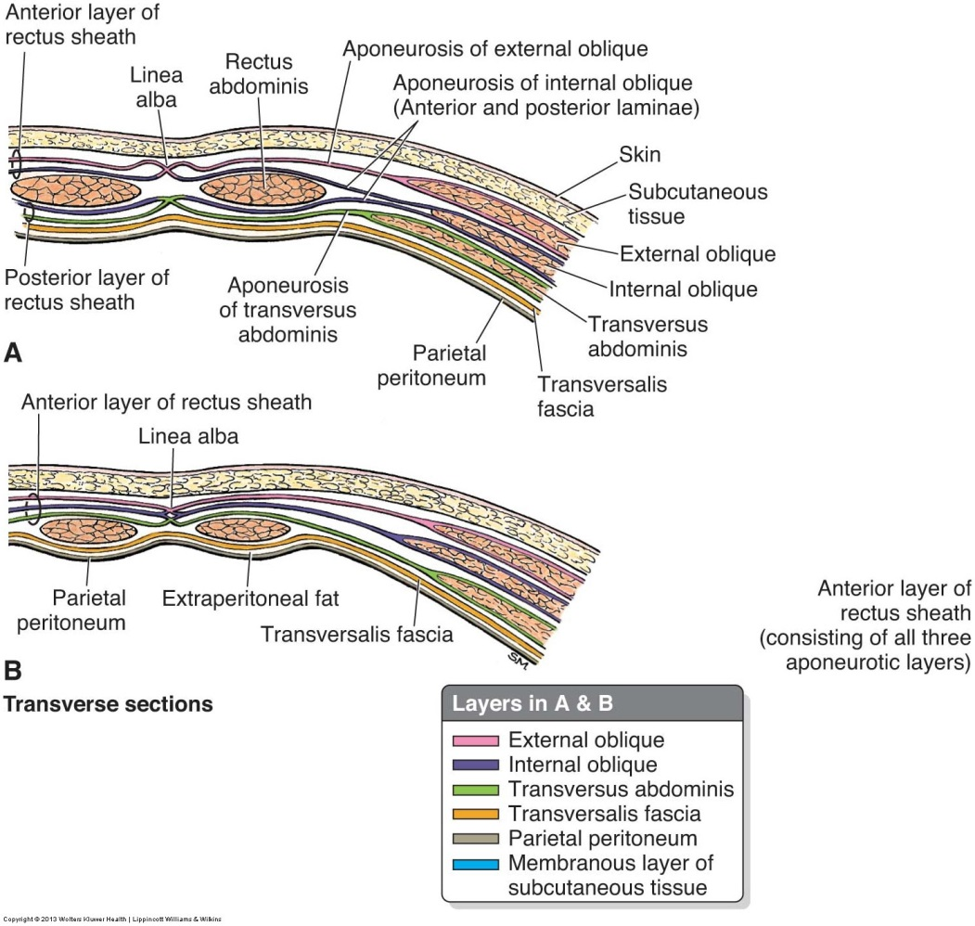
Other Anterolateral Abdominal Wall Structures
Rectus sheath – strong fibrous compartment for the rectus abdominis and pyramidalis muscles
Linea alba – courses the length of the abdominal wall, separating the bilateral rectus sheaths
Umbilicus – area where all layers of the anterolateral abdominal wall fuse
Umbilical ring – defect in the linea alba located deep to the umbilicus
Inguinal canal – oblique passage formed during fetal development where structures exit and enter the abdominal cavity

Slide 5
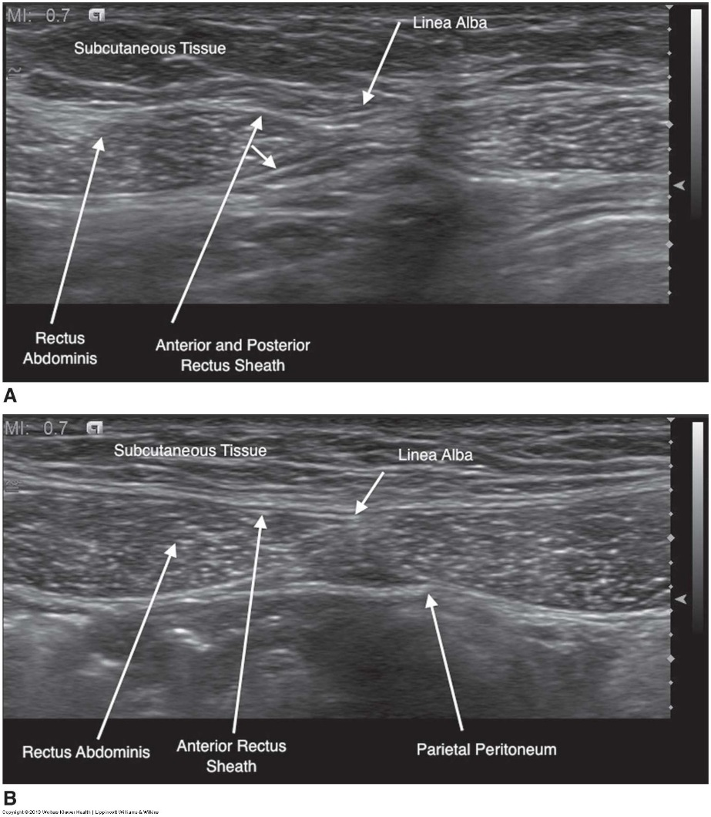
Abdominal Wall Structures

Slide 6
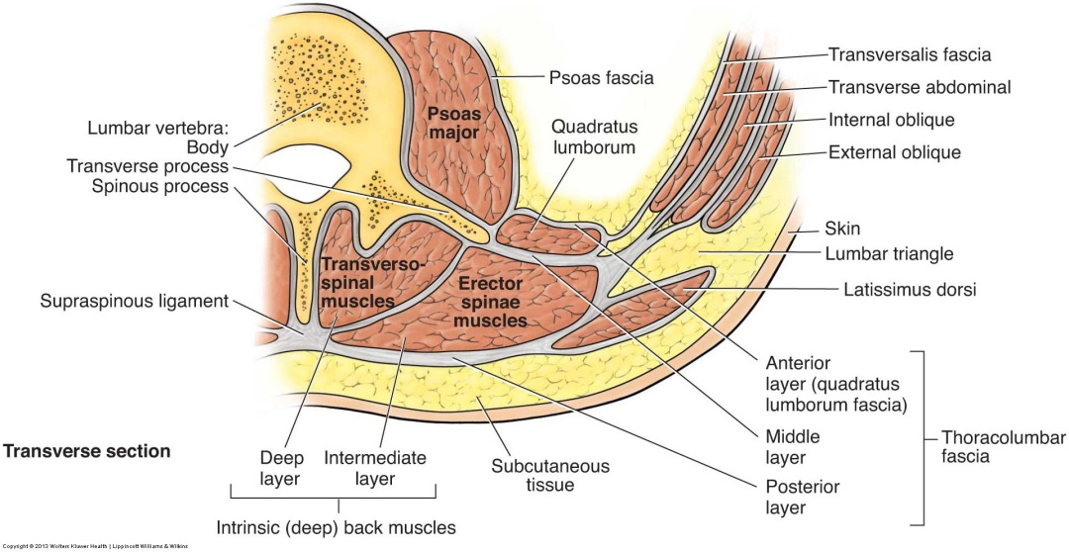
Posterior Abdominal Wall
Lumbar vertebra
Posterior abdominal wall muscles
Diaphragm
Fascia
Lumbar plexus
Fat, nerves, blood vessels, and lymphatic channels

Slide 7
Abdominal Wall Abscess
A collection of dead tissue and pus that forms in response to inflammation
Fluid content allows them to assume varied shapes
Frequently occur as a result of postsurgical incisional infections or as extensions of a superficial intraperitoneal abscess
Clinically, heat, redness, pain, swelling, and ↑ WBC
Treated with antibiotics and possible aspiration

Slide 8
Abdominal Wall Hematoma
Generally associated with muscular trauma that results in hemorrhage
Most common location is within the rectus sheath
Clinically, pain, redness, a palpable mass present in both sitting and supine positions, and ↓ Hct
US used to monitor size and resolution

Slide 9
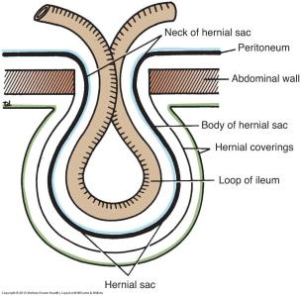
Abdominal Wall Hernias
2 main categories – ventral and groin
Risk factors – abdominal wall defect, naturally weak areas, and any condition that increases intraabdominal pressure
Consist of 3 parts – the sac, the contents of the sac, and the covering of the sac
Contents vary – may contain only fat or fat and bowel
Those containing bowel are at risk for more serious complications
Hernia complications
Incarceration
Obstruction
Strangulation

Slide 10
Ventral Hernias
Hernias occurring in the anterior or lateral abdominal wall
Types include umbilical, paraumbilical, epigastric, hypogastric, Spigelian, and incisional
Umbilical hernia – the most common type of ventral hernia
Can be congenital or acquired
Common in women, infants, and small children

Slide 11
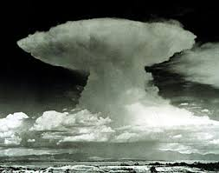
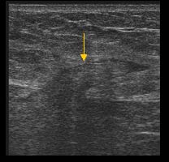
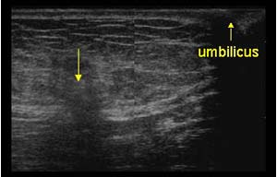
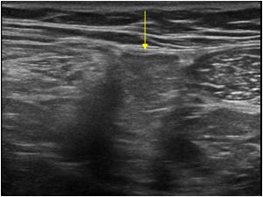
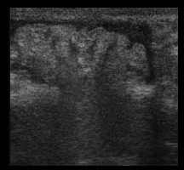
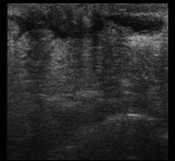
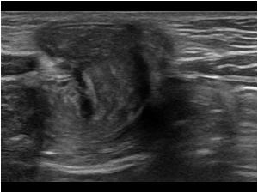
Ventral Hernias

Slide 12
Groin Hernias
Hernias occurring in the ilioinguinal crease at the junction of the abdomen and thigh and the adjacent areas immediately above and below
Types include inguinal and femoral
Inguinal hernias – the most common type of abdominal wall hernia
Can be direct or indirect
Indirect are more common and most commonly occur in boys and young men
Indirect hernias arise from the deep inguinal ring and extend superficially and interomedially down the inguinal canal – they can extend down into the scrotum in males and the labium majorum in females
Direct are usually found in elderly men with weak abdominal muscles - a direct inguinal hernia presents as a generalized bulge

Slide 13
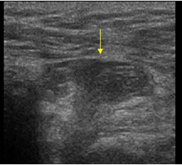
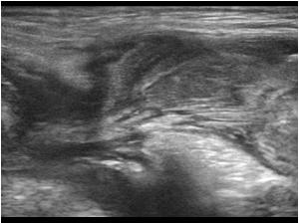
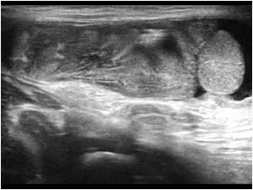
Groin Hernias

Slide 14
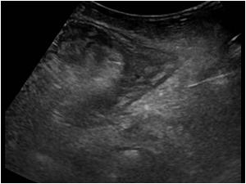
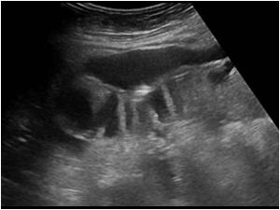
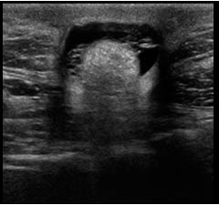
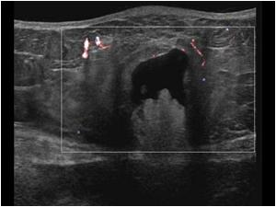
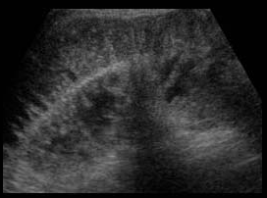
Complicated Hernias

Slide 15
Abdominal Wall Neoplasms
Lipoma – benign fatty tumor found anywhere fat is present
Desmoid tumor – benign fibrous tumor associated with pregnancy
Neuroma – swollen nerve tissue caused by damage to a nerve during surgery
Endometrioma – endometrial tissue located outside of the uterus
Sarcoma – malignant tumor that can grow quite large before causing clinical symptoms
Metastasis – frequently an extension from a nearby primary such as ovary

Slide 16
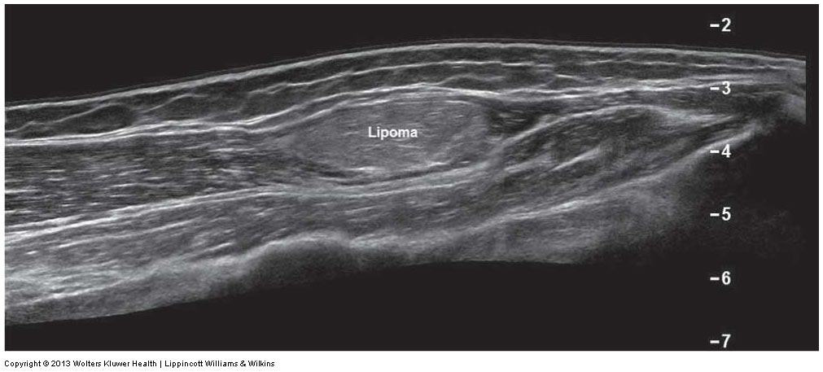
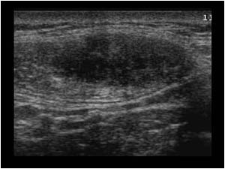
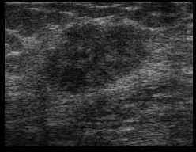
Neoplasms

Slide 17
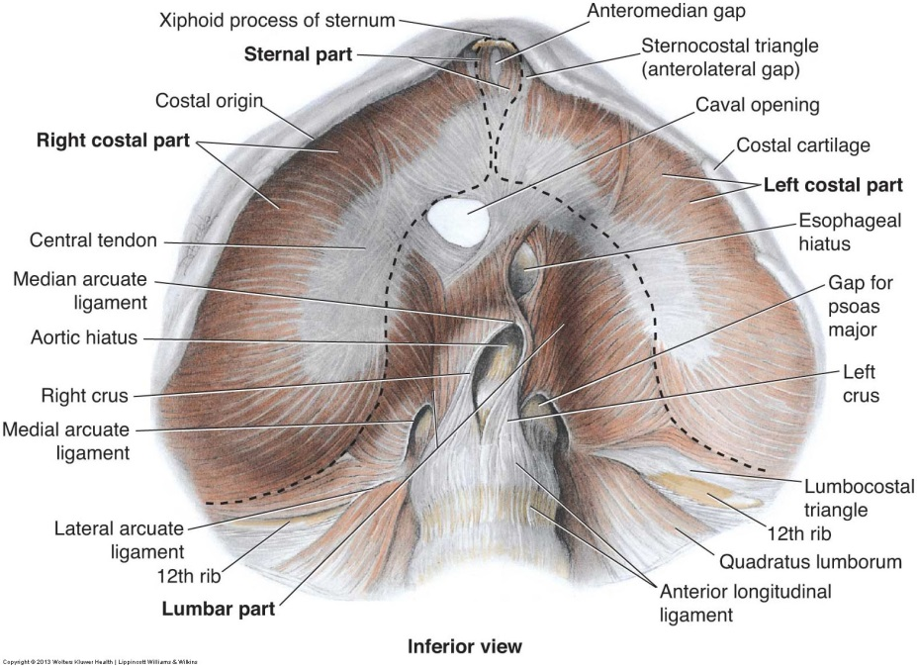
Diaphragm
Musculotendinous partition separating the thoracic and abdominal cavities
Major muscle of inspiration
Diaphragmatic crura – attached to lumbar vertebrae and form a tether for muscular contraction
Diaphragmatic apertures – openings for structures to pass between the thorax and abdomen

Slide 18
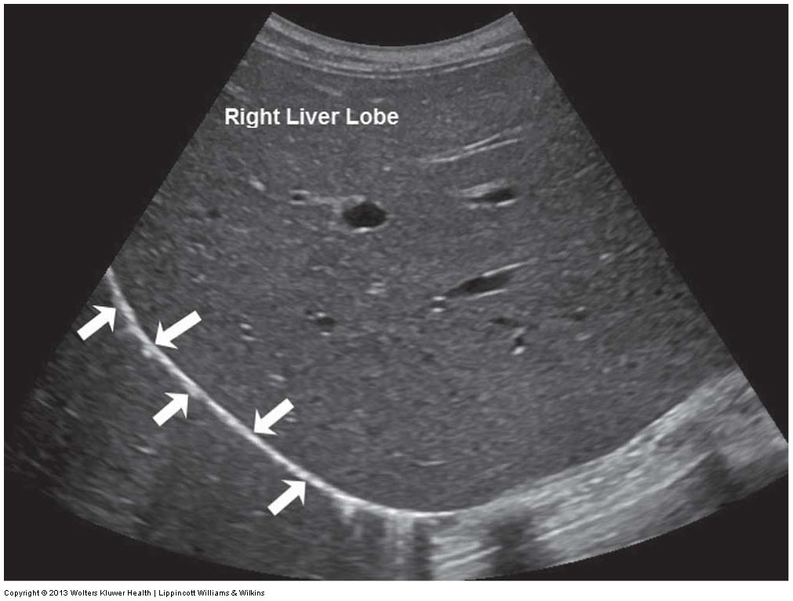
Diaphragm and Diaphragmatic Crus

Slide 19
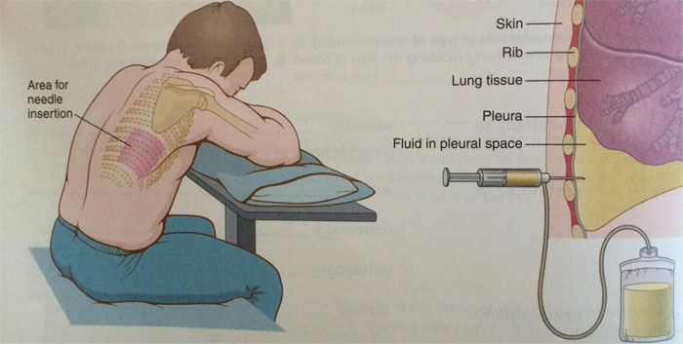
Pleural Effusion
Excessive fluid accumulation in the pleural space around the lung
Fluid can be simple or complex
Variety of causes including CHF, cancer, pneumonia, cirrhosis, and end-stage renal disease
Patients present with SOB and pleuritic chest pain
US used to evaluate presence/ size of effusion, fluid characteristics, and to mark/ guide for thoracentesis

Slide 20
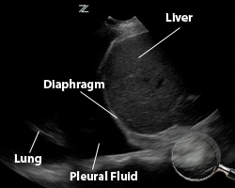
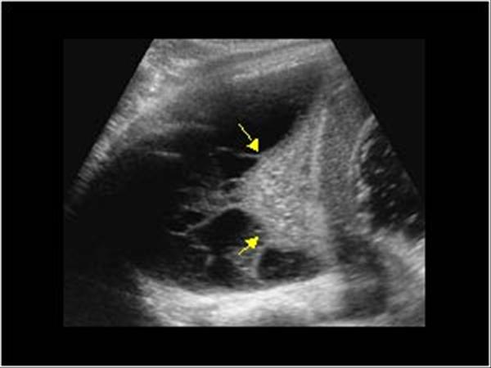
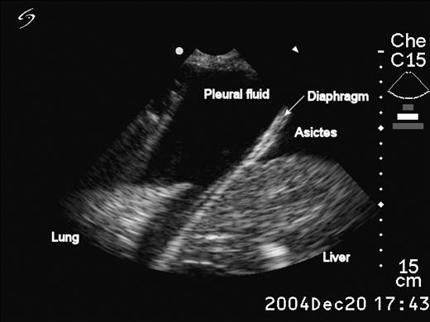
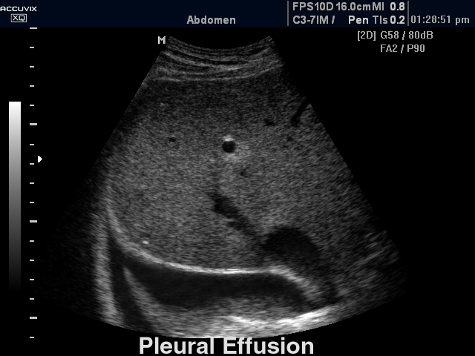
Pleural Effusion

Slide 21
Diaphragmatic Hernia
Defect or whole in the diaphragm that allows abdominal contents to move into the thoracic cavity
Can be congenital or acquired
Congenital hernias result from diaphragmatic fusion failure, maldevelopment, or localized weakness
2 types – Bochdalek and Morgagni
Often diagnosed prenatally
Acquired hernias result from penetrating or blunt trauma

Slide 22
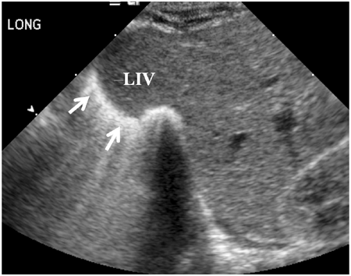
Eventration
Abnormal elevation of the diaphragm
Often due to a congenital weakness, allowing the spleen or liver to protrude upward

Slide 23
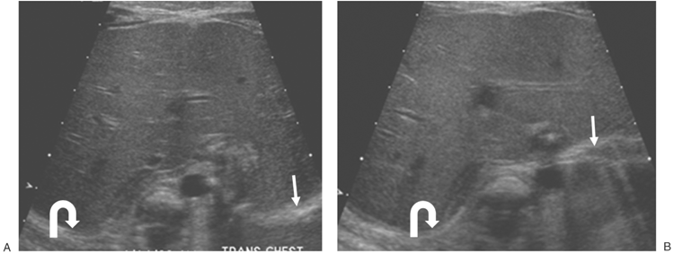
Paralysis
Absent or paradoxical motion of a hemidiaphragm caused by phrenic nerve damage
Lack of diaphragmatic movement inhibits breathing and ventilation

Slide 24
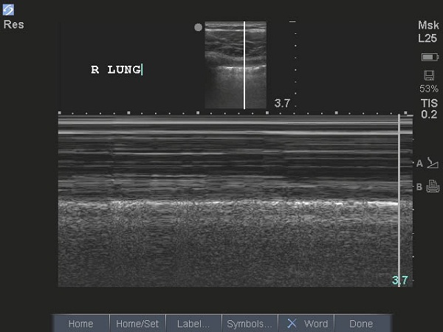
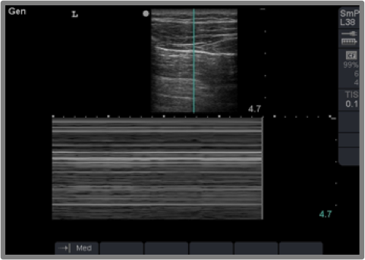
Pneumothorax
Abnormal collection of air in the pleural space between the lung and chest wall
Normal lung sliding is not present with a pneumothorax
Normal – Seashore Sign
Abnormal – Barcode or Stratosphere Sign

Slide 25
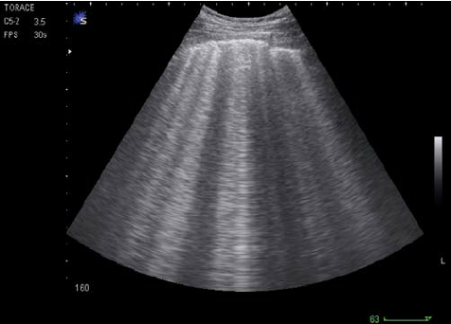
Pulmonary Edema
Excessive fluid accumulation in the alveoli of the lungs
Causes ring down artifacts known as B lines
Normal – A Lines
Abnormal – B Lines

Slide 26
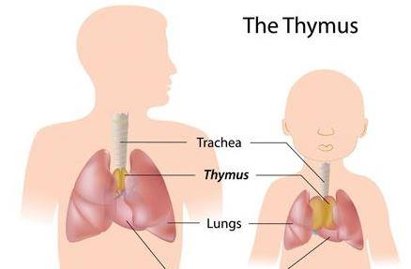
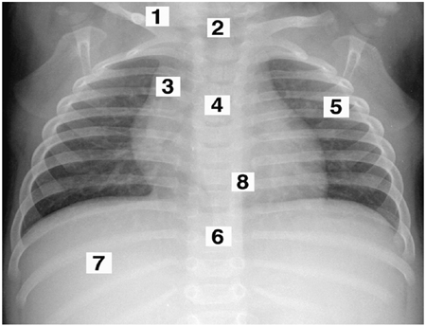
Thymus Gland
Bilobed gland located within the mediastinum
Proportionally larger in neonates and young infants
Increases in size in childhood to reach a maximum weight at puberty
Plays important role in maintaining immune competency
Lies anterior to the great vessels and posterior to the sternum
Best demonstrated using suprasternal, transsternal, or parasternal approaches

Slide 27
Thymus Sonographic Appearance
Quadrilateral shape in infants and more triangular shape in older children
Echogenicity - hypoechoic to subcutaneous tissue and nearly isoechoic to liver
Echotexture – linear and punctate echodensities throughout the gland
Multiple small vessels throughout
Left lobe usually larger than the right

