Slide 1
Vascular structures
Chapter 4
Chapter 19 pages 635-638

Slide 2
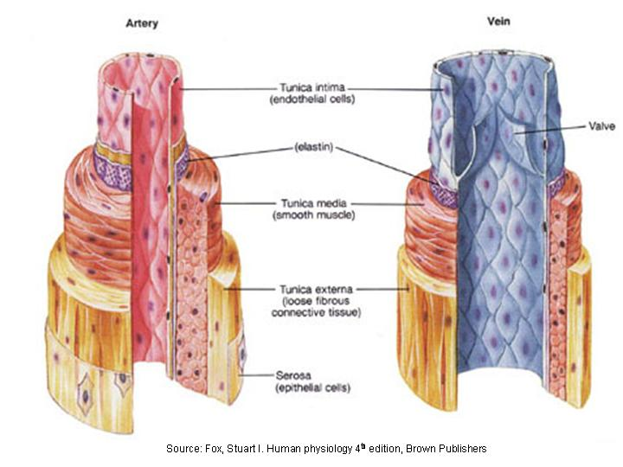
Vessel Wall Anatomy
Tunica intima – inner layer
Tunica media – middle layer
Tunica adventitia – outer layer
Tunica media thinner in veins
Venous valves are continuous with tunica media

Slide 3
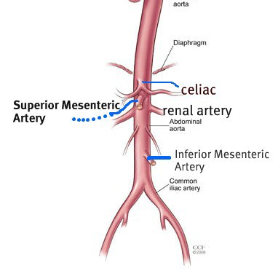
Abdominal Aorta
From aortic hiatus of diaphragm to bifurcation at umbilicus level
Left of midline adjacent to IVC and anterior to the spine
Should taper as it courses inferiorly
Anterior and lateral branches

Slide 4
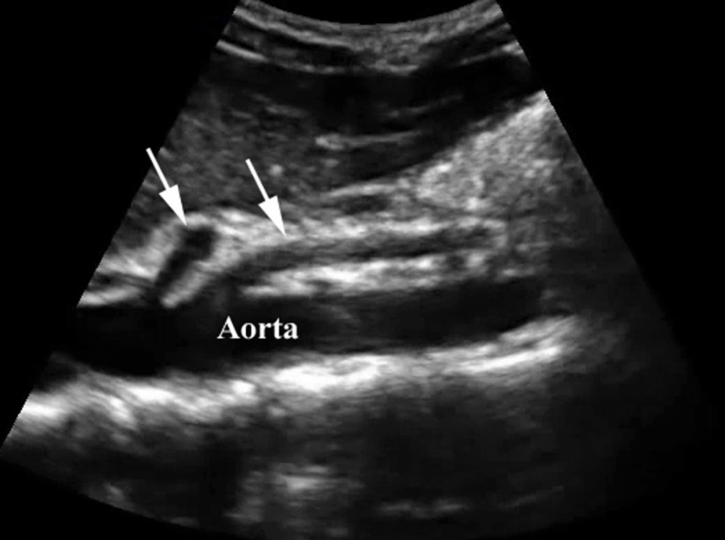
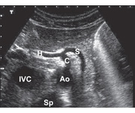
Celiac Artery
1st branch of abdominal aorta
Supplies blood to spleen, pancreas, liver, stomach, proximal duodenum
Branches into common hepatic, splenic, and left gastric arteries
Common hepatic artery courses horizontally and rightward toward porta hepatis
Common hepatic artery branches into proper hepatic artery and GDA
Splenic artery courses horizontally and leftward toward splenic hilum

Slide 5
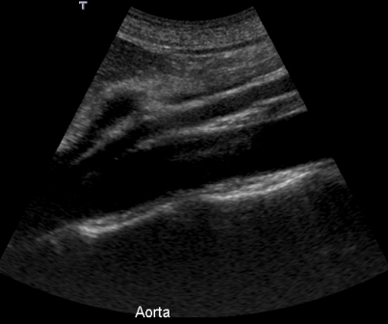
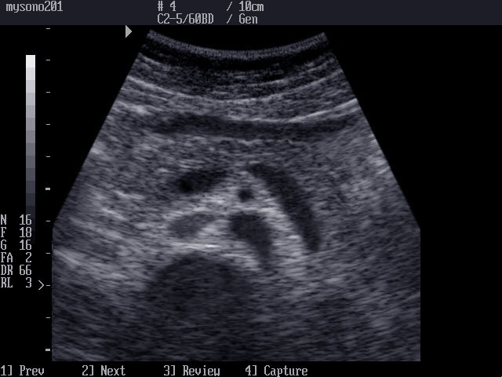
Superior Mesenteric Artery
2nd branch of abdominal aorta
Approx 1 cm below CA origin
Courses parallel to aorta anteriorly
Supplies blood to pancreas, distal duodenum, jejunum, ileum, and proximal colon
Branches into inferior pancreaticoduodenal artery (IPDA) and middle colic artery

Slide 6
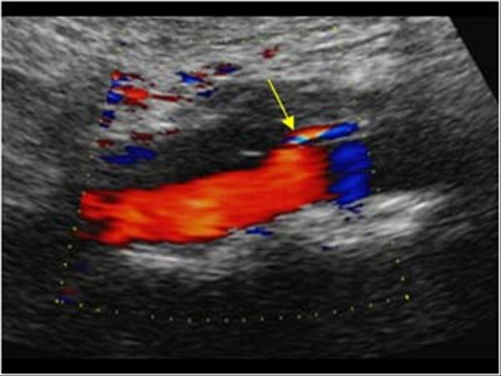
Inferior Mesenteric Artery
Last branch of abdominal aorta
Arises anteriorly, slightly to the left of midline
Originates near aortic bifurcation, approx 2/3 distance between renal arteries and bifurcation
Supplies blood to descending colon, sigmoid colon, and superior rectum

Slide 7
Mesenteric Ischemia
Decrease in arterial supply to the intestinal system
Can be caused by embolus, thrombus, atherosclerosis, aortic dissection, decreased cardiac output, or prolonged vessel constriction
Can be acute or chronic
Present clinically with acute abdominal pain, N/V/D, postprandial pain, and weight loss
Acute mesenteric ischemia is a medical emergency
Chronic mesenteric ischemia is relatively common in the elderly

Slide 8
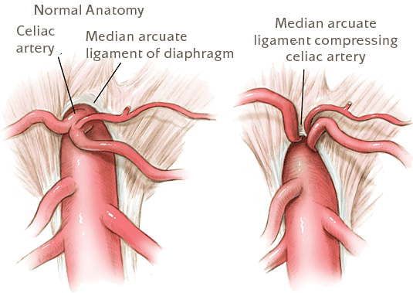
Median Arcuate Ligament Syndrome
Band of fibrous tissue crossing aorta, usually above the origin of CA
Can cause deformity and narrowing of CA
Patients present with symptoms of mesenteric ischemia

Slide 9
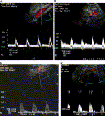
Mesenteric Artery Doppler
Patients should be fasting for 6-8 hours
Blood flow to intestines is relatively low in fasting state
Liver and spleen need more blood than intestines in fasting state
Normal SMA and IMA waveforms are high resistive
Normal CA waveform is lower resistive

Slide 10
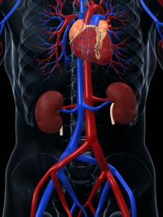
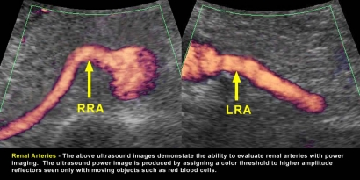
Renal Arteries
Branch from aorta just inferior to origin of SMA
The only large lateral branches of aorta
Right arises anterolaterally and courses posterior to the IVC to the right renal hilum
Left arises posterolaterally and courses directly to the left renal hilum

Slide 11
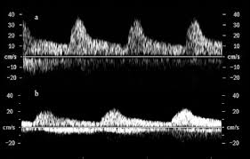
Renovascular Hypertension
1%-5% of HTN attributed to renal artery stenosis
Doppler US is a low cost, noninvasive way to evaluate renal arteries and is not dependent on renal function
Atherosclerotic plaque causing stenosis generally located within 2cm of origin
Normal renal artery waveform is low resistive
Tardus-parvus intrarenal waveform indicates a more proximal renal artery stenosis

Slide 12
Hepatic vasculature
Portal Venous System
MPV begins at junction of SV and SMV
MPV lies anterior to IVC and enters liver at porta hepatis
MPV branches into RPV and LPV after entering liver (intrasegmental)
Hepatic Artery (proper)
Proper hepatic artery begins where common hepatic artery gives rise to GDA
Divides into right and left branches after entering the liver at porta hepatis
Lies anteromedial to MPV
Branches accompany portal vein branches
Hepatic Veins (Right, Middle, and Left)
Thin-walled and intersegmental
RHV typically the largest
MHV and LHV often join just before entering IVC

Slide 13
Portal venous abnormalities
Portal HTN – increased pressure in portal system
Increase in PV diameter
Splenomegaly
Varices
Eventual hepatofugal flow
Portal vein thrombosis – presence of thrombus in portal system
Intraluminal echogenic mass within PV
Collaterals and varices
Cavernous transformation of PV – chronic PV thrombosis and occlusion with collateral formation
Multiple tortuous collaterals at a distorted porta hepatis

Slide 14
Sonographic Examination
Patients should be fasting for 6-8 hours
Curvilinear, sector, or vector transducer
Typically 3MHz-5MHz
Supine position (decubitus if necessary)
Technical settings optimized to demonstrate anechoic lumen

Slide 15
Normal Sonographic Appearance of Aorta
Anechoic lumen
Smooth and parallel walls
Pulsatility seen in real time imaging
Distal tapering demonstrated in sagittal plane
Located slightly left of midline
Left of IVC and anterior to spine
Biphasic waveform suprarenal
Triphasic waveform infrarenal

Slide 16
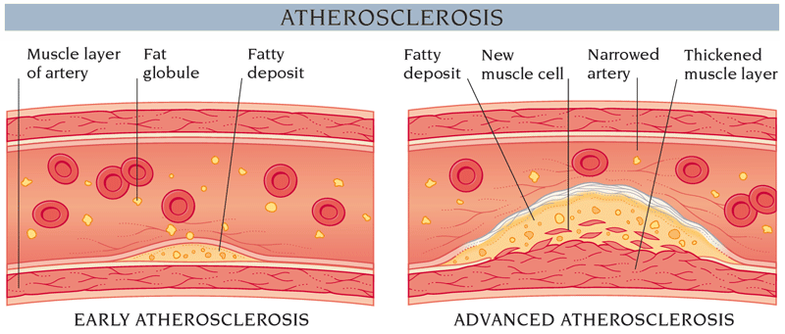
Atherosclerosis
Cholesterol-lipid-calcium deposits occur in the medial and intimal layers of the aorta
Linked to hyperlipidemia, HTN, cigarette smoking, and DM
Presents sonographically as luminal irregularities and vessel wall calcification
Complications include thrombus, embolus, stenosis, occlusion, aneurysm

Slide 17
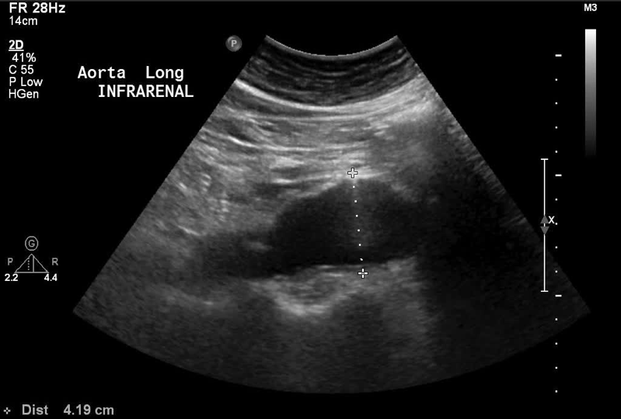
AAA
Atherosclerosis is most common cause
More common in males and Caucasians
Present clinically with pulsatile abdominal mass, vague lower back or abdominal pain, or are asymptomatic
Large aneurysms require surgery
Intermediate aneurysms are monitored

Slide 18
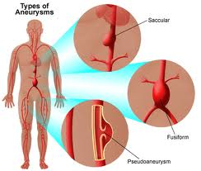
Types of Aneurysms
Fusiform - circumferential involvement
most common type
most are infrarenal
Saccular - localized outpouching, connected by a neck
usually larger than fusiform

Slide 19
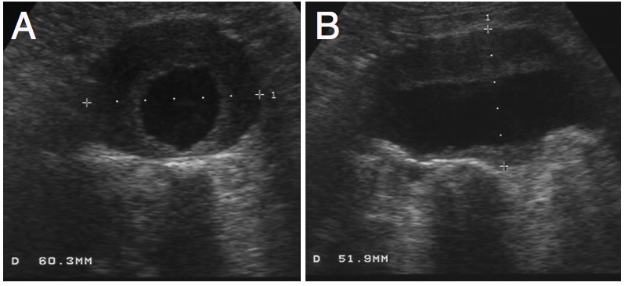
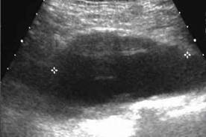
Sonographic Appearance of AAA
Width increased 1.5 times normal size or distal aorta measurement ≥3 cm
Thrombus along anterior and posterior walls is common
Measurements should include:
AP maximum diameter perpendicular to long axis of AAA
Transverse maximum diameter at 90° to AP measurement
Length of AAA in longest plane
Doppler used to show patency
Check for renal and iliac artery involvement

Slide 20
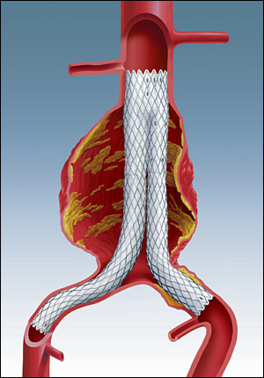
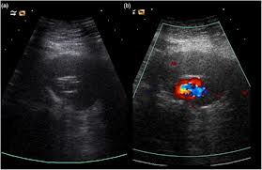
Aortic Grafts
Man-made structure used to repair a AAA
EVAR is the most common placement method
Highly echogenic on US

Slide 21
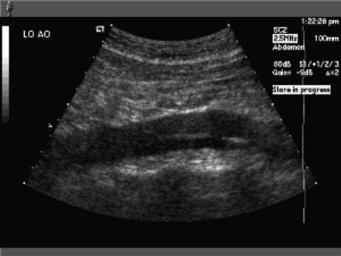
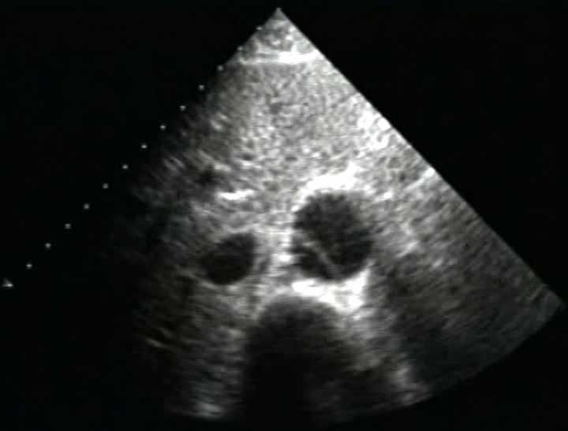
Aortic Dissection
Longitudinal separation of layers of the aortic wall, creating a false lumen between the intima and media layers
Associated with atherosclerosis/ HTN
Present clinically with intense chest pain; abdominal, lower back, or leg pain; shock; headache
Surgical intervention dependent on type, location, extent, acuteness, and patient stability
Many are followed and thrombose on their own

Slide 22
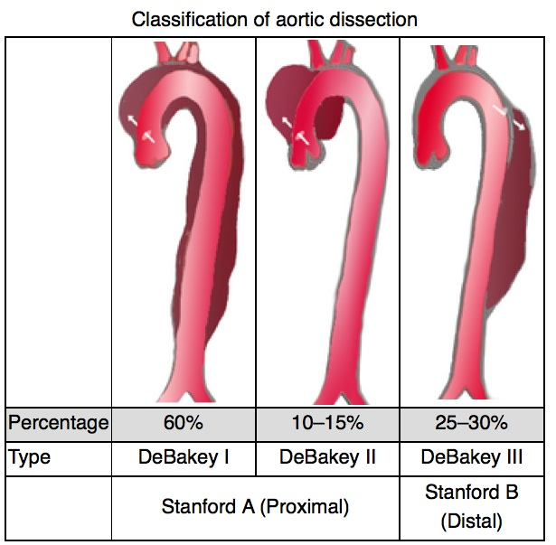
Types of Dissections
Classified according to location/ involvement with aortic arch

Slide 23
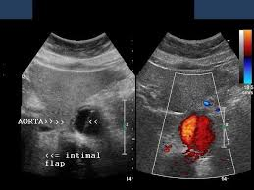
Sonographic Appearance of Aortic Dissections
Thin, echogenic linear flap within the arterial lumen
Motion of the flap seen in real-time imaging
Arterial flow seen on both sides of the flap (true and false lumen)
Important to demonstrate beginning and end of dissection, as well as any branch vessel involvement

Slide 24
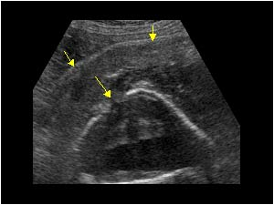
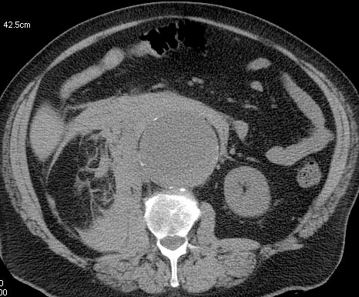
Aortic Rupture
Tear in all 3 layers of aortic wall
Aneurysms >7 cm are at greatest risk of rupture
Present clinically with acute central back pain, hypotension, loss of consciousness
Appears sonographically as a hematoma in abdomen associated with aneurysmal dilatation
Echogenicity depends on stage of hematoma
Surgical emergency - CT better suited to evaluate

Slide 25
Inflammatory Aneurysms
Extremely thickened aortic wall and surrounding fibrosis
Similar to retroperitoneal fibrosis, but aneurysm is present
Occur in younger patients than atherosclerotic aneurysms
Symptoms relating to inflammation and can be treated with anti-inflammatory drugs
Less prone to rupture
CT used to evaluate extent of inflammation to retroperitoneal structures

Slide 26
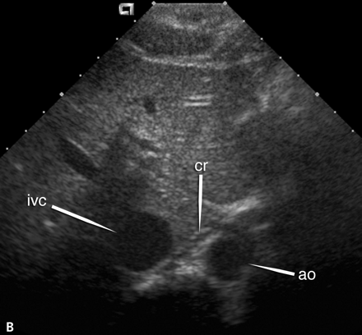
IVC
Carries blood from below the diaphragm into right atrium
Right of midline adjacent to aorta and anterior to the spine
Anechoic lumen with varying luminal size
Should demonstrate respiratory variation
Luminal diameter usually <2.5 cm (considered dilated when >3.7 cm)
Tributaries include common iliac veins, right gonadal, renal veins, and hepatic veins
Pulsatile Doppler waveform close to diaphragm, phasic more distal in abdomen

Slide 27
Anatomic Variants
Duplicated IVC – duplication of infrarenal portion
Transposed IVC – Lt sided infrarenal portion
Accessory right hepatic vein
Circumaortic or retroaortic left renal vein
Right gonadal vein joining right renal vein
IVC interruption with azygos or hemiazygos continuation – infrarenal portion of IVC flows superiorly into azygos or hemiazygos veins and does not course through liver; hepatic veins drain directly into RA

Slide 28
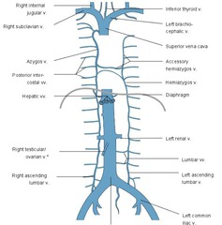
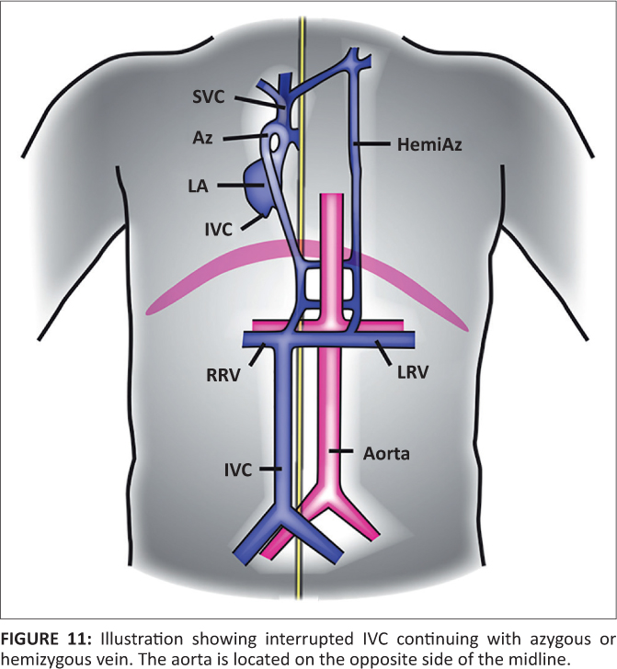
IVC Interruption
Normal
Abnormal

Slide 29
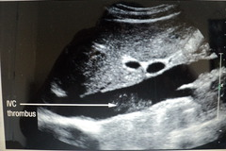
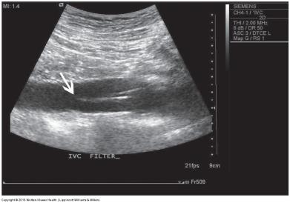
IVC Thrombosis
Usually an extension of thrombus from a tributary vein
May result in partial or complete occlusion of flow
Present clinically with lower extremity swelling, PE, or may be asymptomatic
Sonographically, intraluminal mass of varying echogenicity
Doppler shows loss of phasicity or complete obstruction
Treated with IVC filter, chemical thrombolysis, thrombectomy, antigoagulation therapy

Slide 30
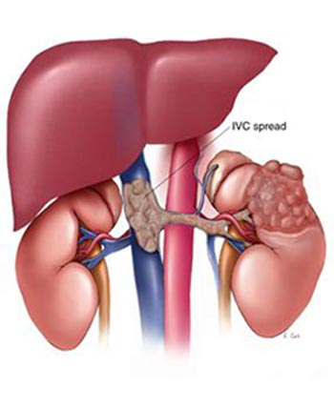
IVC Neoplasms
Primary IVC tumors are rare (leiomyosarcoma)
Most often extension from solid organ tumors through their venous drainage into IVC
Metastatic spread of RCC most common
Sonographically, intraluminal mass of varying echogenicity that appears to extend into vessel wall
Doppler signal within tumor

Slide 31
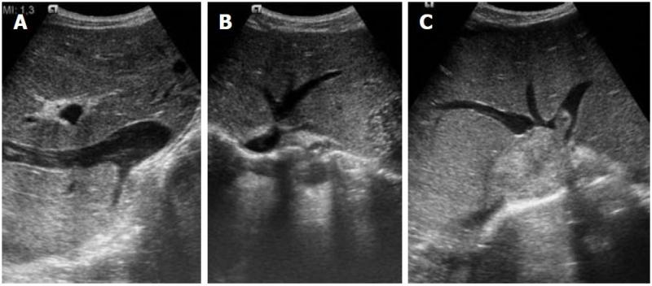
Budd-chiari syndrome
Occlusion of some or all of the hepatic veins and/or occlusion of IVC
Primary – congenital web or fibrous cord
Secondary – tumor or thrombus formation
Sonographic findings
Obstructing membrane in IVC just above hepatic veins (primary)
Narrowing of IVC
IVC thrombosis
Absent or sluggish flow in IVC
Absent or reversed flow in hepatic veins
Clinical findings
RUQ pain
Jaundice
Elevated LFTs
hematemesis

