Slide 1
The Liver
Chapter 5 pages 101-142
Chapter 4 pages 90-95

Slide 2
Embryology
early in 4th week | liver, GB, and bile ducts develop from endodermal outgrowth
week 5 | 2 endodermal cellular buds begin forming the Rt and Lt hepatic lobes
week 6 | Rt lobe becomes larger than Lt lobe; caudate and quadrate lobes develop from Rt lobe
week 6 | Yolk sac regresses, and hemopoiesis begins to take place in liver, ceasing at birth
week 10 | Lymphocyte formation begins to occur in liver, ceasing at birth
weeks 10-12 | Coagulation factors manufactured in liver
weeks 13-16 | Bile is produced in liver

Slide 3
Location and Size
occupies the right hypochondrium, epigastric region, and a portion of the left hypochondrium
size increases with height and body surface area and decreases with age
Liver length routinely measured in sagittal plane in midhepatic line
Normal range for liver length 13-17 cm

Slide 4
Ligaments
coronary - connects the posterior liver surface
to the diaphragm
falciform - separates the Rt and Lt lobes at the diaphragmatic surface
round (aka ligamentum teres) - fibrous cord resulting from obliterated Lt umbilical vein
triangular (Rt and LT) - formed by the coronary ligament and extend from diaphragm to liver
hepatoduodenal - surrounds the portal triad
prior to entering porta hepatis

Slide 5
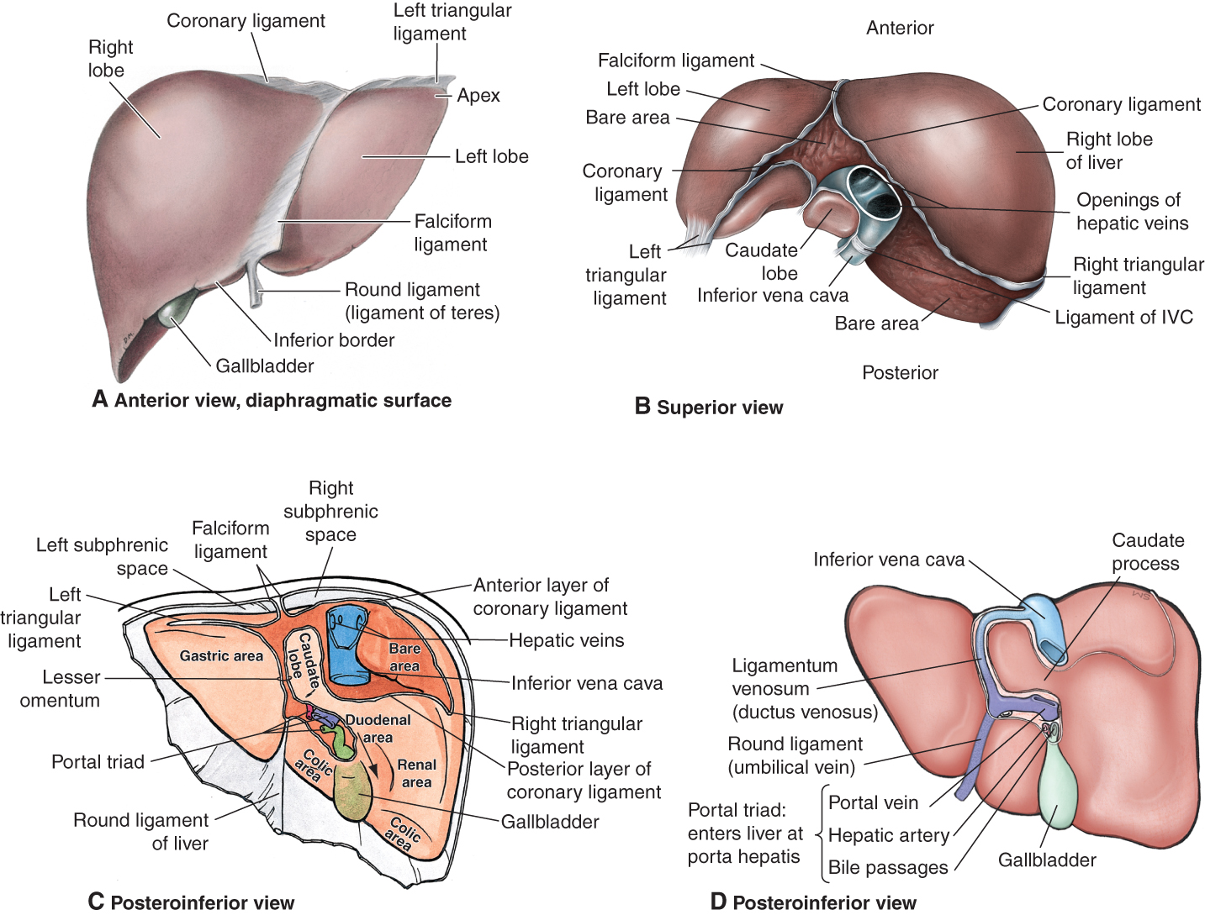
Ligaments

Slide 6
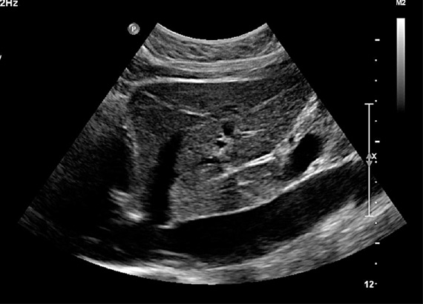
Fissures
main lobar - separates Rt and Lt lobes
Rt intersegmental - divides Rt lobe into anterior and posterior segments
Lt intersegmental - divides Lt lobe into medial and lateral segments
Ligamentum venosum - separates Lt lobe from caudate lobe

Slide 7
Lobes – Anatomic Division
right lobe
6 times larger than Lt
Occupies Rt hypochondrium
left lobe
Flatter and smaller than Rt but varies in size
Epigastric and Lt hypochondrium regions
caudate lobe
Anatomically distinct from Rt and Lt lobes
Caudate process courses between IVC and PV
quadrate lobe
Distinct anatomical lobe
Medial to Lt lobe

Slide 8
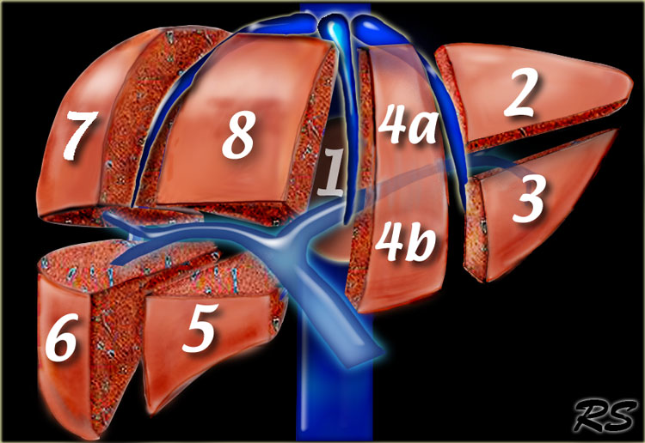
Lobes – Segmental Division
Rt anterior
Rt posterior
Lt medial
Lt lateral
Caudate

Slide 9
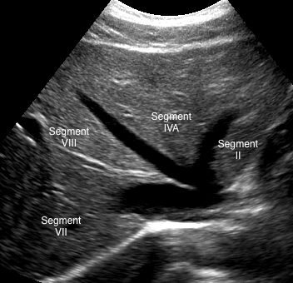
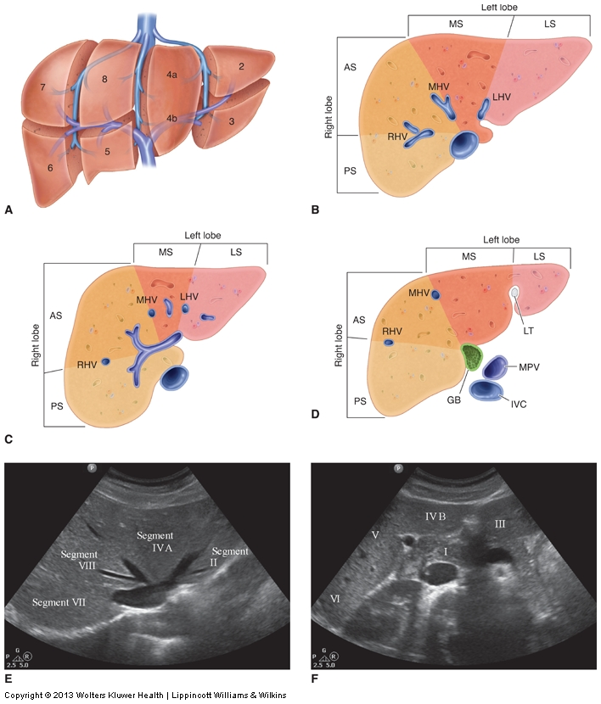
Couinaud’s Hepatic Segmental Classification
E
F
Notes:
Figure 5-8. Couinaud’s anatomy. A. An illustration of the eight segments identified in a clockwise fashion. The hepatic veins divide the liver vertically into four segments and the portal veins divide the liver horizontally creating eight segments. B. A cross-sectional illustration high in the liver at the level of the hepatic veins identifies the four superior segments in Couinaud’s anatomy (VII, VIII, IVa, and II). As the caudate lobe (I) is on the posterior aspect of the liver it is not seen in an anterior view. C. A cross-sectional illustration at a midlevel through the liver identifies the right and left portal vein branches that correspond with the horizontal boundary. D. A cross-sectional illustration low in the liver at the level of the gallbladder and ligamentum teres identifies the four inferior segments in Couinaud’s anatomy (VI, V, IVb, and III). E. A transverse scan at the level of the hepatic veins demonstrates the superior segments. F. A transverse scan through the gallbladder and ligamentum teres demonstrates the inferior segments.

Slide 10
Segmental Division

Slide 11
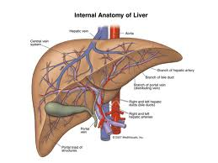
Hepatic Circulation
dual blood supply
hepatic artery
portal vein
Porta hepatis – PV and HA enter and CBD exits
Drainage by hepatic veins directly into IVC

Slide 12
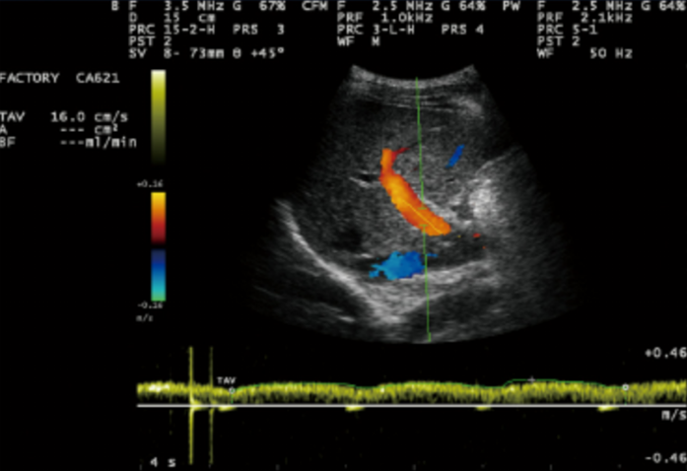
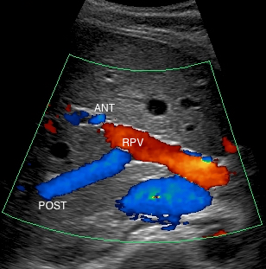
Portal Veins
70-75% of blood supply to liver
MPV originates just right of midline at junction of splenic vein and SMV
MPV gives rise to Rt and Lt branches
intralobar and follow a horizontal course
echogenic walls
hepatopetal Doppler flow with mild phasicity

Slide 13
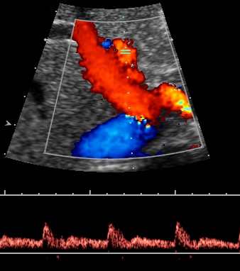
Hepatic Arteries
25-30% of blood supply to liver
common hepatic artery branches off celiac axis
proper hepatic artery enters liver at porta hepatis
proper hepatic branches into Rt and Lt hepatic arteries
smaller in caliber than portal veins
low resistive Doppler flow pattern with antegrade flow throughout diastole

Slide 14
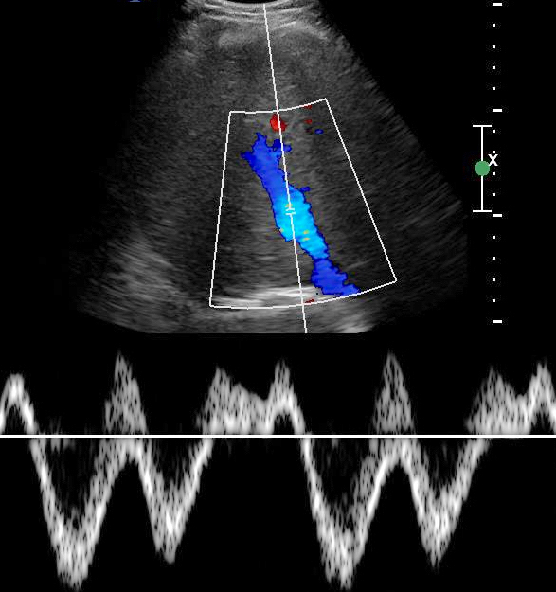
Hepatic Veins
intersegmental and interlobar and follow a longitudinal course
increase in caliber as they course toward the diaphragm and IVC
thin walls are hard to see sonographically
convergence of the 3 hepatic veins with IVC is in the cephalad portion of liver
Doppler waveform dependent on activity and pressures in Rt atrium

Slide 15
Anatomic Variants
Situs inversus
Agenesis
Riedel’s lobe
Diaphragmatic indentations
Diaphragmatic hernia or omphalocele
Vascular anomalies

Slide 16
Hepatic Functions
Bile formation and secretion
Carbohydrate, fat, and protein metabolism
Reticuloendothelial activity
Storage depot
Blood reservoir
Heat production
Detoxification
Lymph formation

Slide 17
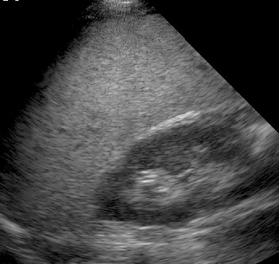
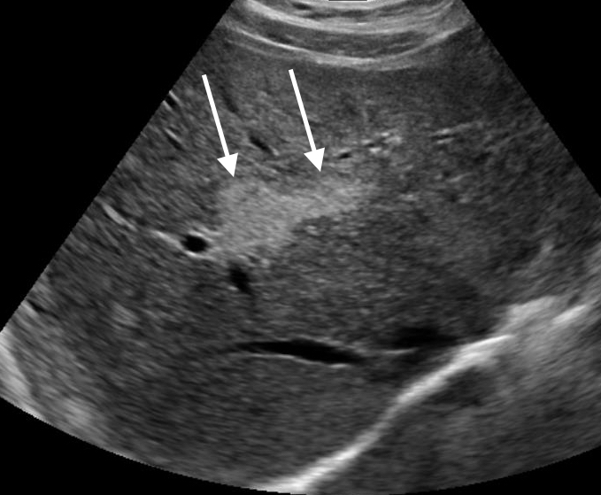
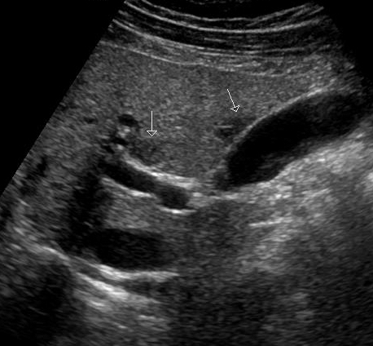
Fatty Infiltration
fatty (lipid) infiltration of hepatocytes
fibrous material surrounding fatty cells causes liver lobules to separate
alcohol abuse and obesity are leading causes
sonographically, diffuse increased echogenicity of the hepatic parenchyma and decreased acoustic penetration
can be focal (fatty infiltration or sparing)

Slide 18
Glycogen Storage Disease
an autosomal recessive disorder
von Gierke’s disease (type 1) is most common
excess glycogen deposited in liver, intestinal tract, and kidneys
Type 1 sonographic features
marked diffuse increase in hepatic parenchymal echogenicity and decreased penetrability
hepatomegaly
possible presence of solid liver masses
Differential diagnosis - diffuse fatty infiltration

Slide 19
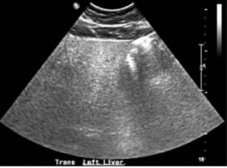
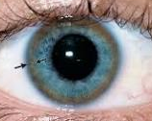
Wilson Disease
Autosomal Recessive Disease
Liver is unable to rid itself of excess copper
Severity of disease is based on amount of copper deposits in body
Clinical Findings:
Evidence of liver disease
Neurologic and/or psychiatric symptoms
Presence of Kayser-Fleischer rings
Gold Standard: Liver biopsy
Notes:
Wilsons dz is aka hepatolenticular degeneration
It is a rare autosomal recessive metabolic disorder of the liver in which the organ cannot eliminate excessive copper.
Typically more copper than necessary is ingested then stored in the liver until needed, while excess amounts are excreted through the biliary system to maintain a health balance. With Wilson disease, the liver can’t get rid of the excess copper which can lead to organ dysfunction if untreated, and eventually liver failure. As the disease progresses, copper begins to accumulate in other organs such as the brain, eyes, kidneys, and heart which can also lead to affected organ failure.
Clinical findings: kayser- Fleischer rings: golden to greenish-brown annular deposition of copper located in the periphery of the cornea
Top image – Transverse image of the left lobe of the liver in the patient with Wilson disease showing diffuse, nonspecific increased echogenicity with no evidence of any discrete mass and diminished tissue penetration.

Slide 20
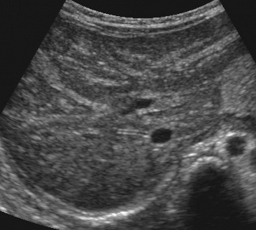
Hepatitis
Inflammation of the liver
Caused by reactions to viruses or toxins
Symptoms vary and include
Fever, chills, N/V, RUQ pain, hepatomegaly, and jaundice
Lab values
Elevated ALT and AST
Elevated bilirubin during icteric(jaundice) phase
Elevated PT in severe cases
Acute – normal to hypoechoic parenchyma
Chronic – more coarse and more hyperechoic parenchyma

Slide 21
Cirrhosis
diffuse process that destroys the normal architecture of liver lobules
12th leading cause of death in US
alcohol abuse and hepatitis are the most common causes
elevated AST, ALT, and bilirubin
clinical presentation varies:
asymptomatic, fatigue, weight loss, diarrhea, hepatomegaly, jaundice, ascites
palliative treatment or liver transplant

Slide 22
Cirrhosis Sonographically
early stage
hepatomegaly, fatty infiltration, scalloped appearance of liver surface
later stage
smaller heterogeneous Rt and Lt lobes, caudate lobe enlargement, hyperechoic coarse liver texture with surface nodularity
associated findings
dilated portal vein with possible hepatofugal flow or thrombus
portosystemic varices
splenomegaly
ascites

Slide 23
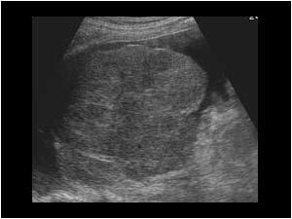
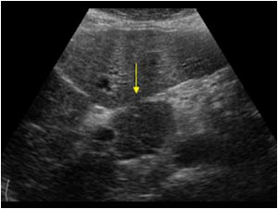
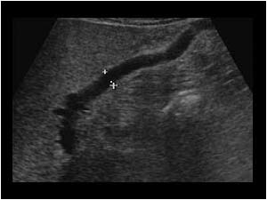
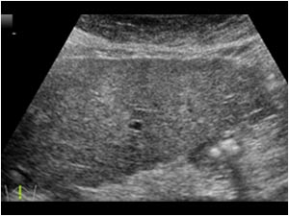

Slide 24
Portal Hypertension (PH)
increased BP in the portal venous system due to increased hepatic vascular resistance
etiology
extrahepatic obstruction of PV
intrahepatic disease processes such as cirrhosis
offending process occurring after the sinusoidal level (hepatic venous obstruction)
clinical presentation
ascites/ abdominal distention
GI bleeding
treatment
transjugular intrahepatic portosystemic shunt (TIPS)
shunts require routine Doppler follow-up

Slide 25
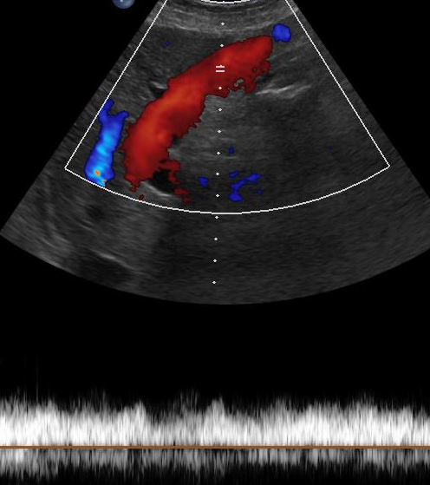
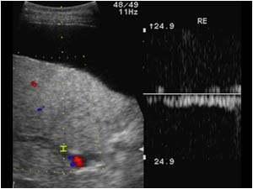
PH Sonographically
dilated MPV, splenic vein, and SMV
recanalized ligamentum teres (umbilical vein)
splenomegaly
portosystemic venous collaterals and varices
ascites
to and fro flow or reversal of MPV flow

Slide 26
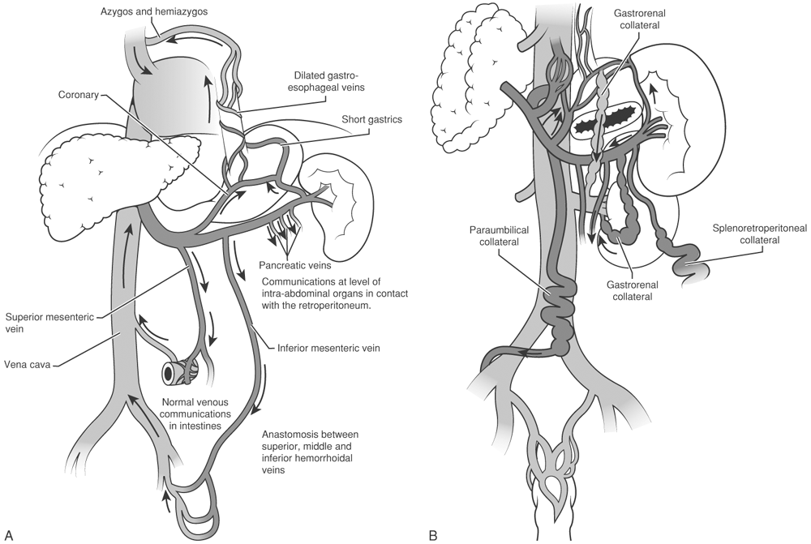
PH - Portosystemic Shunts

Slide 27
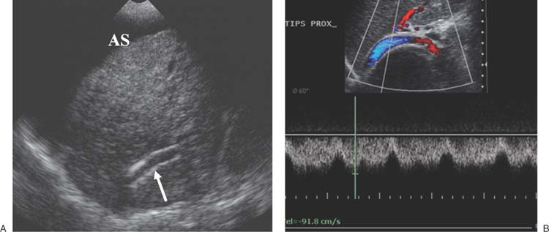
TIPS
Percutaneous treatment for portal HTN via jugular vein
Less risky than previously used surgical shunts
Stent connects a portal vein to a hepatic vein (usually the right)
Blood rerouted away from the liver, thus alleviating pressure

Slide 28
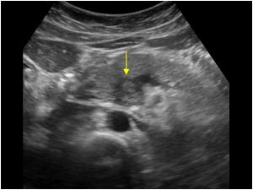
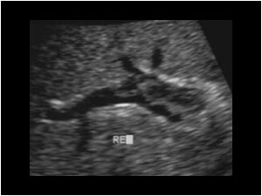
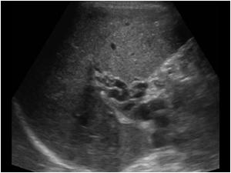
Portal Vein Thrombosis
echogenic thrombus in the PV lumen
PV collaterals
increased PV caliber
cavernous transformation

Slide 29
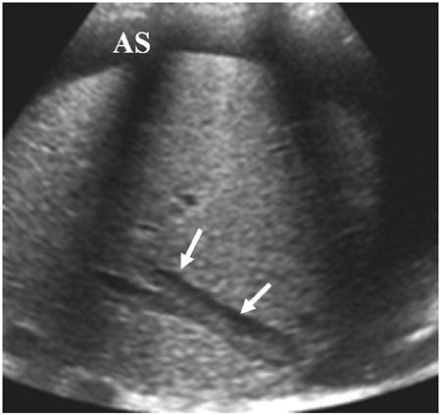
Budd-Chiari Syndrome
occlusion of hepatic veins and/or IVC
primary - congenital web or fibrous cord
secondary - tumor or thrombus formation
clinical presentation
RUQ pain
hepatomegaly
ascites
hematemesis
sonographic appearance
hepatomegaly (especially caudate lobe)
thrombus or tumor invasion in hepatic veins
reduced or non-visualization of hepatic veins
regional inhomogeneity
ascites
Doppler used to document patency or absence of flow

Slide 30
Aneurysm
portal vein
rare
congenital or related to PH
hepatic artery
4th most common intra-abdominal aneurysm
anechoic cystic mass that connects to respective vessel
turbulent flow demonstrated on color and spectral Doppler

Slide 31
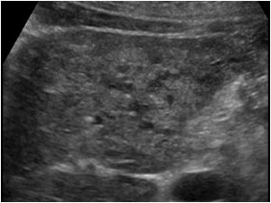
Hereditary Hemorrhagic Telangiectasia
aka Osler-Weber-Rendu disease
autosomal dominant disorder that leads to repeated incidents of hemorrhage
causes AV malformations in liver
clinical presentation
multiple telangiectasias
recurrent episodes of bleeding
sonographic findings
enlarged common hepatic artery
multiple dilated tubular structures in liver
enlarged hepatic veins

