Slide 1
The Liver
Chapter 5 pages 142-169
Chapter 19 pages 615-627
Chapter 24 liver transplant portions
1

Slide 2
Hepatic Masses
benign and malignant neoplasms, as well as masses related to trauma
most common benign are hemangiomas, FNH, and adenomas
most common malignant are HCC and mets
US used to show presence, size, echogenicity, and vascularity
CEUS, CECT, and MRI used to further characterize liver masses

Slide 3
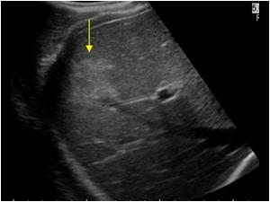
Hematoma
collection of blood due to trauma or rupture of neoplasm
blunt abdominal trauma more frequently affects Rt lobe posterior segment
clinical presentation
pain
hypotension
decreased hematocrit
varied appearance depending on the age of trauma and stage of clotting

Slide 4
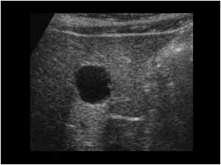
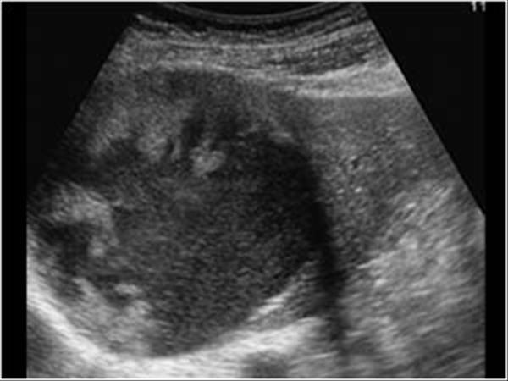
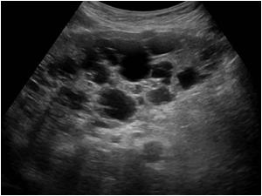
Congenital hepatic cysts
Can be simple or related to hereditary disorders such as polycystic liver disease
A fluid-filled space with an epithelial lining
Incidence increases with age
Simple cysts are anechoic with a thin, well-demarcated wall and posterior enhancement
Hemorrhage or infection can occur

Slide 5
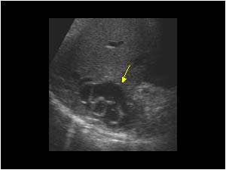
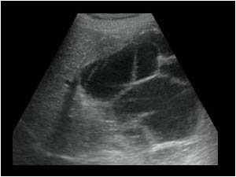
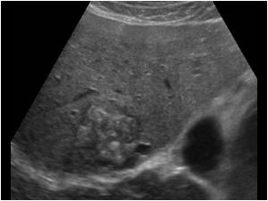
HYDATID DISEASE/ ECHINOCOCCAL CYSTS
caused by a parasitic tapeworm passed through dog feces
cattle, sheep, hogs, and humans serve as hosts
ingested larvae hatch in intestine and migrate to right hepatic lobe
Sonographic appearance depends on course of larval mutation

Slide 6
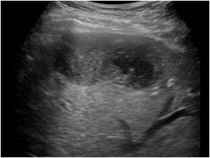
Pyogenic abscess
Pyogenic bacteria reach the liver from biliary tree, portal vein, or hepatic artery
Symptoms vary, and include
Fever, leukocytosis, elevated LFTs, RUQ pain, pleuritic pain, and hepatomegaly
US appearance varies, and includes
Round or ovoid with irregular, poorly defined walls
Anechoic to hyperechoic, depending on the presence of debris, adhesions, or air
Differentials
Cyst, hematoma, biloma, necrotic tumor, echinococcal cyst, cystadenocarcinoma

Slide 7
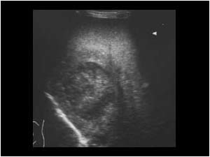
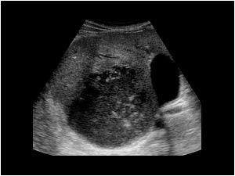
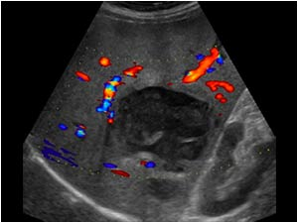
Amebiasis/ amebic abscess
Parasites from the colon reach the liver through the portal vein
Presents with RUQ pain and diarrhea
Labs
Leukocytosis, mild anemia, elevated LFT’s
Sonographic findings change over time
Echogenic to hypoechoic
Sonography used to monitor involution and resolution of inflammatory process

Slide 8
Schistosomiasis
common in locations with contaminated water
immature worms penetrate the skin and can eventually migrate to portal vein
granulomatous reaction and periportal fibrosis develop
Sonographic features
marked thickening of portal vein walls
dilated MPV
enlarged liver initially
contraction with progression of periportal fibrosis

Slide 9
PNEUMOCYSTIS Jiroveci
majority of AIDS patients develop pneumocystis pneumonia
pneumocystis jiroveci infection can spread outside the lungs into the liver and other organs
Liver involvement sonographically ranges from:
tiny, diffuse, nonshadowing echogenic foci
replacement of hepatic parenchyma by dense calcification
differential diagnoses include CMV, histoplasmosis, and TB

Slide 10
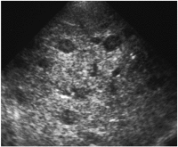
candidiasis
Mycotic infection spread to the liver via bloodstream
Most often in patients with HIV or other immunocompromised conditions
Symptoms: RUQ pain and fever
Sonographically:
Hepatomegaly and increased parenchymal reflectivity
Focal lesions change over course of disease
“wheel within a wheel”
bull’s-eye
Hypoechoic
Echogenic with variable calcification

Slide 11
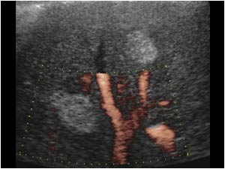
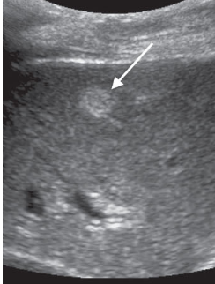
Cavernous Hemangioma
tumor composed of a large network of vascular endothelium-lined spaces filled with RBCs
most common benign liver lesion
most often located in Rt lobe
more common women (5:1)
usually asymptomatic
typically less than 3 cm in size
typically round, well-defined, homogeneous, hyperechoic
extremely low flow seen with Doppler
frequently followed-up with US

Slide 12
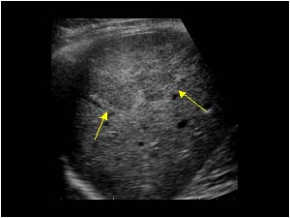
Focal Nodular Hyperplasia (FNH)
composed of abnormally arranged hepatocytes, Kupffer cells, bile duct elements, and fibrous connective tissue
2nd most common benign liver mass
more common in reproductive age females
usually asymptomatic
typically less than 5 cm
subtle, isoechoic mass that can cause mass effect on surrounding structures
central stellate scar or linear hypoechoic area
well-developed peripheral and central vessels seen with Doppler

Slide 13
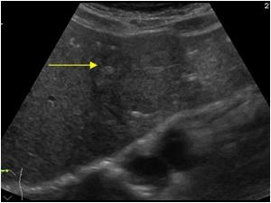
Hepatic Adenoma
normal or slightly atypical hepatocytes frequently containing areas of bile stasis and focal hemorrhage or necrosis
less common than FNH
linked to oral contraceptives and von Gierke’s disease
asymptomatic or palpable mass
bleeding or infarct causes RUQ pain
shock may occur due to rupture and hemoperitoneum
may undergo malignant transformation
variable US appearance
usually less vascular than FNH

Slide 14
Infantile Hemangioendothelioma
Most common benign hepatic tumor in childhood
Most are diagnosed within the first 6 months of life, virtually all by age 3
AFP usually normal
2 types
GLUT-1 positive infantile hemangioendothelioma
Multiple small hypoechoic nodules
GLUT-1 negative hepatic vascular malformation
Large complex mass

Slide 15
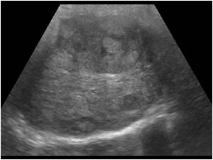
Hepatocellular Carcinoma (HCC)
primary liver CA that often destroys portal venous walls and invades vessel lumen
aka hepatoma
most common primary liver CA in adults
2nd most common pediatric liver CA
more common in men (5:1)
cirrhosis is the most common cause in the west
also linked to carcinogens and hepatitis
clinical presentation
palpable mass
symptoms of cirrhosis
elevated AST, ALT, and AFP
variable sonographic appearance
solitary, multiple, or diffuse invasion
high velocity waveforms with spectral Doppler

Slide 16
Hemangiosarcoma
aka angiosarcoma
very rare malignant neoplasm comprised of endothelial and fibroblastic tissue
seen in patients 60-80 years of age
linked to carcinogens
large mass with mixed echogenicity
progresses rapidly and spreads to portal vein and other organs

Slide 17
Hepatoblastoma
Most common malignant liver tumor in children (typically under age 5)
Can be asymptomatic or present with abdominal pain, anorexia, weight loss, or jaundice
Elevated AFP
Mets to lungs, brain, and skeleton
Usually unifocal and in the right lobe
Vascular invasion (PV) is common

Slide 18
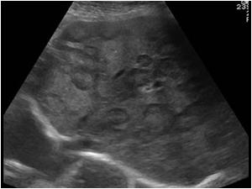
Metastatic Liver Disease
dissemination of tumor cells to the liver via the portal vein, lymphatics, hepatic artery, or direct extension of tumor
more common than HCC
liver most common site for mets
colon, breast, and lung are most common primary sites
multiple masses throughout liver with a wide range of appearances
elevated ALT, AST, ALP, direct bilirubin
important to correlate clinical history

Slide 19
Contrast-enhanced US
FDA approved UCA for evaluation of adult and pediatric liver masses in April 2016
Allows for better evaluation of lesions based on their perfusion characteristics
Without contrast: Sonography correctly characterizes focal liver lesions 60% to 65% of the time.
With contrast: Lesions correctly characterized 86% to 95% of the time.
Without contrast: Sonography able to differentiate between benign and malignant lesions 23% to 68% of the time.
With contrast: Sonography able to correctly make the distinction in 92% to 95% of patients.

Slide 20
Contrast-enhanced US
Advantages
Used to evaluate vascularity and enhancement patterns of lesions.
Different enhancement patterns for benign and malignant liver lesions may allow for definitive diagnosis without further testing.
Real-time assessment of vascularity
No nephrotoxic contrast eliminates the need for lab tests to assess renal function before contrast agent is administered.
Narrow ultrasound beam allows for improved vascularity visualization in small structures such as septations or mural nodules.
Can be used on patients allergic to contrast agents or patients with renal failure.
Can perform study at same time as initial sonographic discovery of liver lesion.
May be used to assist with liver mass biopsies as contrast makes biopsy of isoechoic lesions easier and more accurate.

Slide 21
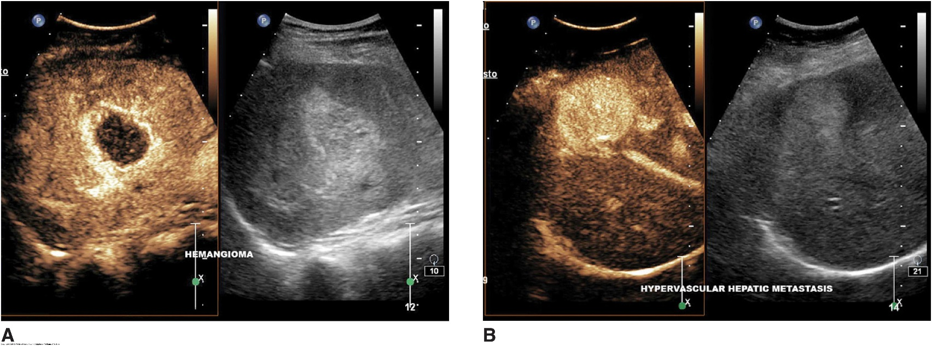
Contrast-enhanced US

Slide 22
Liver Transplant
Treatment for end-stage liver disease
Diseases leading to liver transplant include cirrhosis and Hep C
Patients with metastatic CA, active substance abuse, sepsis, and compromised cardiac function are not typical candidates
Patients with PV thrombosis are considered high risk for complications
Cadaveric (whole or split) and living related donor allografts are used
Allografts should begin functioning immediately and should have the same sonographic appearance as native liver
Minimal fluid collections may be seen for 7-10 days postop
Bile duct measurement criteria is the same that is used in postcholecystectomy patients
Vessel waveforms should be the same as those from a native liver

Slide 23
Liver Transplant Complications
Hepatic artery complications are critical bc the liver and biliary system are highly dependent on the hepatic arterial flow
Thrombosis – typically occurs In the 1st 2 postop months and most commonly involves the anastomotic site
Collaterals may develop
Usually requires immediate retransplantation
Stenosis – usually occurs at anastomotic site
High velocity, turbulent flow with tardus parvus waveform distally
Can be treated with angioplasty
Portal vein complications are not as common, but hepatopetal flow must be documented
Thrombosis – usually at the anastomotic site
Varices may be seen
Stenosis – less common

Slide 24
Liver Transplant Complications
Miscellaneous vascular complications
IVC thrombosis
Hepatic vein thrombus or stenosis
Hepatic artery pseudoaneurysm or AVF
Biliary complications
Biliary strictures – develop in as many as 25% of patients
Patients present with painless jaundice and elevated LFTs
Stricture can be intra- or extrahepatic
Treated surgically or with stent placement
Cholangitis – bacteria ascend through the biliary tree and invade the liver
Sludge in the biliary tree
Miscellaneous parenchymal complications
Rejection – heterogeneous parenchyma
Proven by biopsy
Abscess, hematoma, biloma, seroma

