Slide 1
The Peritoneal Cavity and Potential Spaces
Notes:
The abdominopelvic cavity is lined with a thin continuous layer of peritoneum.
The peritoneum that surrounds the organs is referred to as visceral peritoneum. The peritoneum that lines the walls of the abdominopelvic cavity is referred to as the parietal peritoneum.
The peritoneum secretes a small amount of serous fluid that acts as a lubricant, allowing the organs to move without friction.
The parietal peritoneum lining the anterior abdominal wall may be visualized sonographically using a transducer in the 5-9 MHz range. It will appear as a thin hyperechoic continuous line posterior to the hypoechoic abdominal wall muscles. The visceral peritoneum and the parietal peritoneum along the posterior peritoneal wall are typically not appreciated sonographically due to their depth. We are typically evaluating the actual organs in the peritoneal cavity along with the potential spaces where fluid can form.

Slide 2
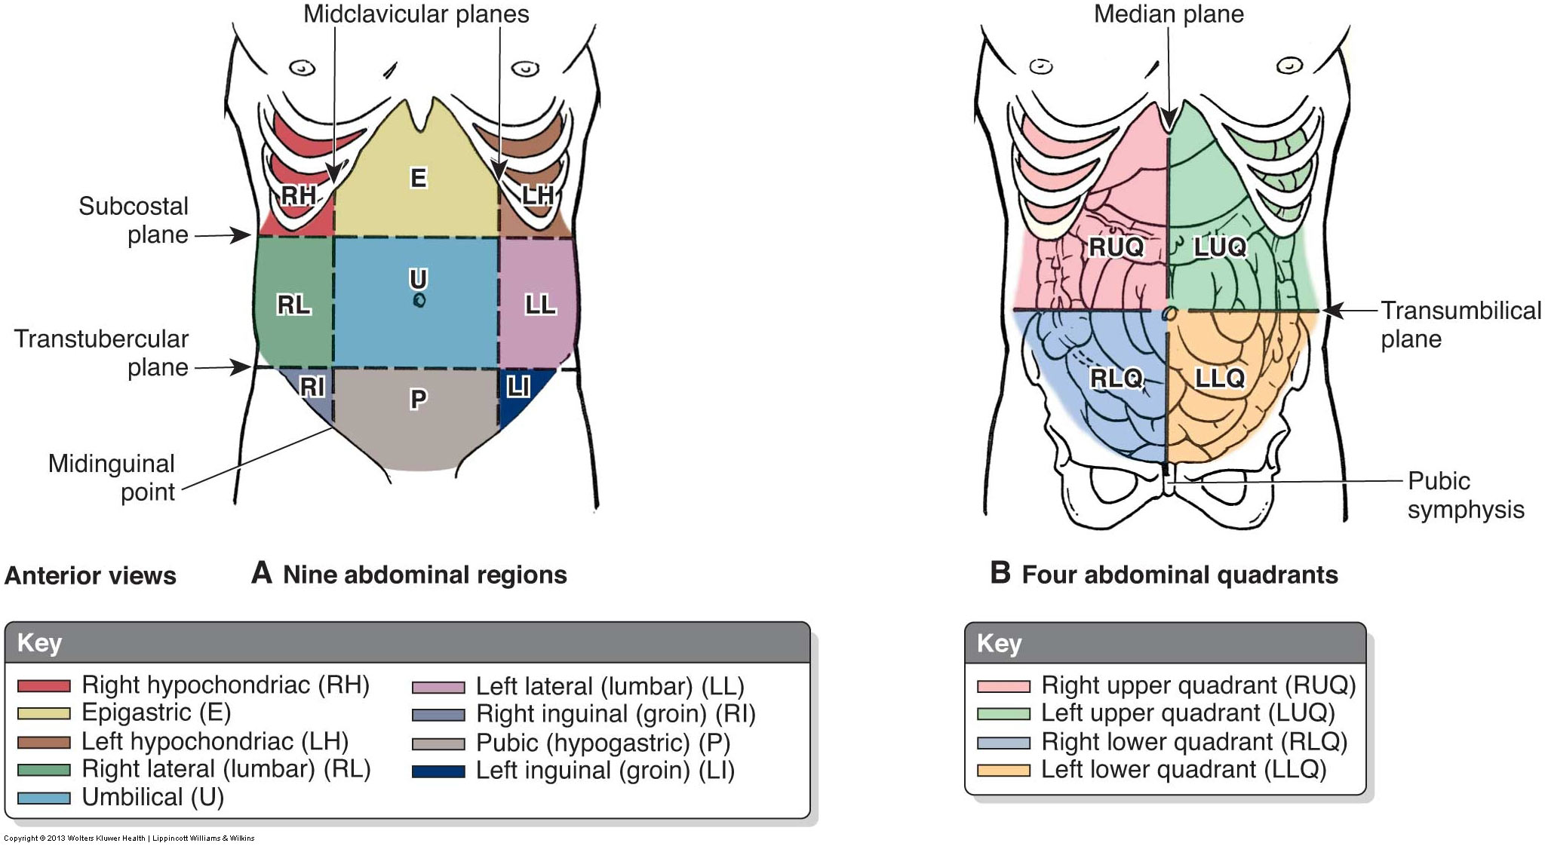
Abdominopelvic Cavity
Notes:
This image shows the different ways that the abdominopelvic cavity can be subdivided.
The left shows the 9 regions, and the right shows the 4 quadrant method.
The regions are color coded and labeled accordingly. We have the right hypochondriac, epigastric, and left hypochondriac superiorly. The right lumbar, umbilical, and left lumbar across the middle, and the right inguinal, hypogastric, and left inguinal inferiorly. The regions are formed by the 2 vertical midclavicular planes, the horizontal subcostal plane, and the horizontal transtubercular plane.
I know that you are all familiar with the 4 quadrants, which are the RUQ, LUQ, RLQ, and LLQ. The quadrants are formed by the midsagittal plane and a transumbilical plane that crosses horizontally through the umbilicus.

Slide 3
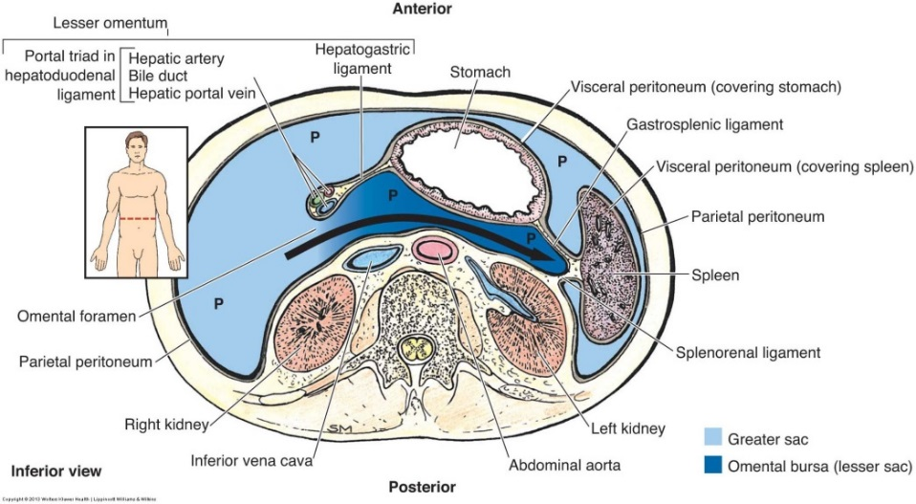
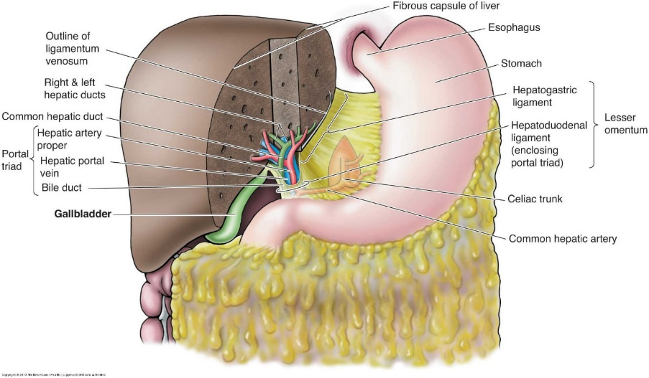
Divisions of the Peritoneal Cavity
Greater sac – largest compartment, housing the liver, spleen, stomach, and portions of the intestines
Greater omentum is a large double-layered sheet of peritoneum that subdivides the greater sac into a supracolic and infracolic compartment
Greater omentum prevents the parietal peritoneum of the anterior abdominal wall from adhering to the visceral peritoneum
Lesser sac aka omental bursa - much smaller and contains no organs; considered a diverticulum of the greater sac
Notes:
The peritoneal cavity can be divided into two compartments: the greater sac and the lesser sac. The greater sac is the largest, housing the liver, spleen, stomach, first portion of the duodenum, jejunum, ileum, cecum, transverse colon, sigmoid colon, and the upper two-thirds of the rectum. It also contains several potential spaces that must be evaluated for free fluid.
The greater omentum is located within the greater sac and extends inferiorly from the greater curvature of the stomach, anterior to the bowel, folds inward, and travels superiorly to attach on the transverse colon. The greater omentum subdivides the greater sac into a supracolic and infracolic compartment. The division of the greater sac by the greater omentum is important bc it limits the spread of infection within the peritoneal cavity. The greater omentum functions to prevent the parietal peritoneum of the anterior abdominal wall from adhering to the visceral peritoneum. It is very mobile and moves to areas of inflammation, surrounding the inflamed area by creating adhesions to wall off infection. It also acts to cushion the abdominal organs to prevent trauma and acts to prevent the loss of body heat from abdominal organs.
The lesser sac is aka the omental bursa. It is much smaller than the greater sac and does not contain any organs. It lies immediately posterior to the stomach and anterior to the pancreas, extending superiorly to the left suprahepatic recess between the posterior left lobe of the liver and the left hemidiaphragm. It extends inferiorly into the fold of the greater omentum. It’s enclosed superiorly by the lesser omentum and laterally on the left by the splenorenal and gastrosplenic ligaments. It communicates with the greater sac through its right lateral aspect – this opening is called the omental foramen or foramen of Winslow.
The diagram on the left shows the greater and lesser sacs, with the greater sac in light blue and the lesser sac in dark blue. Notice small size and location of the lesser sac. You can see the omental foramen, which allows communication between the two compartments. Also notice its location immediately posterior to the stomach.
The diagram on the right shows the greater and lesser omentums. The greater omentum is not labeled but is this area right here, extending from the greater curvature of the stomach. The lesser omentum is labeled. It is a fused double layer of peritoneum stretching between the lesser curvature of the stomach and the transverse fissure of the liver – it creates the anterior superior border of the lesser sac, separating it from the supracolic compartment of the greater sac

Slide 4
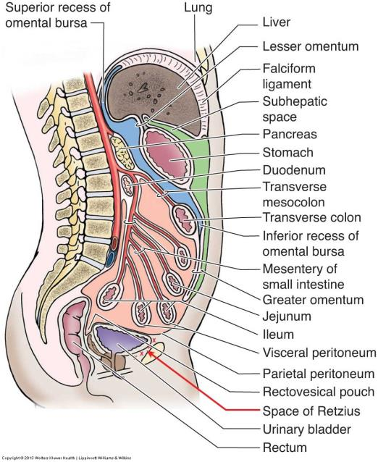
Notes:
Divisions of the peritoneal cavity. Green represents the supracolic compartment of the greater sac; pink represents the infracolic compartment of the greater sac; and blue represents the lesser sac. Notice the location of the lesser sac posterior to the stomach and anterior to the pancreas. Also notice the visceral peritoneum covering the intestine and the parietal peritoneum lining the cavity.

Slide 5
Potential Spaces of the Peritoneum
Left anterior subphrenic space
Left posterior suprahepatic space
Right subphrenic space
Hepatorenal space aka Morrison pouch
Omental bursa aka lesser sac
Right and left paracolic gutters
Vesicorectal space
Rectouterine space aka pouch of Douglas or posterior cul de sac
Uterovesicle space aka anterior cul de sac
Notes:
Potential spaces are areas created by the peritoneal layer, reflecting between two organs or an organ and the peritoneal wall. A potential space is an empty fold; however, when disease is present, fluid or other materials may collect in this space.
The left anterior subphrenic space is aka the left anterior suprahepatic space – It is an extension of the greater sac between the diaphragm and the anterior superior liver left of the falciform ligament
The left posterior suprahepatic sapce is aka the superior recess of the lesser sac – It is an extension of the lesser sac between the diaphragm and the posterior superior liver
The right subphrenic space is aka the right suprahepatic space – It is an extension of the greater sac between the right hemidiaphragm and the anterior superior liver right of the falciform ligament
The hepatorenal space is aka Morrison pouch – It is created by peritoneum reflecting from the liver over the right kidney and the right posterior peritoneal wall – It is the most gravity dependent potential space in the abdominal cavity when the patient is supine and is therefore a common site for ascites to collect
The omental bursa or lesser sac is sandwiched between the posterior stomach and the parietal peritoneum covering the anterior pancreas – It is a common site for pancreatic pseudocyst formation
Paracoloic gutters are potential spaces or grooves found along the lateral ascending and descending colon that conduct fluids between the supracolic and infracolic compartments of the peritoneum
The vesicorectal space is the potential space between the rectum and posterior bladder wall in males – It is the most gravity dependent potential pelvic space in supine males
The rectouterine space is aka the posterior cul de sac and the pouch of Douglas – It is a potential space between the posterior portion of the uterus and vagina and the anterior portion of the rectum – It is the most gravity dependent potential pelvic space in supine females
The uterovesicle space is aka the uterovesicle pouch and the anterior cul de sac. It is the potential space between the anterior portion of the uterus and the posterior portion of the bladder
The retropubic space is aka the space of Retzius. It is not located within the peritoneal cavity, but it is a potential extraperitoneal space. It is located between the anterior bladder wall and the pubic symphisis.

Slide 6
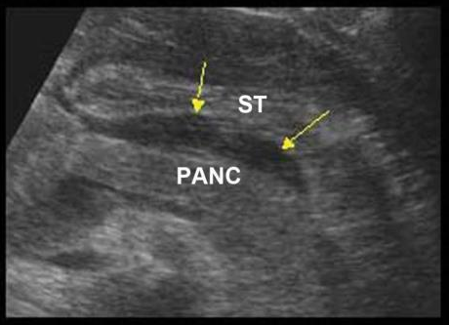
Lesser Sac
Notes:
These US and CT images show the location of the lesser sac. On the US image, the yellow arrows are pointing to the lesser sac posterior to the stomach and anterior to the pancreas. On the middle CT image, the black arrow is again pointing to the lesser sac in between the pancreas and stomach. The CT on the right shows a pseudocyst in this area, again posterior to the stomach and anterior to the pancreas.
This is a common area for pancreatic pseudocysts to form or for fluid from gastric wall perforation to collect.

Slide 7
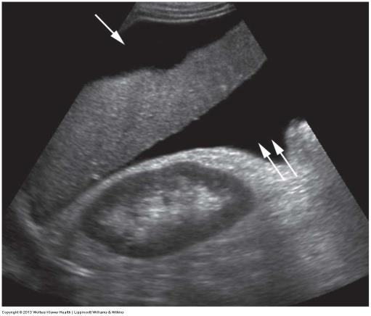
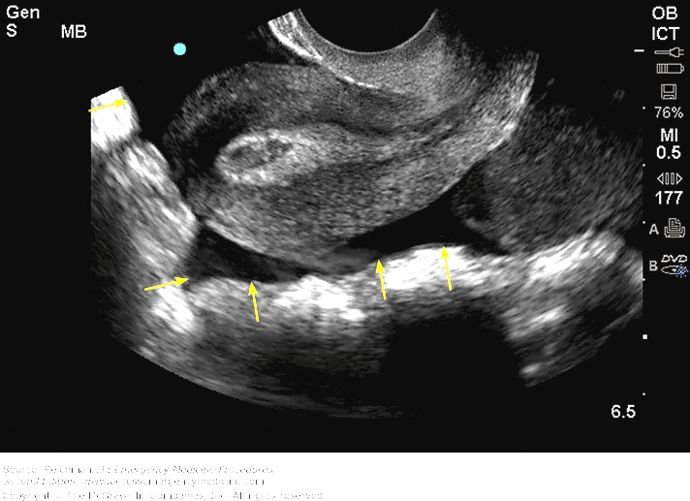
Other Potential Spaces
Notes:
Remember that these potential spaces are areas for fluid to collect in pathologic situations.
On the left, we have an image showing free fluid that has collected around the liver. The single arrow is pointing to the right subphrenic space, the the two arrows are pointing to the hepatorenal space, which is aka Morison’s pouch.
On the right, we can see free fluid that has collected around the uterus. The single arrow is pointing to the anterior cul de sac, and the multiple arrows are pointing to the posterior cul de sac, which is aka the pouch of Douglas. Be aware that a small amount of fluid may be seen in the pouch of Douglas following ovulation. This fluid is physiologic (from the ruptured follicle) and is not considered pathologic.

Slide 8
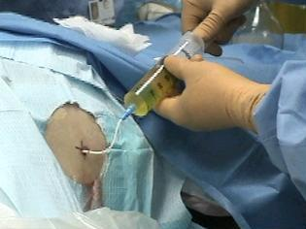
Ascites
Abnormal accumulation of fluid within the peritoneal cavity
Variety of causes including liver disease, malignancy, heart failure, and renal failure
2 types
Transudative
Exudative
Patients present with abdominal distention, lack of appetite, and trouble breathing if large amount of fluid present
Paracentesis is done to remove fluid from the peritoneal cavity
Can be diagnostic or therapeutic or both
Notes:
The remainder of the PPT will cover pathologies of the peritoneal cavity.
Ascites is the most frequently encountered of these pathologies and is just an abnormal accumulation of fluid within the peritoneal cavity.
Liver disease and malignancy are the most common causes, with cirrhosis being the most common liver cause.
Ascites can be classified as transudative or exudative. Transudative ascites is characterized by a lack of protein and cellular materials in the fluid. It has a simple (anechoic) appearance. Ascites caused by liver disease is typically transudative. Exudative ascites is fluid that seeps out from blood vessels and contains a large amount of protein and cellular material. It typically results in a more complex and echogenic appearance of the fluid. Ascites caused by malignancy is typically exudative.
Patients present with abdominal distention and lack of appetite and may even have difficulty breathing if they have a large amount of ascites that is putting pressure on the diaphragm. The lack of appetite can be attributed to the fluid putting pressure on the intestines and stomach.
A paracentesis can be done to remove the ascites from the peritoneal cavity. These are typically done with US guidance, meaning that we will scan to determine the largest and safest pocket to draw the fluid from. Just like with thoracentesis, remember the effects of gravity… if we go too anterior, then there will be a large amount of fluid that we won’t be able to remove. With a diagnostic paracentesis, a sample of the fluid is sent to the lab so that they can analyze the cells and content of the fluid. With a therapeutic paracentesis, we are just removing the fluid in order to provide comfort to the patient. Typically our repeat patients who already know the cause of their ascites just get therapeutic paras. They can be done frequently… some people will have fluid build back up much more quickly than others.

Slide 9
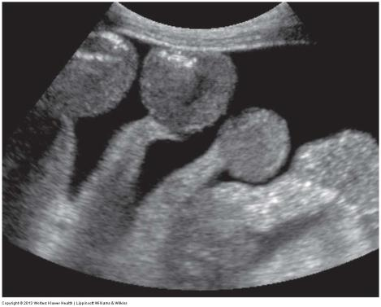
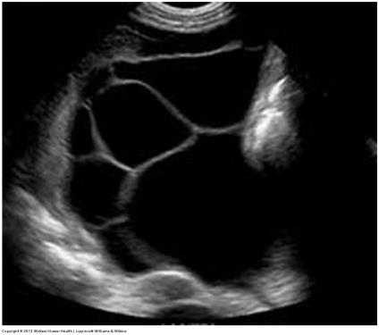
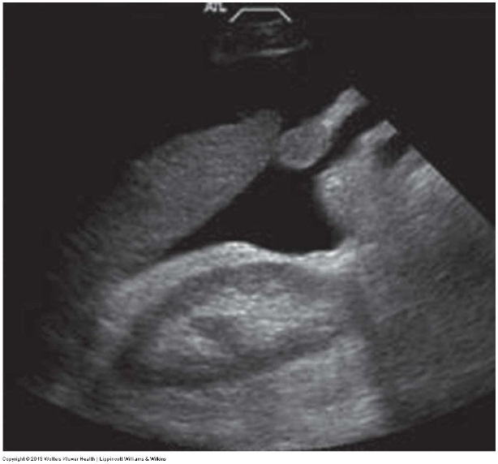
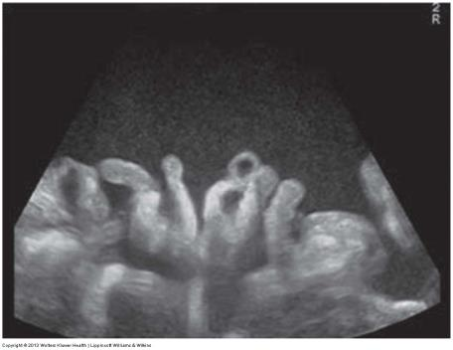
Ascites
Transudative (simple)
Exudative (complex)
Notes:
On the left, we can see examples of transdudative ascites. Notice that the fluid is anechoic and free of debris or septations.
Pathologies like portal hypertension, liver failure, and CHF tend to cause ascites with this appearance. Loops of bowel can be seen floating in the free fluid.
On the right, we can see examples of exudative ascites. The ascites on the left is loculated, with septations. The fluid on the right contains echogenic particles, likely proteins and cellular material. Pathologies like malignancy, inflammation, and renal failure tend to cause ascites with these types of appearances

Slide 10
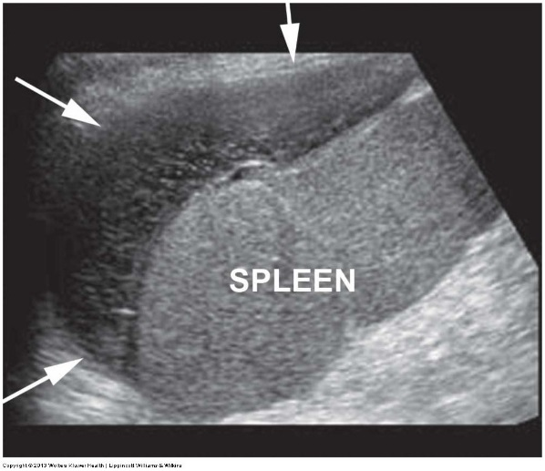
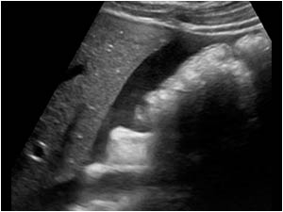
Abscess, Hemoperitoneum, & Hematoma
Abscess – collection of ischemic tissue and pus within a potential space or adjacent to an inflamed or perforated organ
Hemoperitoneum – bleeding into the peritoneum from blunt trauma to abdominal viscera or vasculature
Hematoma – organized collection of blood occurring from a surgical complication, following trauma, or spontaneously in patients with coagulation disorders
Notes:
Peritoneal abscess may occur secondary to appendicitis, diverticulitis, peritonitis, or as a surgical complication.
Peritonitis is defined as diffuse inflammation of the parietal and visceral peritoneum, with both infectious and noninfectious causes. Infectious causes include bacteria, viruses, fungi, and parasites – most cases of peritoninits are bacterial, secondary to complications of disease processes involving intraabdominal organs (bowel necrosis secondary to ischemia, perforated appendicitis, diverticulitis, or duodenal ulcer). The sonographic appearance of peritonitis varies, but complex ascites is often seen. Diffuse thickening of the peritoneum, mesentery, and omentum may also be observed. When peritonitis is untreated or treatment is delayed, an abscess may occur.
Percutaneous abscess drainage can be done with sonographic guidance . Depending on the abscess contents, a drain may or may not have to be left in.
The top image shows a perisplenic abscess in the left upper quadrant of the peritoneum. Note the complex echogenicity and the rounded edges that demonstrate this is not free fluid.
Bleeding into the peritoneum from blunt trauma to abdominal viscera or vasculature is referred to as hemoperitoneum.
Middle image - Hemoperitoneum - Image is a patient who had a ruptured spleen but presents with complex free fluid in the abdominal cavity. The echoes in the fluid along with the clinical history is suggestive of hemoperitoneum, which is a completely different diagnosis than ascites. This is often evaluated as part of a FAST exam – FAST stands for focused assessment with sonography in trauma. The primary purpose of a FAST exam is to search for free fluid (blood) in the dependent regions of the pericardium, pleural spaces, intraperitoneal spaces, and the retroperitoneum in patients who have undergone trauma. US is especially useful for unstable patients who are not stable enough to go for a CT.
A hematoma is a localized collection of blood that can occur anywhere, including in the peritoneum.
The bottom image shows an acute splenic hematoma in a patient with recent abdominal trauma. Remember that the sonographic appearance of hematomas changes over time. They are initially anechoic, then become more echogenic and complex as fibrin is deposited. It then changes to a homogeneous, echogenic appearance before it progresses to the lytic phase, when it will decrease in size and become more complex again, eventually being resorbed by the body. It is very important that any patient who has experienced trauma be thoroughly examined for hemoperitoneum as this often accompanies the hematoma.

Slide 11
Pseudomyxoma Peritonei
Rare borderline malignant process that results when a benign appendiceal or ovarian adenoma ruptures, spilling epithelial cells into the peritoneum
These cells develop into noninvasive peritoneal implants that secrete a gelatinous mucous into the peritoneal cavity
Notes:
Pseudomyxoma peritonei is a rare borderline malignant process that results when a benign appendiceal or ovarian adenoma ruptures, spilling epithelial cells into the peritoneum. These cells develop into noninvasive peritoneal implants that secrete a gelatinous mucous into the peritoneal cavity. As the mucous accumulates, it takes up space around the bowel and causes fibrosis of the peritoneal membranes causing adhesions. Sonographically, PMP most commonly appears as simple or multiloculated ascites. It may also present as several thin walled cysts of varying sizes scattered throughout the peritoneum
The image on the left shows the multicystic appearance of pseudomyxoma peritonei within the peritoneal cavity. This was secondary to a mucinous carcinoma of the appendix. On the right, you can see complex mucinous ascites in the same patient.

Slide 12
Miscellaneous Fluid Collections
Seroma – collection of serous fluid around a surgical site or transplant organ; typically appear in the early postsurgical period
Lymphocele – collection of lymphatic fluid outside of the lymphatic system due to disruption of the lymphatic vessels or lymph node resection; typically present 4-8 weeks after surgery
Biloma – collection of bile located within the peritoneal cavity outside of the biliary tree; typically associated with hepatic transplant but may also result from biopsy or cholecystectomy
Notes:
A seroma is a collection of serous fluid around a surgical site or a transplant organ. They typically appear in the early postsurgical period. They are typically anechoic but may contain septa.
A lymphocele is a collection of lymphatic fluid outside of the lymphatic system due to disruption of the lymphatic vessels or lymph node resection. They typically present 4-8 weeks after surgery, unlike the seromas which form earlier. They are also usually simple but may contain septations
A biloma is a collection of bile located within the peritoneal cavity outside of the biliary tree. It is typically associated with hepatic transplant but may also result from biopsy or cholecystectomy.

Slide 13
Peritoneal Masses
Mesenteric cysts – may occur anywhere along the mesentery, but the majority originate from the small bowel mesentery; contain peritoneal serous secretions
Mesenteric adenopathy – aka lymphadenopathy; enlargement of the lymph nodes along the mesentery or on the bowel
Peritoneal mesothelioma – primary malignant tumor of the peritoneum associated with asbestos exposure
Peritoneal implants - small polypoid masses projecting from the peritoneum; associated with peritoneal mets
Omental caking – thickening of the greater omentum due to malignant infiltration; indicative of peritoneal mets
Notes:
Mesenteric cysts may occur anywhere along the mesentery, but the majority originate from the small bowel mesentery. They contain peritoneal serous secretions. They vary in size and may have internal echoes due to serous secretions or hemorrhage.
Mesenteric adenopathy is aka lymphadenopathy; It is enlargement of the lymph nodes along the mesentery or on the bowel. It may be associated with inflammatory diseases of the bowel such as colitis and appendicitis as well as with viral infections. It may also be associated with lymphoma or metastatic malignancy, such as colon CA that has invaded the lymph nodes. Enlarged nodes lose their oval shape and become more rounded as they increase in size.
Peritoneal mesothelioma is a primary malignant tumor of the peritoneum associated with asbestos exposure. Masses occur along the pleura and peritoneum, metastasizing by direct invasion into adjacent organs. The masses may appear as a generalized thickening of the peritoneum, mesentery, and omentum, or as a discrete nodule.
Peritoneal metastases, which is aka peritoneal carcinomatosis, is commonly associated with primary cancers of the ovary, stomach, and colon. Both peritoneal implants and omental caking are associated with peritoneal mets.
Peritoneal implants are small polypoid masses projecting from the peritoneum
Omental caking is thickening of the greater omentum due to malignant infiltration. It is frequently associated with a significant amount of complex ascites and peritoneal implants. It appears sonographically as a moderately echogenic, homogenous, thick soft tissue layer deep to the anterior abdominal wall.

Slide 14
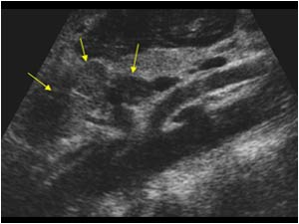
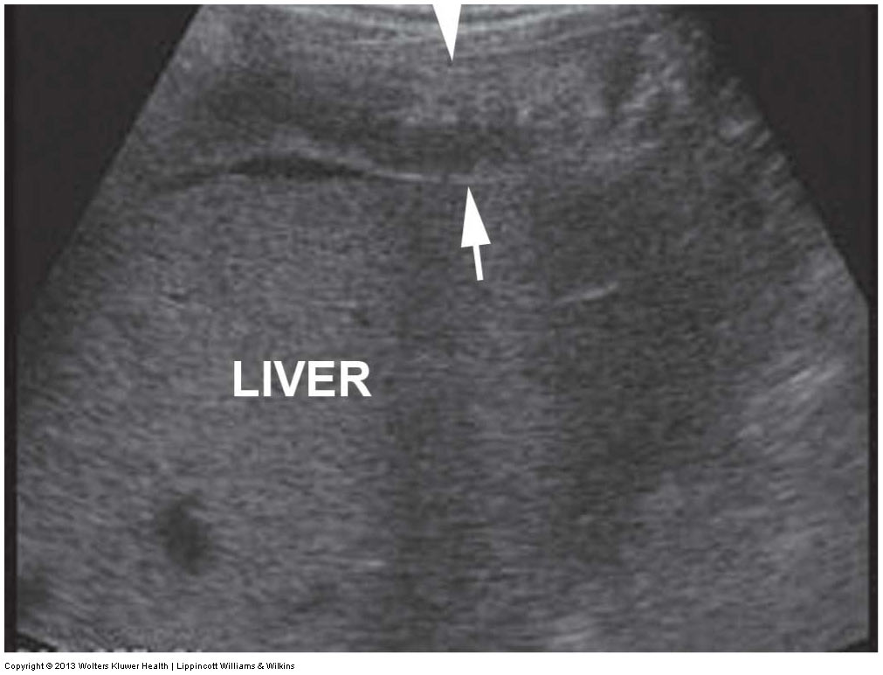
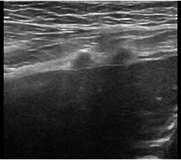
Notes:
Here are some examples of the masses covered on the previous slide.
The top left image shows an omental cyst anterior to the pancreas
The top middle 2 images show mesenteric lymphadenopathy. Notice the multiple hypoechoic round nodules around the celiac and SMA, including the one posterior to the SMA displacing it from the aorta. The other images show multiple nodes in a patient with colitis.
The top right image shows peritoneal mesothelioma. It appears as thickening of the peritoneum anterior to the liver.
The US and CT images on the bottom left show peritoneal implants in 2 different patients. The US shows 2 small hypoechoic masses located along the peritoneum. The CT shows multiple masses along the peritoneum. The polypoid nature of the masses can be better appreciated on this patient due to the ascites that is present.
The US and CT images on the bottom right show omental caking in a patient with a primary ovarian CA. Notice the thickened omentum on both the US and CT images.

