Slide 1
The Retroperitoneum
Chapter 14
Notes:
The retroperitoneum is located posterior to the peritoneal cavity, more specifically, posterior to the posterior parietal peritoneum.. The retroperitoneum extends from the diaphragm superiorly to the pelvic brim inferiorly.

Slide 2
Retroperitoneal Compartments
Anterior pararenal space – bordered anteriorly by the posterior parietal peritoneum and posteriorly by the anterior perirenal fascia
Contains variable amounts of fat, the pancreas, distal CBD, parts of the duodenum, and the ascending and descending colon
Perirenal or perinephric space – bordered anteriorly by the anterior renal fascia and posteriorly by the posterior renal fascia; lies between the anterior and posterior pararenal spaces
Contains the kidneys, adrenal glands, perinephric fat, the abdominal aorta, and the IVC
Posterior pararenal space – bordered anteriorly by the posterior renal fascia and posteriorly by the transversalis fascia
Contains no organs – only fat
Notes:
The retroperitoneum is divided into 3 major compartments or spaces by the anterior and posterior perirenal fascia. These retroperitoneal compartments are the anterior pararenal space, the perirenal or perinephric space, and the posterior pararenal space.
The anterior pararenal space is bordered anteriorly by the posterior parietal peritoneum and posteriorly by the anterior perirenal fascia
It contains variable amounts of fat, the pancreas, distal CBD, parts of the duodenum, and the ascending and descending colon
The perirenal or perinephric space is bordered anteriorly by the anterior renal fascia and posteriorly by the posterior renal fascia. It lies between the anterior and posterior pararenal spaces and contains the kidneys, adrenal glands, perinephric fat, the abdominal aorta, and the IVC
The posterior pararenal space is bordered anteriorly by the posterior renal fascia and posteriorly by the transversalis fascia
It contains no organs – only fat

Slide 3
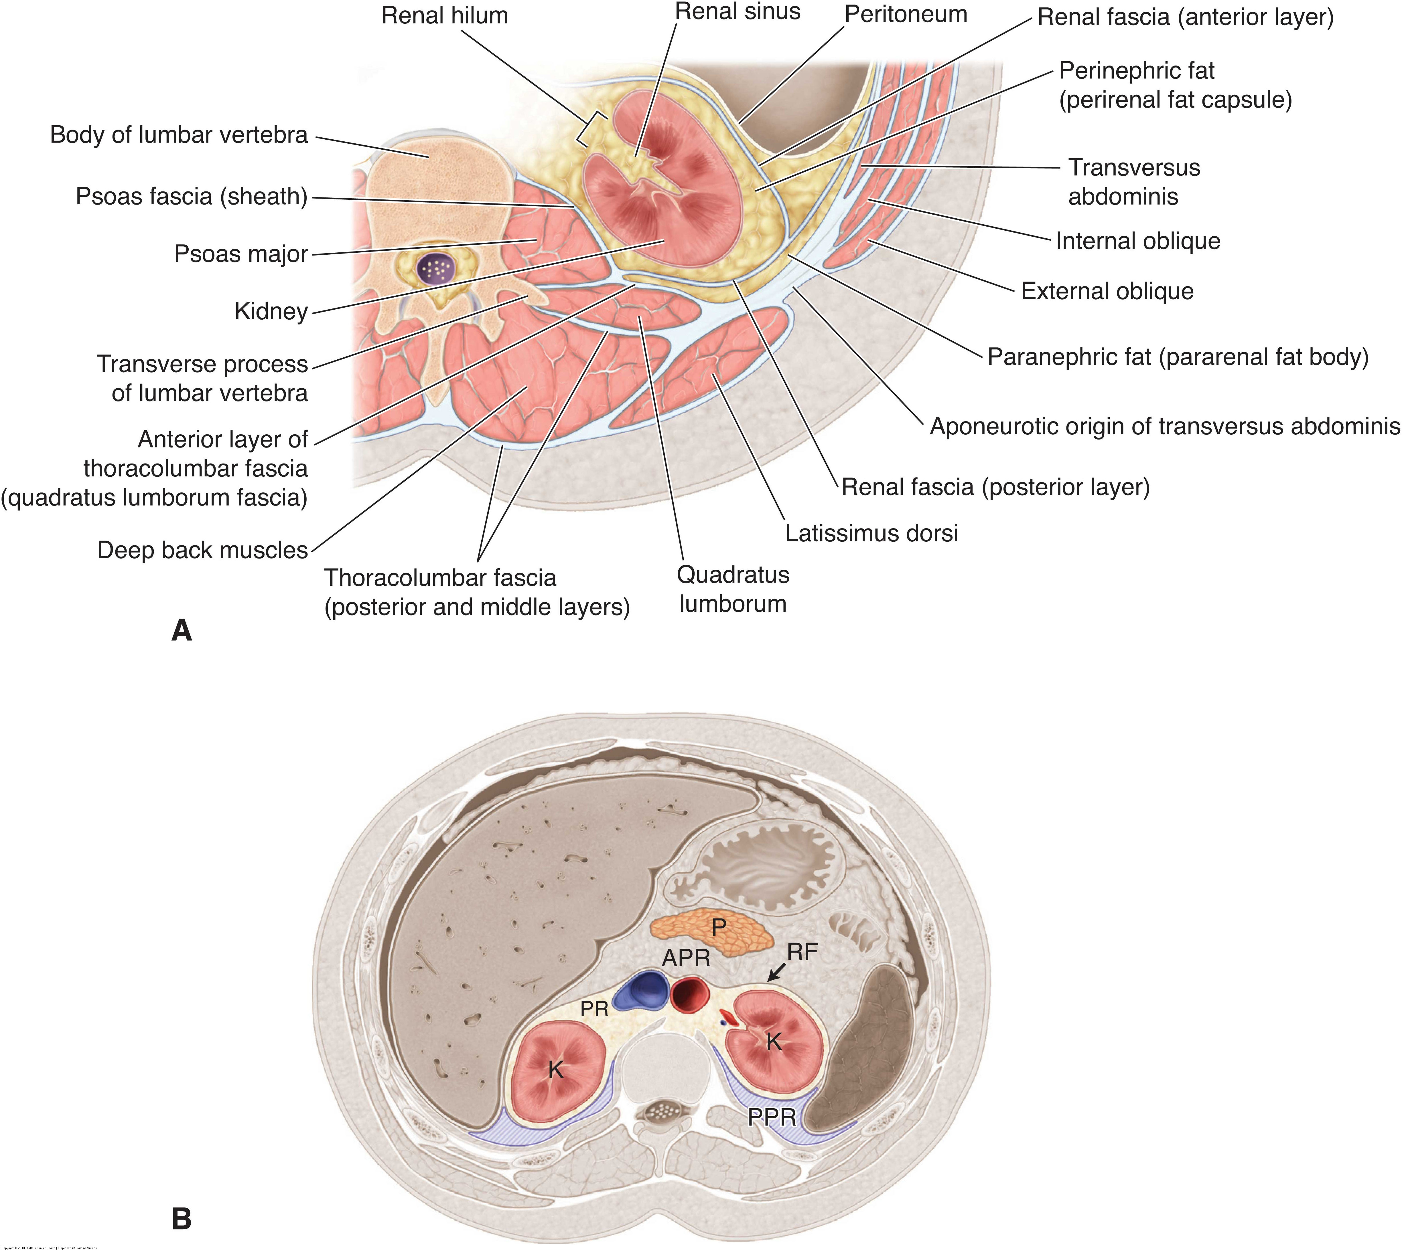
Notes:
The diagram up top is a transverse section through the renal hilum. Notice the anterior and posterior renal fascia surrounding the perirenal space. You can also see the psoas major and quadratus lumborum muscles located posterior and medial to the kidney. Also notice the transversus abdominis, internal oblique, and external oblique muscles that form the lateral abdominal wall.
The bottom diagram shows the 3 compartments that we talked about on the last slide. Notice the anterior pararenal space anterior to the anterior perirenal fascia. The pancreas head, neck, and body are contained within this compartment. Then you can see the perirenal space which includes the kidneys, perinephric fat, and prevertebral vessels. It also contains the adrenal glands, but they are not shown on this diagram. Then you can see the posterior pararenal space behind the posterior renal fascia.

Slide 4
Sonographic Evaluation of the Retroperitoneum
Can be scanned from an anterior, coronal, or posterior approach
Normal retroperitoneal lymph nodes are not visualized
Variable amount of fat is identified in the retroperitoneal compartments depending on the patient’s body fat composition
Typically more fat in the perirenal space than the other 2 compartments
Diaphragmatic crus can be seen as a hypoechoic linear structure anterior to the proximal aorta in the sagittal plane and obliquely between the aorta and IVC in the transverse epigastric plane
Quadratus lumborum and psoas muscles can be seen as hypoechoic structures with echogenic striations posterior and medial to the kidneys
Notes:
Kidneys, pancreas, aorta, IVC, and adrenal glands (in pediatrics) are frequently evaluated with sonography and have been covered in previous modules.
CT is the primary imaging modality used to evaluate the retroperitoneum, but sonography can definitely be useful.

Slide 5
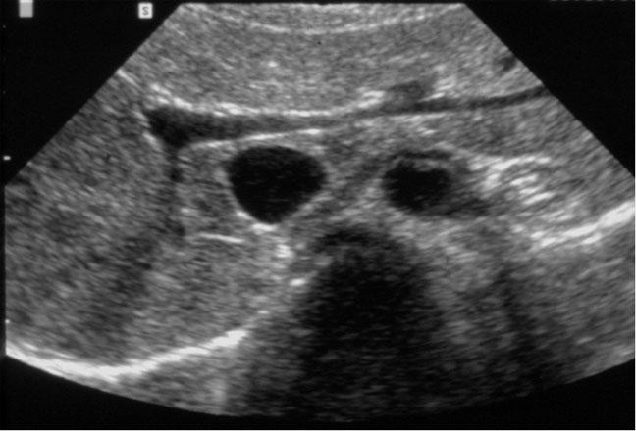
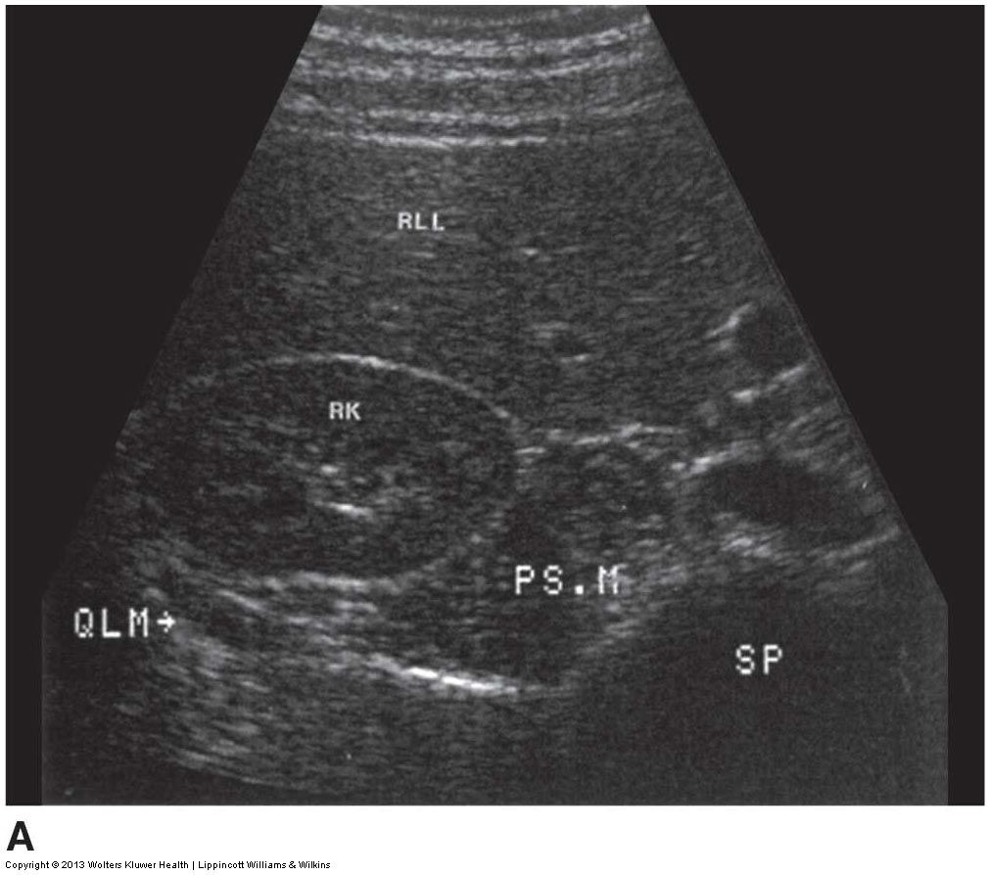
Notes:
The top 2 images show perinephric fat. The perirenal space contains more fat than the other retroperitoneal compartments. The left is a sagittal image of the right kidney and liver with echogenic fat seen surrounding the kidney. The right is a transverse image of the right kidney also displaying echogenic fat.
The bottom left and middle show the diaphragmatic crus. The left is a sagittal midline image showing the diaphragmatic crus as a hypoechoic linear structure anterior to the aorta. The middle is a transverse midline image showing the diaphragmatic crus running obliquely in between the aorta and IVC.
The bottom right image is a transverse view of the right kidney showing the normal quadratus lumborum and psoas muscles. The quadratus lumborum is located posterior to the kidney and the psoas muscle is located posterior and medial to the kidney.
The anatomic locations of the psoas muscle (PS.M) and quadratus lumborum muscle (QLM) to the right kidney (RK) can be identified on this transverse section through the right upper quadrant. These muscles could be mistaken for either renal mass if the contiguous renal capsule is not observed or a retroperitoneal mass without an understanding of surrounding anatomy.

Slide 6
Lymphatic System
Lymph – clear fluid similar in composition to blood plasma
Lymphatic vessels aka lymphatic ducts – thin vessels/ducts that accompany arteries and veins throughout the body and transport lymph
Lymphatic tissue – a specialized form of reticular connective tissue that is composed of masses of lymphocytes; can occur alone as lymph nodes or can be organized into various lymphatic organs
Lymphatic organs – lymph nodes, spleen, thymus, and red bone marrow
Lymph nodes – secondary lymphatic organs containing lymphocytes and macrophages surrounded by a matrix of dense connective tissue
Approximately 600 of these bean-shaped glands throughout the body along the lymphatic vessels
Main groups of lymph nodes include the axillary, cervical, and inguinal nodes
Retroperitoneal nodes include the lumbar, aortic, celiac, mesenteric, colic, and rectal nodes
Notes:
The lymphatic system consists of lymphatic vessels that circulate lymph, lymph nodes, the spleen, thymus, and red bone marrow.
Lymph is a clear fluid similar in composition to blood plasma
Lymphatic vessels are thin vessels that accompany arteries and veins throughout the body and transport lymph
Lymphatic tissue is a specialized form of reticular connective tissue that is composed of masses of lymphocytes. These either occur alone as lymph nodes or are organized into various lymphatic organs.
Lymphatic organs include the lymph nodes, which filter the fluid that flows through the lymphatic vessels, the spleen, thymus, and red bone marrow.
Lymph nodes are secondary lymphatic organs and contain lymphocytes and macrophages, which are surrounded by a matrix of dense connective tissue. Each lymph node filters the lymph fluid, phagocytizing foreign proteins and infectious debris, and generating and sending lymphocytes to infected tissues
Approximately 600 of these bean-shaped glands are distributed throughout the body along the lymphatic vessels. Large groups of lymph nodes are present in the axillary, cervical, and inguinal regions.
Abdominal lymph nodes interrupt the passage of some of the abdominal lymph vessels and include lumbar, aortic, celiac, mesenteric, colic, and rectal nodes.

Slide 7
Lymphatic System
Extends throughout the body with lymph vessels found immediately adjacent to normal arteries and veins
Acts as a fluid recovery system, collecting plasma fluid that oozes from the normal vascular capillaries into the extracellular space
Returns excess fluid to the bloodstream, maintaining fluid balance
Removes cellular debris and material
Sends lymphocytes to infected tissues to help fight infection
Lymph is thin, clear fluid that moves through lymphatic vessels toward the central part of the body, passing through lymph nodes along the way
Notes:
The lymphatic system extends throughout the body with lymph vessels found immediately adjacent to normal arteries and veins
It acts as a fluid recovery system, collecting plasma fluid that oozes from the normal vascular capillaries into the extracellular space
It maintains fluid balance by returning excess fluid to the bloodstream
It also removes cellular debris and material and sends lymphocytes to infected tissues to help fight infection
Lymph is thin, colorless or slightly yellow fluid that moves through lymphatic vessels toward the central part of the body, passing through lymph nodes along the way
It flows from the lymph capillary plexus toward the great vessels in the abdomen, eventually to the right and left subclavian veins in the thorax. Unlike the vascular system, the lymph vessels only carry lymph in one direction, from the vascular capillary level centrally in the body. The right lymphatic duct conducts lymph collected from the right head, neck, arm, and chest back into the venous system at the confluence of the right internal jugular and the right subclavian vein. The thoracic duct conducts lymph from the rest of the body back into the venous system at the confluence of the left internal jugular and left subclavian vein. The chyle cistern is a dilated collecting area found in the midreptroperitoneum collecting lymph from the lower extremities and pelvis before it ascends to the thoracic duct. The bottom diagram shows the right lymphatic duct emptying into the venous system at the confluence of the right IJV and subclavian vein and the thoracic duct emptying into the venous system at the confluence of the left IJV and subclavian vein. Also notice the chyle cistern midline in the retroperitoneum; the chyle cistern collects lymph from the lower extremities and pelvis. You can see from the diagram that it connects with the thoracic duct.
The top diagram just shows the inter-relationship between the lymphatic and vascular systems. Fluid that seeps out of the vascular capillaries enters into the lymphatic ducts, which are aka lymphatic vessels. The lymph fluid travels through the lymphatic ducts, passing through lymph nodes, and eventually makes its way up towards the central veins close to the heart.

Slide 8
Lymphadenopathy
Enlargement of the lymph nodes caused by inflammation, primary neoplasia, or metastases
Nodes affected by lymphadenitis typically maintain an ovoid shape, exhibit a fatty hilum, and demonstrate hyperemia with color Doppler
Nodes affected by lymphoma tend to appear hypoechoic to anechoic with loss of the fatty hilum and round in shape
Nodes affected by metastases tend to appear more echogenic and heterogeneous
Enlarged nodes may fuse together forming a lobulated mantle-like soft tissue mass anterior to the aorta and IVC
They may completely encase the great vessels moving them away from the vertebral column and may displace branch vessels from their normal position
Notes:
Enlargement of the lymph nodes is referred to as lymphadenopathy, or sometimes just adenopathy. It can be caused by inflammation (lymphadenitis), primary neoplasia (lymphoma), or metastases
Nodes affected by lymphadenitis typically maintain an ovoid shape, exhibit a fatty hilum, and demonstrate hyperemia with color Doppler
Nodes affected by lymphoma tend to appear hypoechoic to anechoic with loss of the fatty hilum and round in shape
Nodes affected by metastases tend to appear more echogenic and heterogeneous
Enlarged nodes may fuse together forming a lobulated mantle-like soft tissue mass anterior to the aorta and IVC
They may completely encase the great vessels moving them away from the vertebral column and may displace branch vessels from their normal position

Slide 9
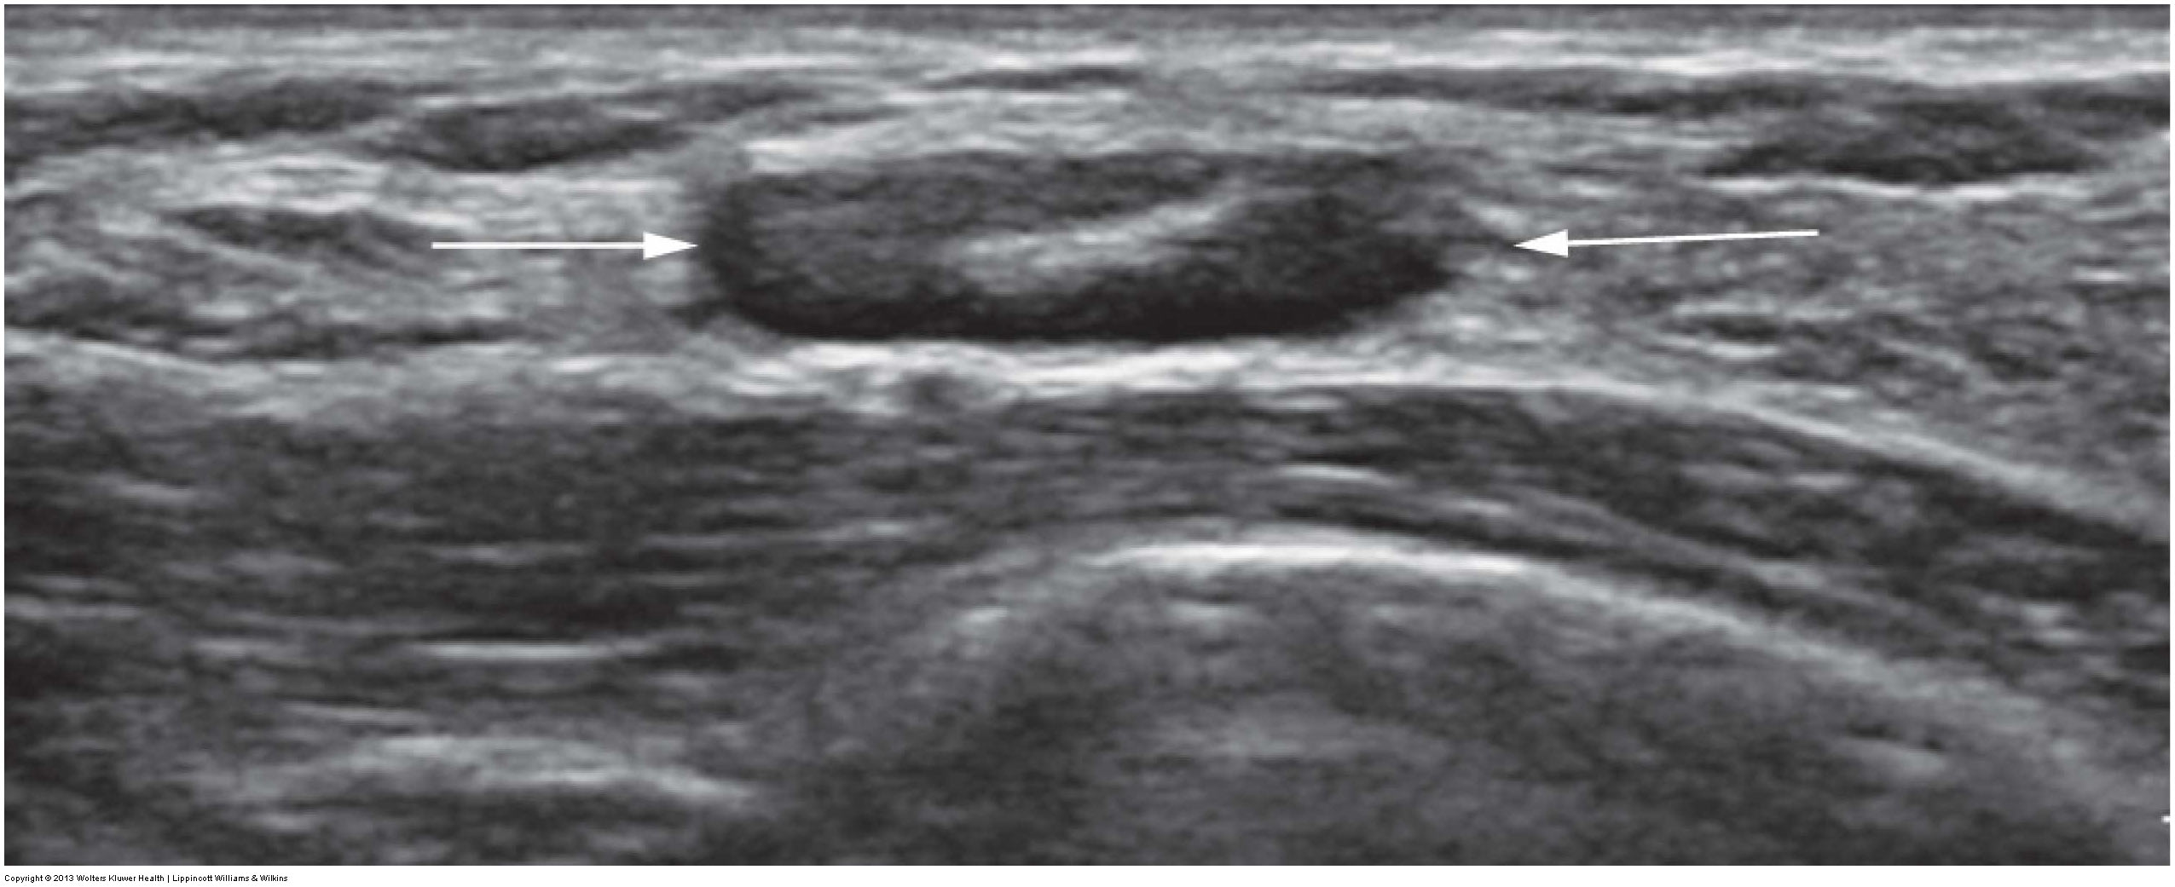
Notes:
Top left – Normal lymph node. The longitudinal image displays a normal ovoid-shaped hypoechoic lymph node. Note the echogenic central fatty hilum.
Top middle and right: Lymphadenitis. Longitudinal (middle) and transverse (right) images of an infected lymph node demonstrate hyperemia with power Doppler.
Middle and bottom left: Lymphadenopathy. Middle: Retroperitoneal lymph nodes (N) are seen surrounding the aorta (AO) and inferior vena cava (IVC). The lymph nodes are more rounded in shape and a normal fatty hilum is not seen. Bottom: Rounded lymph nodes (arrows) are seen at the splenic hilum. Visceral lymph nodes are located at the hilum of the spleen and liver and can be seen when enlarged.
Bottom middle and right: Midline adenopathy. Bottom middle: Longitudinal image of the abdomen demonstrates compression of the inferior vena cava (IVC; arrows) by lymphadenopathy seen anterior and posterior to the vessel. Bottom right: Transverse midline image demonstrates an echogenic mass encompassing and compressing the aorta (A) and IVC (I). The mass is consistent with lymphadenopathy.

Slide 10
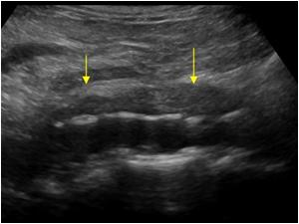
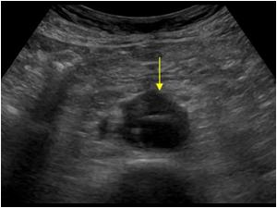
Retroperitoneal Fibrosis
Aka Ormond disease or chronic periaortitis
A chronic inflammatory process that results in fibrous tissue proliferation affecting and encasing the great vessels, ureters, and lymphatics of the retroperitoneum
Most cases are idiopathic
More common in middle-aged males
Ureters are frequently affected resulting in hydronephrosis
The posterior wall of the aorta is usually spared, with hypoechoic fibrotic tissue seen along the anterior and lateral walls
Notes:
Retroperitoneal fibrosis is aka Ormond disease or chronic periaortitis
It is a chronic inflammatory process that results in fibrous tissue proliferation affecting and encasing the great vessels, ureters, and lymphatics of the retroperitoneum
Most cases are idiopathic, thought by some to be autoimmune in nature. It affects middle-aged males twice as often as females.
The ureters are frequently affected resulting in either unilateral or bilateral hydronephrosis
The posterior wall of the aorta is usually spared, with hypoechoic fibrotic tissue seen along the anterior and lateral walls. This is extremely important when trying to distinguish the fibrotic material from atherosclerotic plaque.

Slide 11
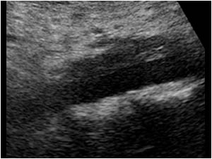
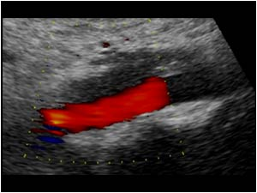
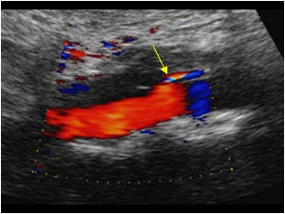
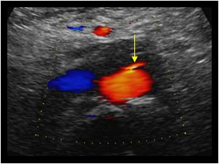
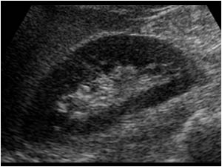
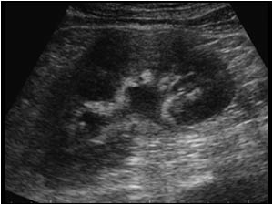
Notes:
This was another patient with retroperitoneal fibrosis. Notice the fibrotic mass anterior to the distal aorta and inferior mesenteric artery. On the transverse image, you can appreciate the tissue around the lateral aorta. The bottom two images show a normal right kidney and slight dilatation of the left renal collecting system. This is due to the left ureter being obstructed by the fibrotic tissue.
Again, notice that the back wall of the aorta was spared.

Slide 12
Primary Neoplasms
Malignant
Benign
Liposarcoma
Leiomyosarcoma
Rhabdomyosarcoma
Myxosarcoma
Fibrosarcoma
Lipoma
Leiomyoma
Rhabdomyoma
Myxoma
Fibroma
Notes:
Solid retroperitoneal tumors are rare. Primary malignancies include liposarcoma, leiomyosarcoma, rhabdomyosarcoma, myxosarcoma, and fibrosarcoma. Benign retroperitoneal tumors include lipoma, leiomyoma, rhavdomyoma, myxoma, and fibroma. These benign tumors are listed on the slide next to their malignant counterparts. Biopsy is required to distinguish these two masses from each other and also from metastatic lesions, lymphoma, and adrenal malignancies.
Malignant tumors tend to appear larger and more complex than their benign counterparts. They tend to demonstrate mass effect, compressing the IVC and other veins, ureters, and extrahepatic bile ducts
Clinical detection of retroperitoneal masses is often delayed due to their deep location, which often prevents them from being palpated until they have grown large enough to displace intraperitoneal contents.

Slide 13
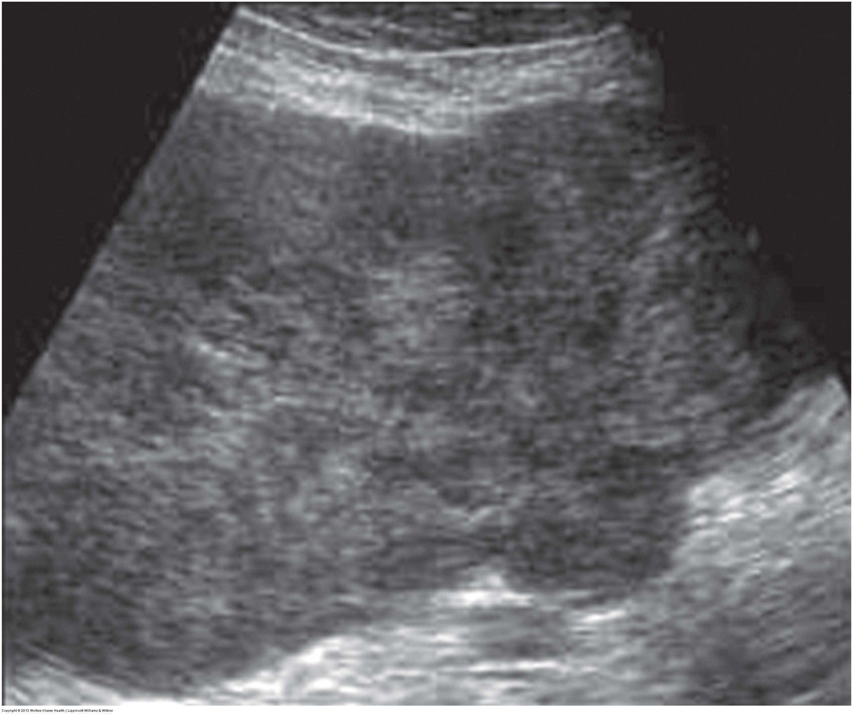
Malignant Primary Neoplasms
Liposarcoma
Leiomyosarcoma
The most common primary retroperitoneal malignancy
The 2nd most common primary retroperitoneal malignancy
Notes:
Liposarcoma is the most common primary retroperitoneal malignancy
It is slow-growing and affects middle-aged males more frequently than females
Sonographically, it appears as a poorly marginated, lobulated, complex mass that displaces adjacent anatomy rather than infiltrating it
It most commonly occur anterior to the spine and psoas muscles
The image on the left proved to be a liposarcoma on biopsy. Notice the large heterogeneous mass posterior to the right lobe of the liver. Just like with any other mass, you would attempt to determine its origin. In this case, it would not be connected to the liver, kidney, or adrenal gland and you would need to try to demonstrate that sonographically.
Leiomyosarcoma is the 2nd most common primary retroperitoneal malignancy
It typically affects middle-aged females
40% of patients demonstrate metastases by the time of diagnosis
Sonographically, it appears as a well-circumscribed, heterogeneous mass
The image on the right proved to be a leiomyosarcoma on biopsy. Again, notice the large size of the mass.
Masses as large as these can compress the ureters, which can lead to hydronephrosis and subsequent pyelonephritis and uremia.

Slide 14
Fluid Collections
Hematoma – bleeding can be the result of trauma, hemophilia, malignant invasion, surgery, or anticoagulant therapy
Patients present with sudden onset of flank pain
Variable appearance depending on the age of the bleed
Lymphocele – extravasated lymphatic fluid typically iatrogenically induced following node dissection or renal transplant
Typically small and resolve on their own
If large, may cause hydronephrosis or edema
Typically appear anechoic but may be complex
Urinoma – extravasated urine due to a tear of the urinary collecting system and continued renal function/urine production
May be caused by obstruction, trauma, surgery, or infection; obstructive causes are the most common
Patients present with fever, nausea, malaise, hematuria, and a compressible, tender mass
Typically appear as anechoic fluid confined to the perirenal space
Abscess – may develop as an extension from an adjacent organ or due to an existing fluid collection that has become infected
Patients present with elevated WBCs, malaise, and fever
Variable, nonspecific sonographic appearances
Notes:
It is impossible to differentiate the pathologic process of these fluid collections on the basis of sonography alone; you need to correlate sonographic findings with the patient’s clinical history.
Identifying the compartment in which the collection is localized may also help narrow the diagnostic possibilities.
A hematoma is a collection of blood. The bleeding can be the result of trauma, hemophilia, malignant invasion, surgery, or anticoagulant therapy.
Patients present with a sudden onset of flank pain
The sonographic appearance is variable depending on the age of the bleed
A lymphocele is a collection of lymphatic fluid that has extravasated out of the lymphatic vessels. It is typically iatrogenically induced following node dissection or renal transplant
They are typically small and resolve on their own
If large, they may cause hydronephrosis or edema
They typically appear anechoic but may be complex
A urinoma is a collection of extravasated urine due to a tear of the urinary collecting system and continued renal function/urine production
It may be caused by obstruction, trauma, surgery, or infection, but obstructive causes are the most common
Patients present with fever, nausea, malaise, hematuria, and a compressible, tender mass
They typically appear as anechoic fluid confined to the perirenal space
An abscess is a collection of ischemic tissue and pus. It may develop as an extension from an adjacent organ or due to an existing fluid collection that has become infected.
Patients present with elevated WBCs, malaise, and fever
Abscesses have variable, nonspecific sonographic appearances

Slide 15
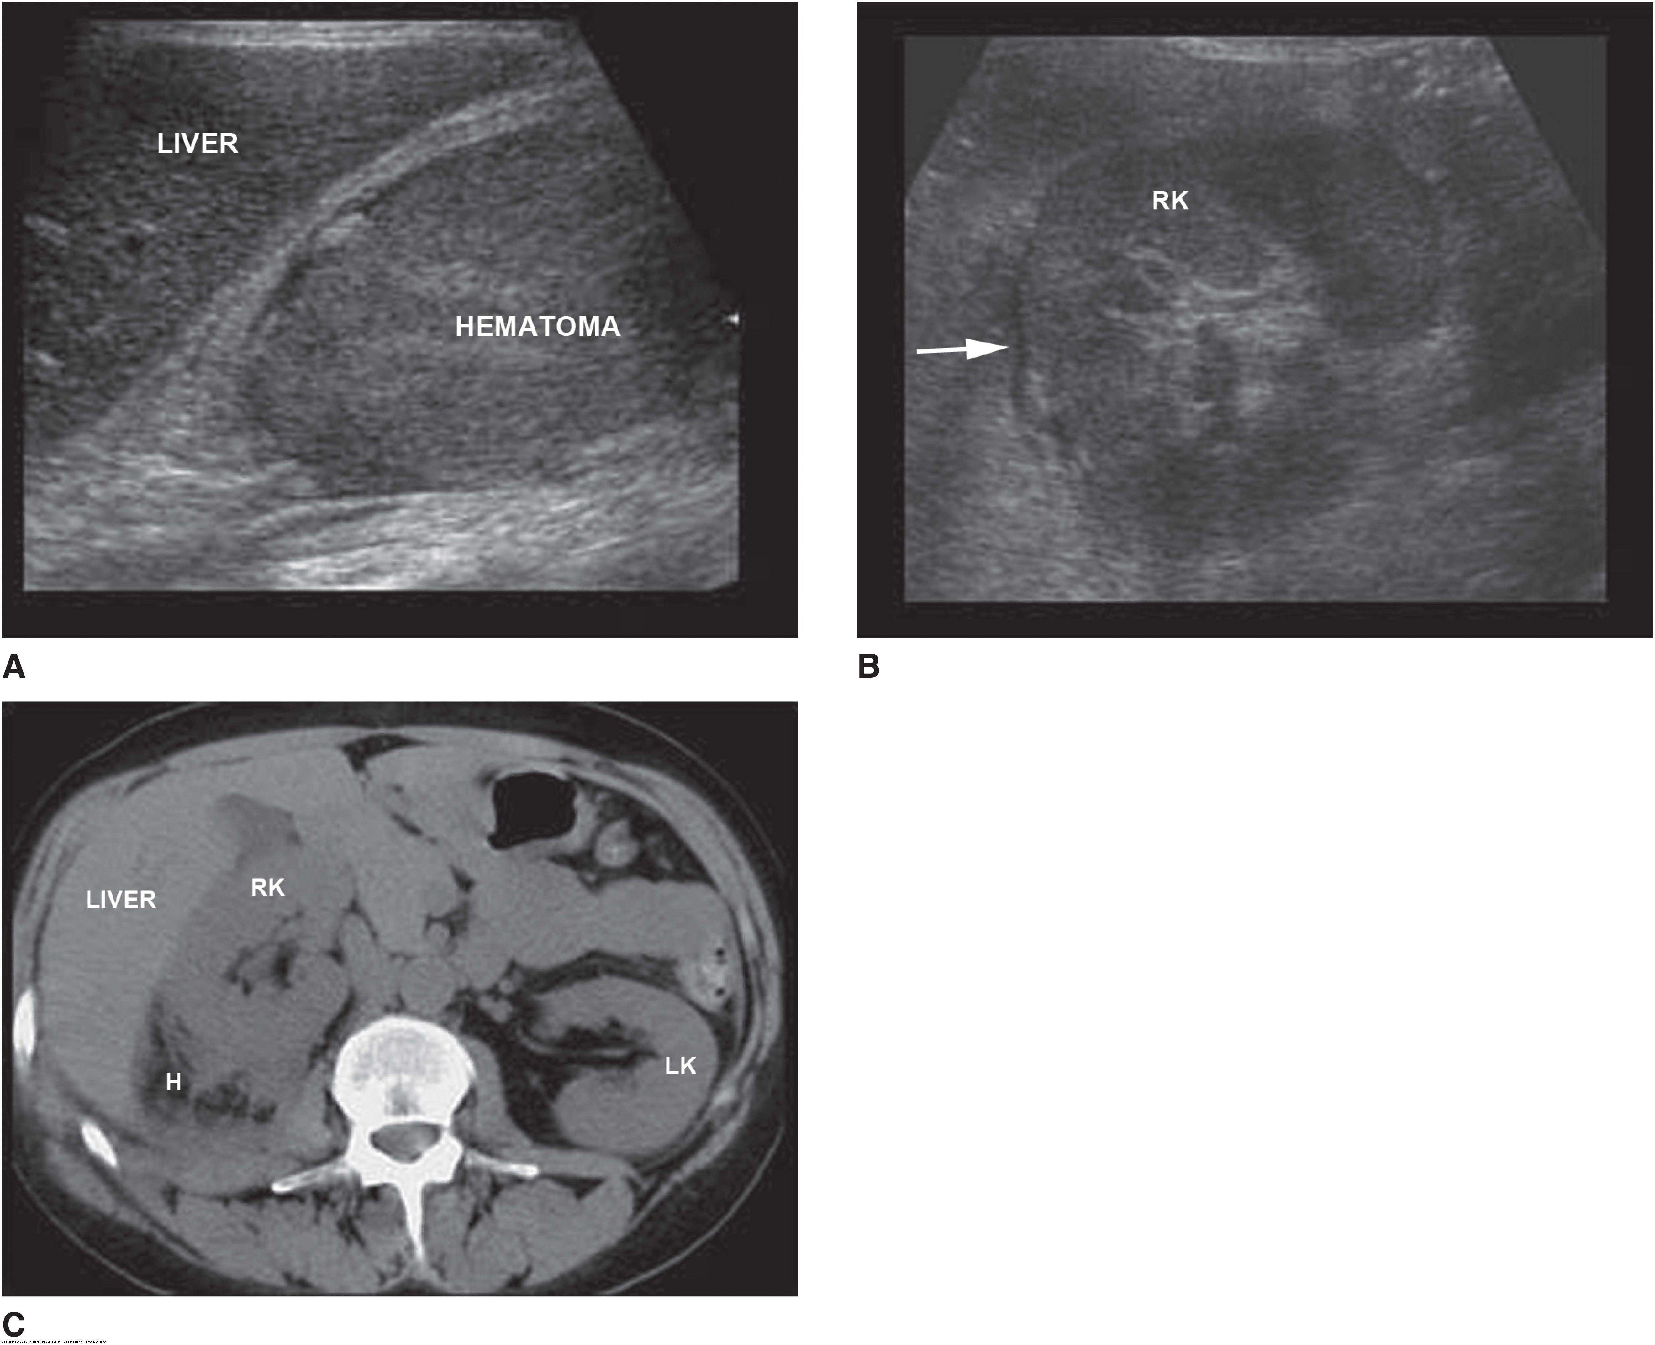
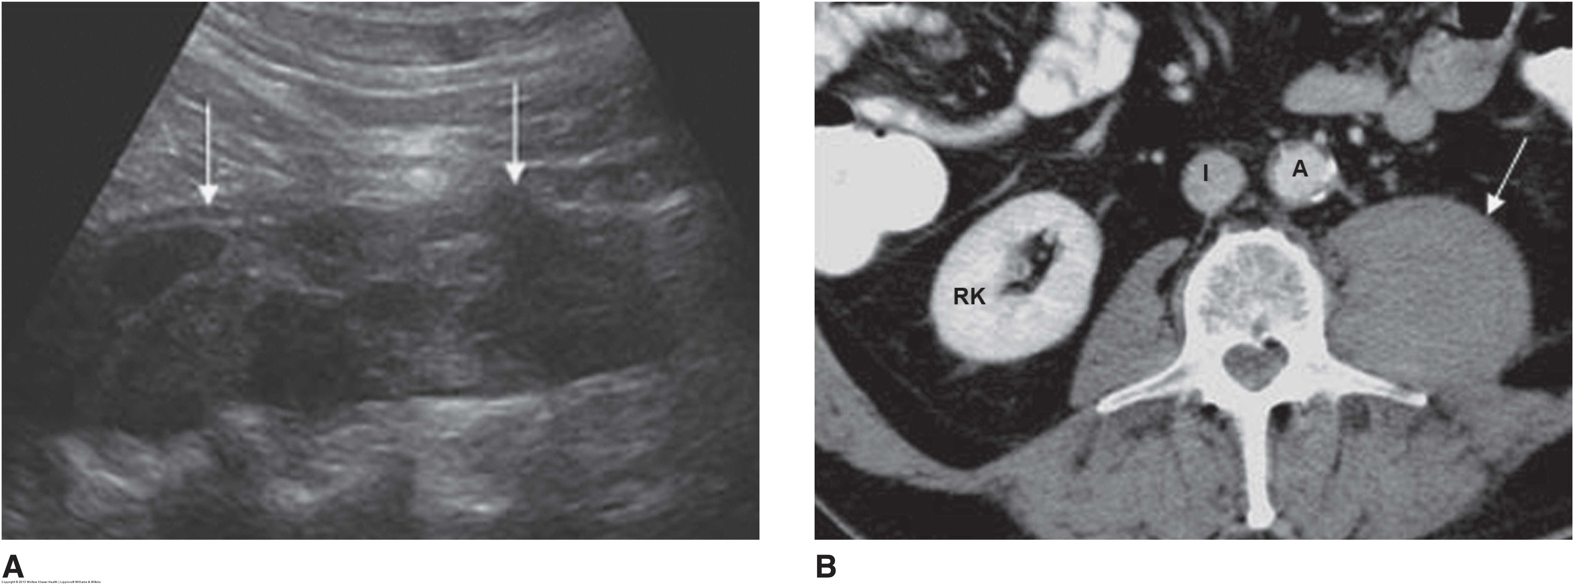
Notes:
Top - Perirenal hematoma. Patient with blunt abdominal trauma presents for an abdominal sonogram. A: Longitudinal image of the right upper quadrant demonstrates a large homogeneous mass consistent with a hematoma in the right renal fossa. B: Transverse image of the right kidney (RK) demonstrates a small amount of free fluid around the kidney (arrow). The right kidney was displaced anteriorly by the large hematoma. C: Computed tomography scan of the same patient demonstrates the right kidney (RK) displaced anteriorly with the hematoma (H) posterior to the kidney. LK, left kidney.
Bottom - Psoas muscle hematoma. A: Longitudinal image of the left retroperitoneum demonstrates an ovoid complex mass (arrows) consistent with a psoas muscle hematoma. B: Computed tomography scan of the same patient demonstrates a left-sided mass (arrow) adjacent to the spine. The mass was diagnosed as a psoas muscle hematoma. A, aorta; I, inferior vena cava; RK, right kidney.

Slide 16
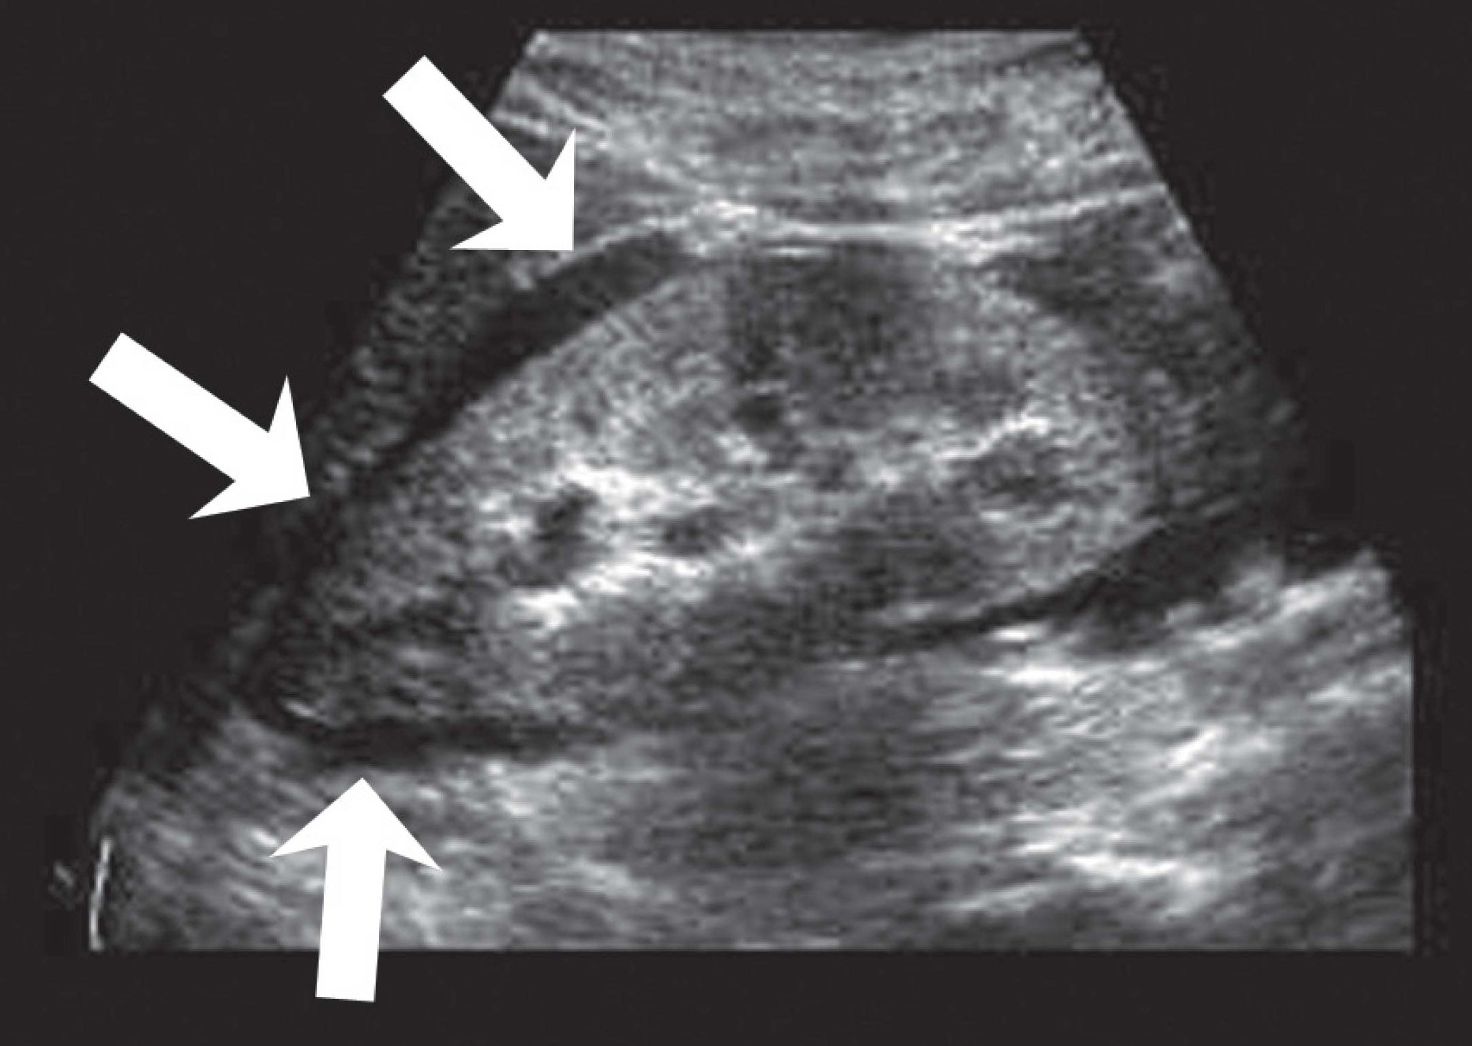
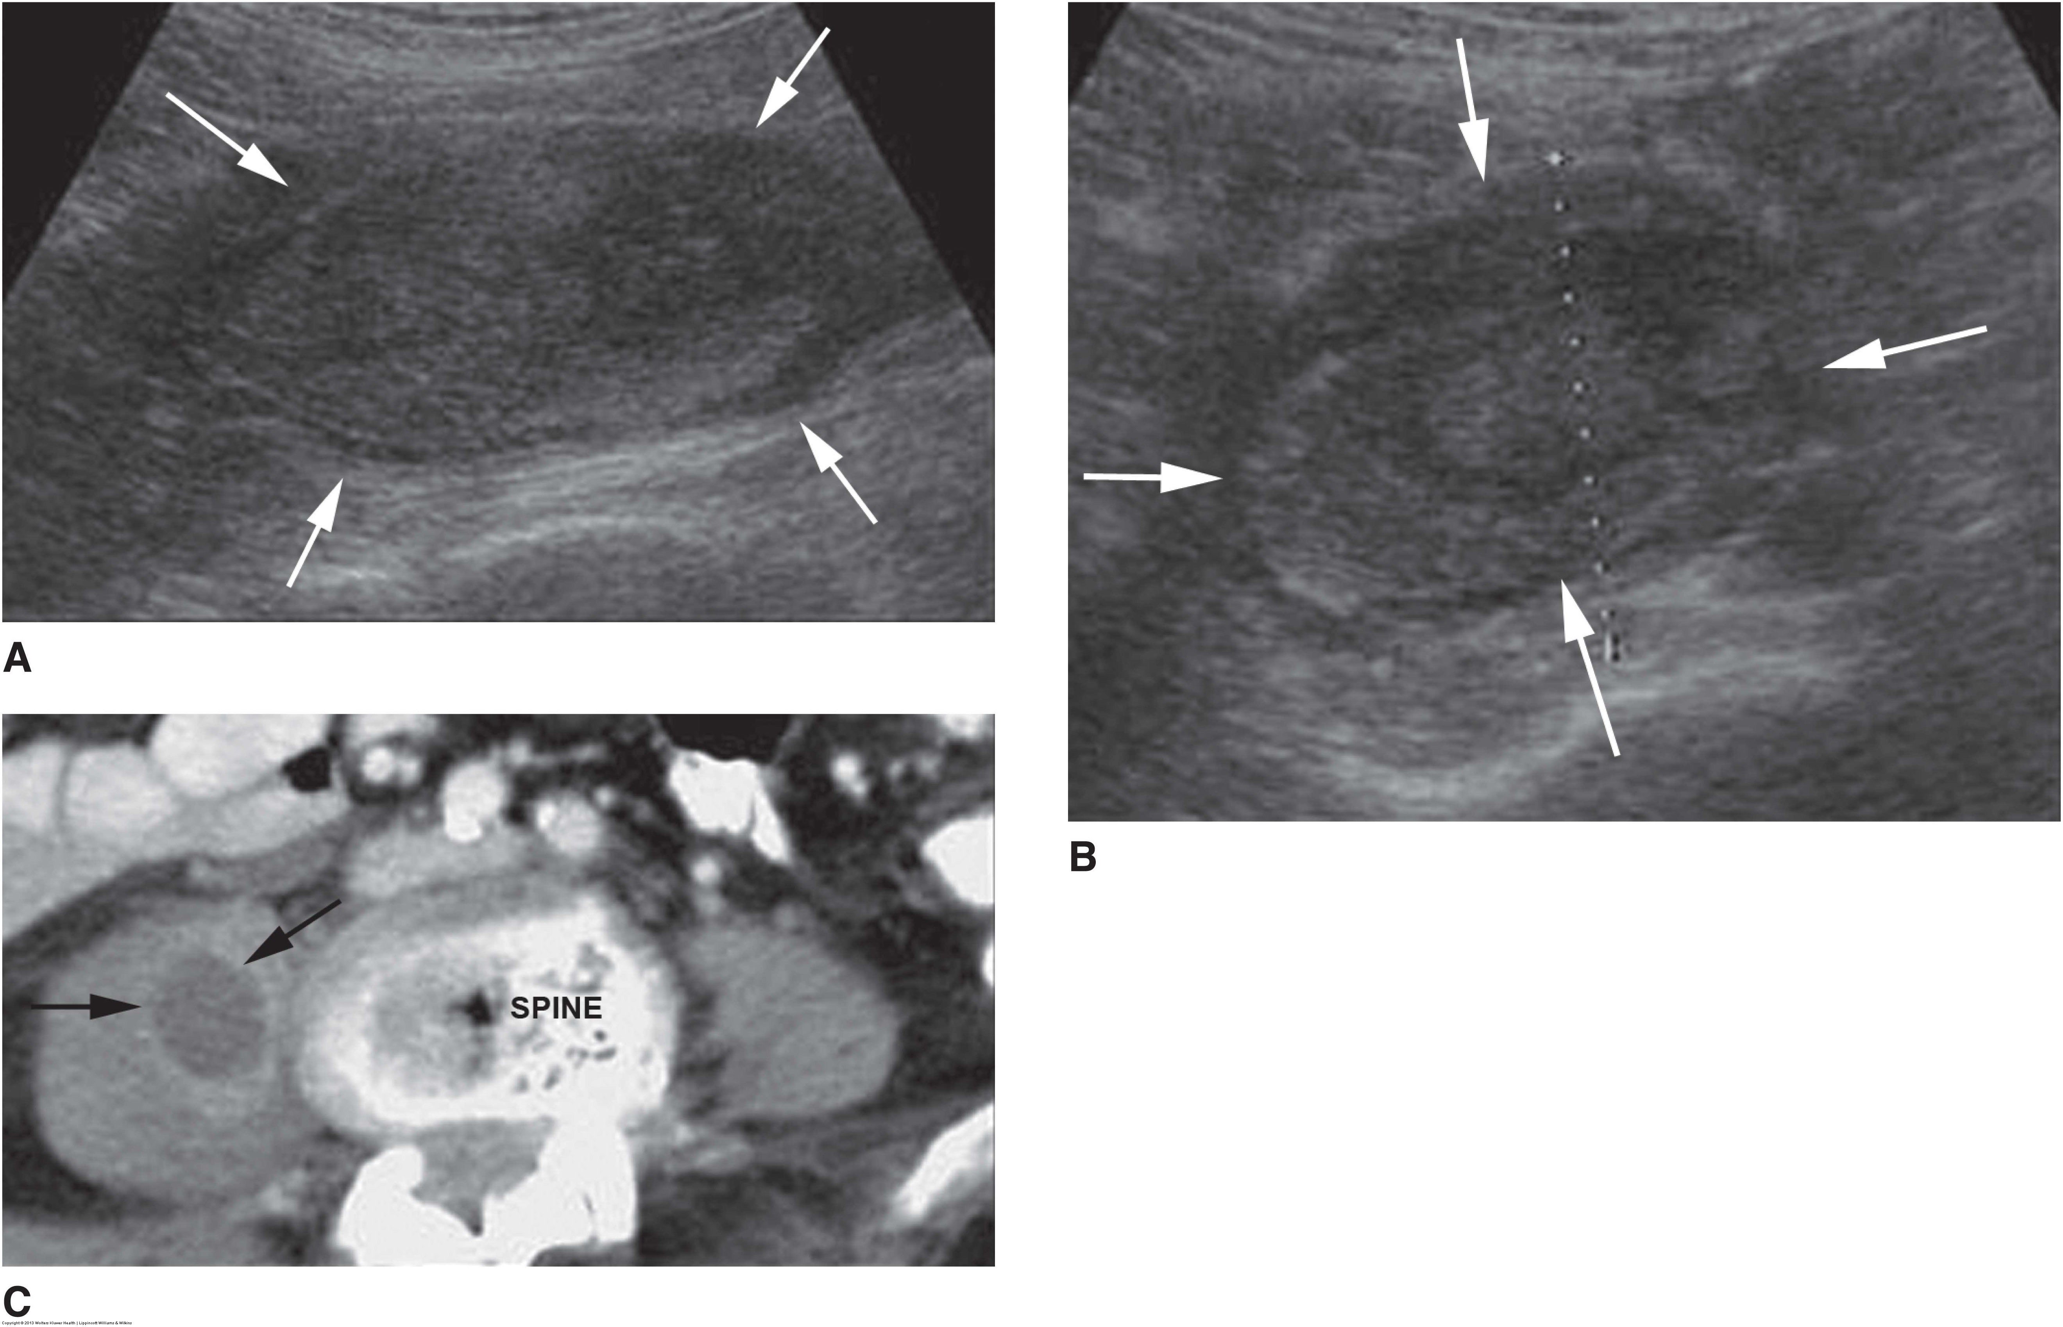
Notes:
Top left - Urinoma. Longitudinal image of the kidney demonstrates an anechoic fluid collection (arrows) surrounding the kidney. The fluid collection was diagnosed as a urinoma.
Bottom right - Psoas muscle abscess. Longitudinal (A) and transverse (B) images of the right retroperitoneum demonstrate a large hypoechoic mass (arrows) in the region of the psoas muscle. C: Computed tomography of the same patient demonstrates an abscess of the right psoas muscle.

