Slide 1
Pancreas Class Activity

Slide 2
Pancreas
Head, Neck, Body, and Tail
Duct of Wirsung , Ampulla of Vater, CBD
Duct of Santorini
Exocrine, enzymes, ducts
Endocrine, hormones, bloodstream
Amylase and Lipase
Glucose
Notes:
Endocrine hormones: Insulin and Glucagon
Increased glucose = DM, liver disease, or overactive endocrine gland
Decreased glucose = pancreatic tumors of islet cells

Slide 3
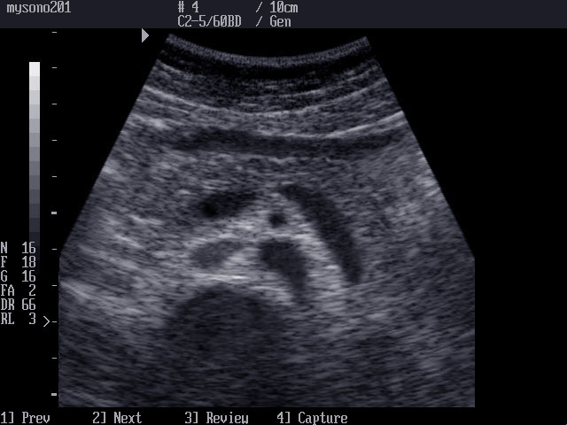
Pancreas
Notes:
216 & 220
Identify:-
Head, neck, and body in transverse and longitudinal views
SMA-posterior to body and splenic vein, anterior aorta
SMV-posterior to the pancreatic neck
Splenic Vein-posterior to the tail
IVC-right of the aorta
CBD-posterior and lateral in the pancreatic head
GDA-anterior and lateral in the pancreatic head
Left Renal vein-from the IVC between the aorta and SMA
Stomach-Superior to the body
Pancreatic duct-courses the length of the pancreas

Slide 4
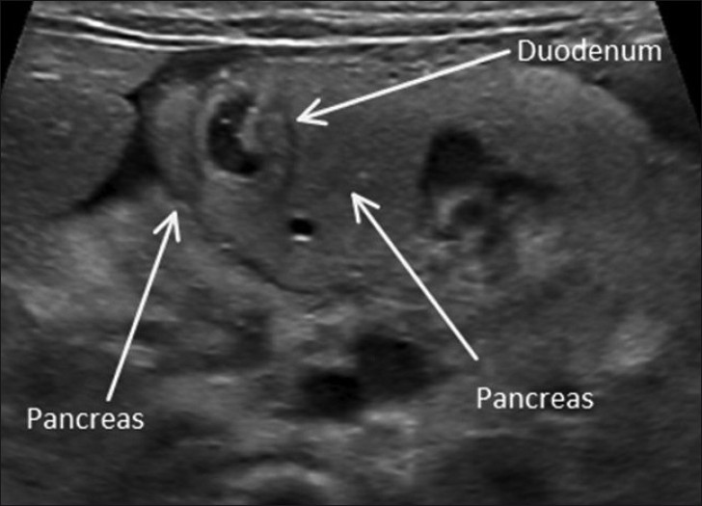
Annular Pancreas
Notes:
Page 224

Slide 5
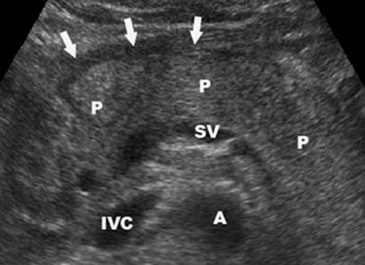
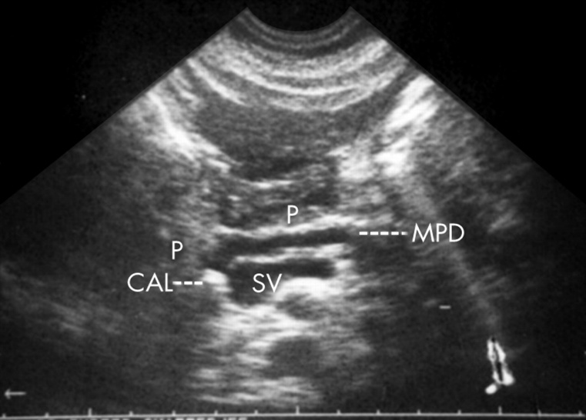
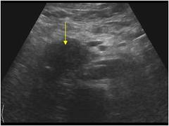
Acute Pancreatitis
Patient presents with:
Moderate to severe epigastric tenderness-constant
Fever& Distended abdomen
Increased Amylase and Lipase

Slide 6
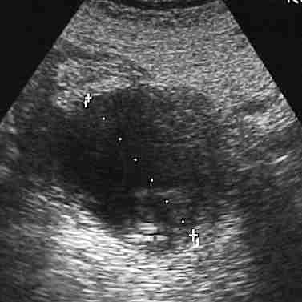
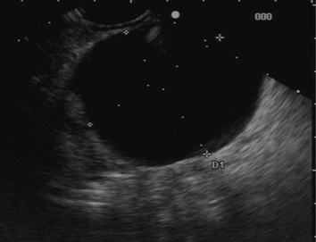
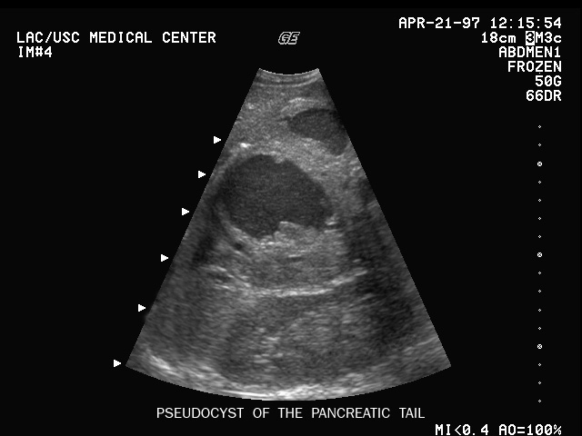
Pseudocyst
A
Anechoic, complex, or loculated round or oval mass
C
B
Notes:
Page 232-233

Slide 7
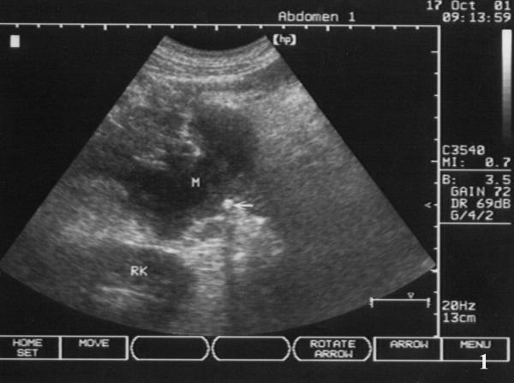
Abscess
Clinically presents with:
Sonographic Findings
Fever
Increased WBC
Chills
Tender abdomen
Irregular thick walls
Anechoic and hypoechoic complex mass
Notes:
Page 235-236

Slide 8
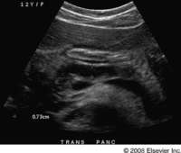
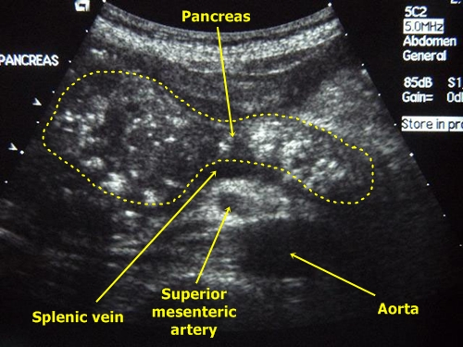
Chronic Pancreatitis
B
Ultrasound: Diffuse or localized
Increased echogenicity
Irregular borders
Dilated duct
Ductal stone
A
C
Notes:
Page 237 images 238

Slide 9
Acute Pancreatitis
18 years old female with abrupt onset of intense epigastric pain in morning, continuing throughout day. On admission to emergency service ultrasound of the abdomen was immediately ordered. Free fluid was seen in the pouch of Morrison and in the paracolic gutters

Slide 10
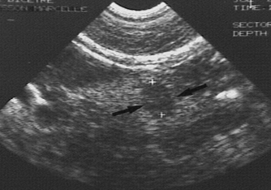
Insulinomas
Clinically
Sonographic Features
Obese
Hypoglycemia
50 year old female
Solid homogenous mass with well defined walls
Located in the body of the pancreas
Notes:
Page 254

Slide 11
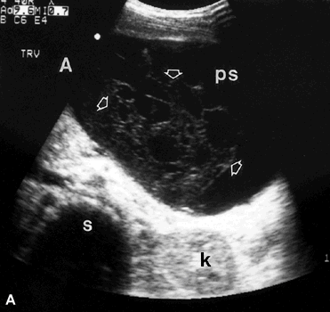
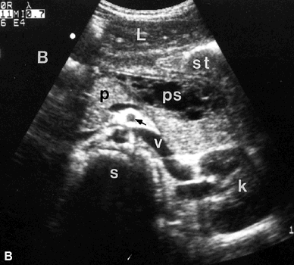

Slide 12
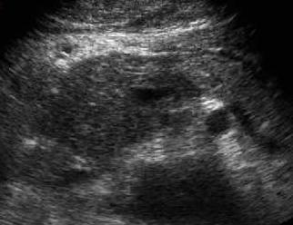
Case Study
A 30 year old man presented with a history of a one day non-radiating pain in the epigastrium and nausea. He has a history of significant alcohol consumption.

Slide 13
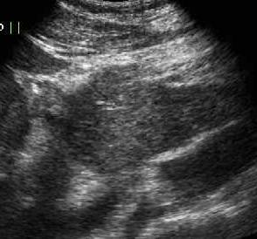
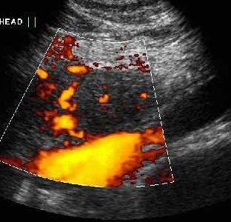
HMMMMM… What could this be….????
Sagittal view of the pancreas.
Power Doppler study of the pancreas.

Slide 14
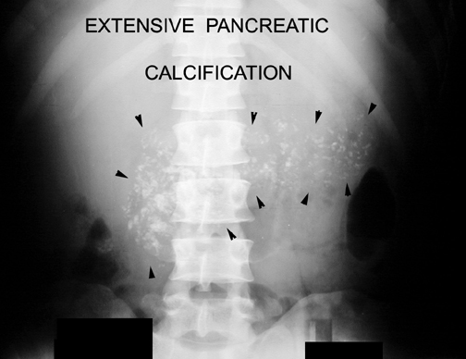
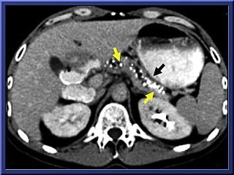
Chronic Pancreatitis
http://www.healthcentral.com/peds/fullsize/1157.jpg

Slide 15
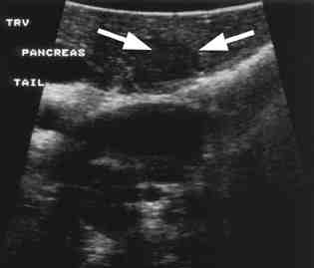
Functional Islet Cell Tumor
http://www.imagingeconomics.com/library/200309-03/200309-03-01.jpg

Slide 16
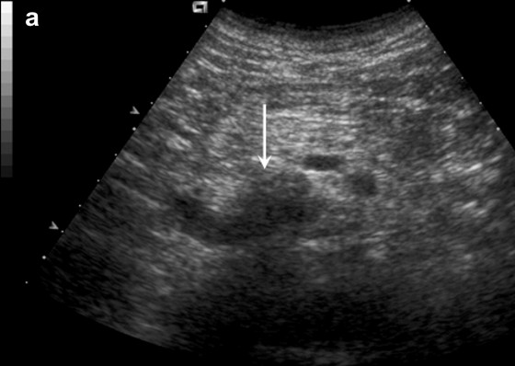
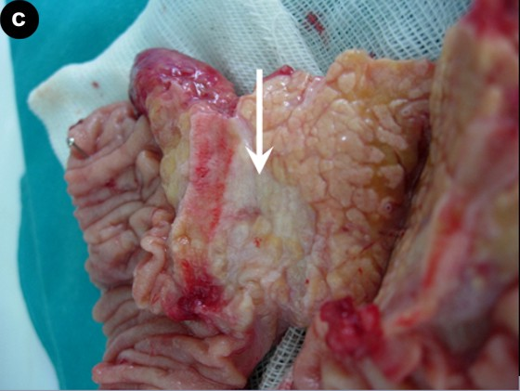
Adenocarcinoma

