Slide 1
The Spleen

Slide 2
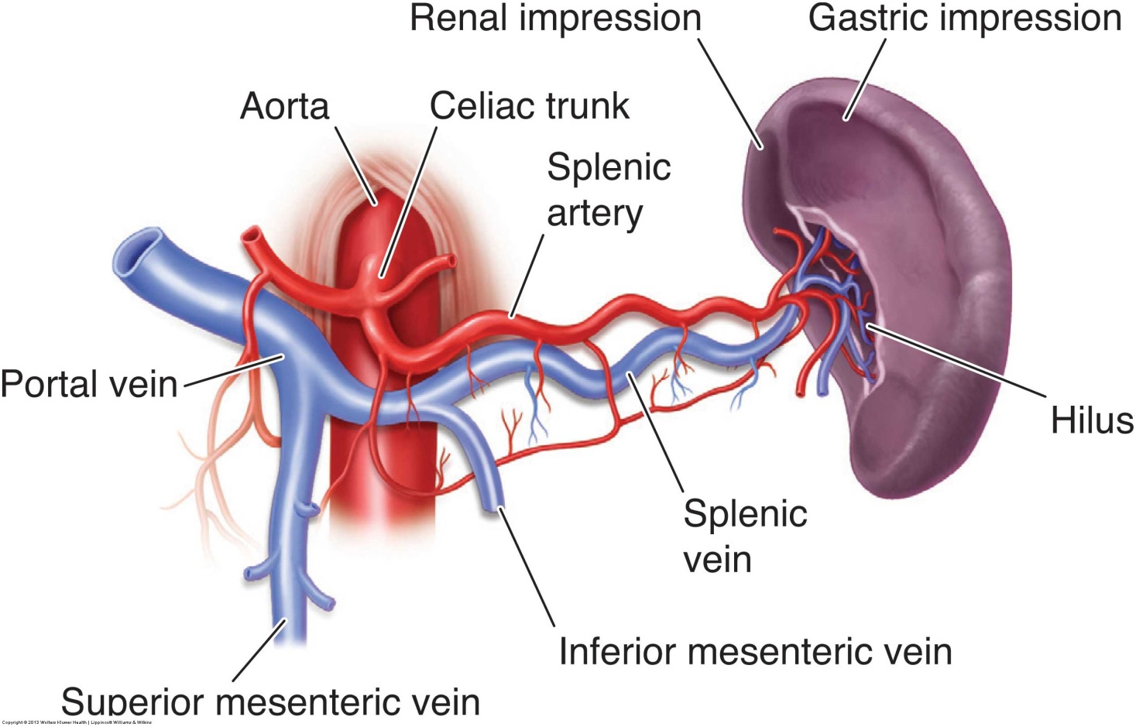
Splenic Circulation

Slide 3
Key Terms
Erythrocyte – RBC; contains hemoglobin and is responsible for transporting oxygen
Erythropoiesis – process of RBC production; occurs in the fetal spleen from the 5th to 6th month of fetal life after which the bone marrow assumes the function
Hematocrit – lab value of the % of blood volume made up of RBCs; can be low in cases of anemia, blood loss, and leukemia
Infarct – tissue death caused by an interruption of the blood supply

Slide 4
Key Terms
Leukocyte – WBC; its main function is to protect against and fight infection in the body
Leukocytosis – elevated WBC count usually due to infection
Leukopenia – decreased WBC count; can be a result of many factors including viral infection and leukemia
Phagocytosis – process used by the red pulp to destroy old RBCs

Slide 5
What structure is the arrow pointing to in this image? What is the significance of this structure?

Slide 6
A 10 year old girl presents for a sonogram of the spleen following a bicycle accident. Describe what is seen in this sagittal image of the spleen. What is the most likely diagnosis? What other areas in the abdomen will you evaluate based on these finding? Which lab value may be associated with this finding?

Slide 7
A 12 year old patient with a history of sickle cell disease present in a sickle cell crisis with severe LUQ pain. Describe what is seen in this image of the spleen. What is the most likely diagnosis?

Slide 8
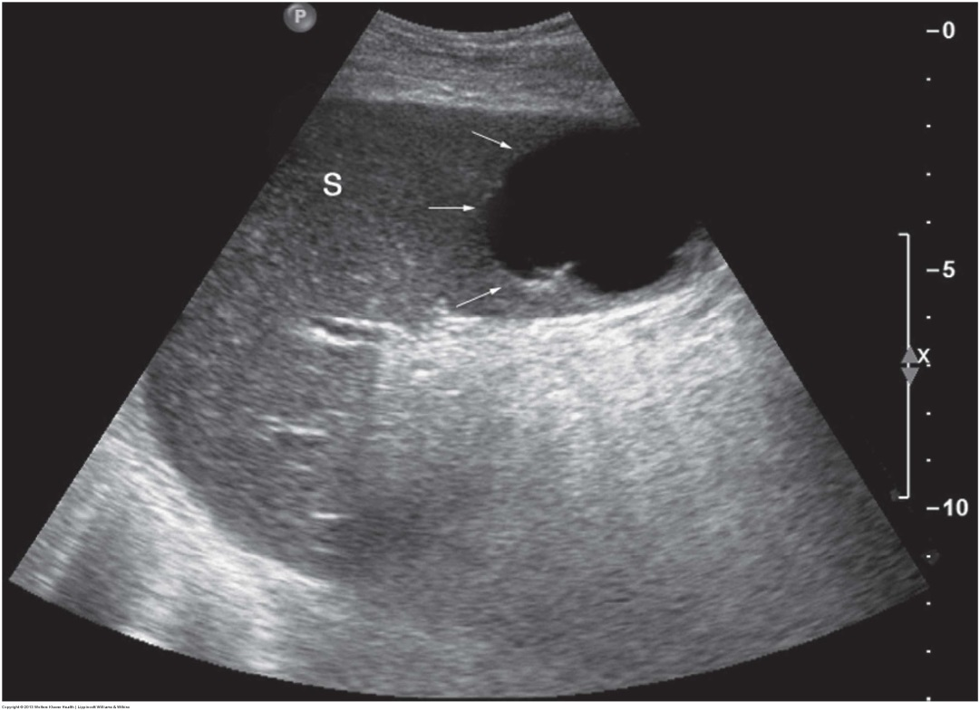
Describe what is seen in this image of the spleen. List 3 of the most common causes of this splenic pathology.

Slide 9
A 47 year old man presents for an abdominal sonogram with a history of chronic alcohol abuse and cirrhosis. What pathology is seen in this image of the spleen? What is the normal measurement of the spleen? Why does the spleen enlarge in cases of cirrhosis? You are asked to evaluate the splenic hilum with color Doppler. What are you looking for?

Slide 10
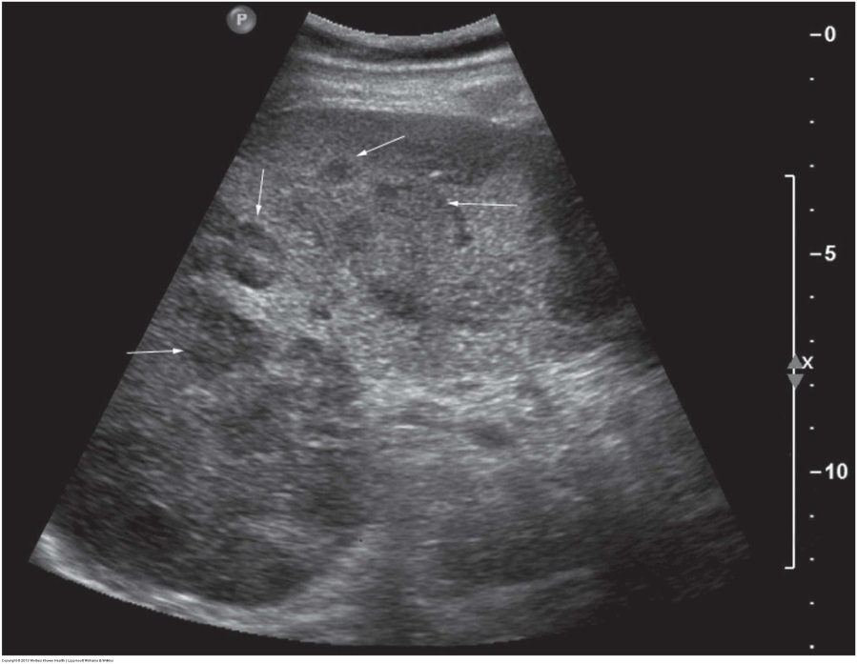
A 56 year old woman presents with a history of pancreatic cancer. Describe what is seen in this image of the spleen. What is the most likely diagnosis? What other pathology may cause multiple target or hypoechoic lesions in the spleen?

