Slide 1
The Urinary System
Class Activity

Slide 2
Renal Anatomy

Slide 3
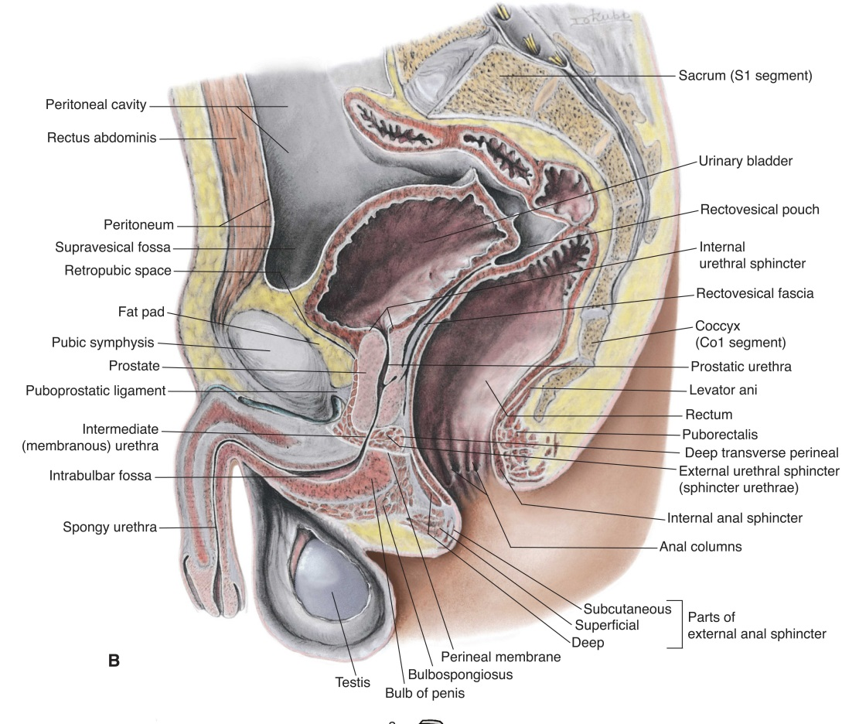
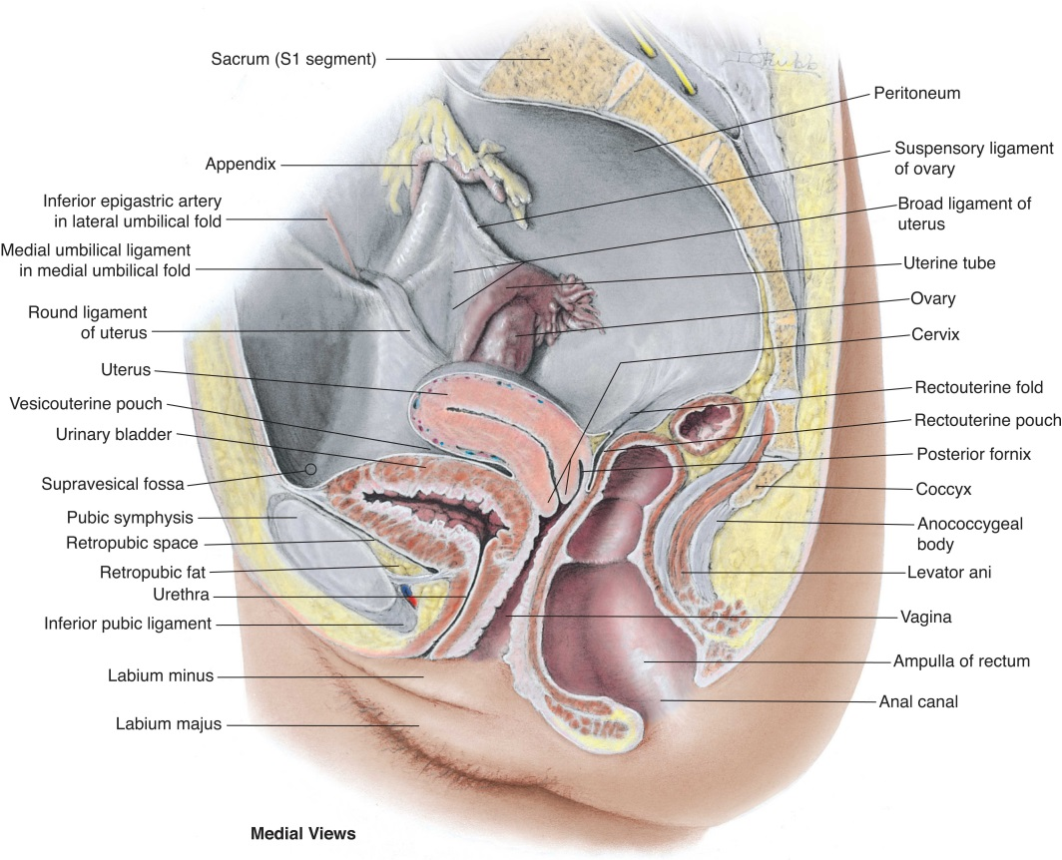
Male and Female Pelvis

Slide 4
Embryology
During embryological development, three pairs of kidneys are formed at successive intervals: the _____________, the _______________, and the _________________ and _______________ ducts.
In the male, the _______________ duct persists and develops into the male _____________, the ______________ ______________, and the ejaculatory duct.
In the female, the mesonephric duct develops into the _____________ duct, which develops into the ____________ and _______________.

Slide 5
Anatomy
The urinary system is made up of two ____________, two _____________, the _____________ _____________, and the ______________.
The kidneys are located in the _______________ cavity.
At the renal hilus, the renal ______________ and renal ____________, ______________, nerves, and the ____________ enter or exit the kidney.
The kidney is surrounded by three layers of supportive tissues: the innermost fibrous ____________ _____________, which protects against _____________ and _____________; the middle layer, called the ____________ capsule; and the outermost layer, called ______________ fascia.

Slide 6
Anatomy
The right kidney is located _____________ than the left due to the presence of the _____________.
The length of the kidneys should be within _______ cm of each other.
The calyces collect urine and join together to empty into the ___________ ___________, which is continuous with the _____________ _____________.
The renal arteries arise from the lateral aspects of the ___________ just inferior to the ____________. The ___________ renal artery is longer than the _____________ and passes _______________ to the IVC.
The renal veins exit the ___________ ___________ and empty into the lateral aspects of the ____________. The __________ renal vein crosses _____________ to the aorta and ___________ to the SMA before entering the ___________.

Slide 7
Anatomy
The lower urinary tract consists of the ____________, ___________, and _____________.
On transverse sections, the shape of the bladder anteriorly is ____________, whereas more posteriorly, the shape is _____________. On sagittal sections, the bladder shape is more ______________.
The ___________ is located on the floor of the bladder and contains __________ openings for the ________ _________ and the __________. Color Doppler of the __________ can be used to visualize ___________ ____________.
If the ureters are dilated, they can be visualized as round structures _____________ to the urinary bladder in the _____________ plane.

Slide 8
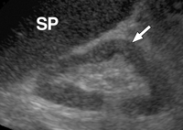
Anatomic Variants
Dromedary hump
Hypertrophied column of Bertin
Extrarenal pelvis
Junctional cortical defect
Renal sinus lipomatosis

Slide 9
Congenital Anomalies
Renal
Bladder
Hypoplasia
Unilateral agenesis
Bilateral agenesis
Duplicated collecting system
Ectopic kidney
Horseshoe kidney
Duplication
Agenesis
Exstrophy
Diverticula
Ectopic ureter
Ureterocele
Posterior urethral valve

Slide 10
Anatomy/ Sonographic Appearance
The renal ___________ extends from the renal capsule to the bases of the renal _____________ and the spaces between them. The renal or ____________ pyramids are visualized sonographically as hypoechoic, triangular structures deep to the _____________.
In a normal adult, the renal cortex is _____________ to the liver or ___________ parenchyma. In neonates, the renal cortex is ____________ or _____________ to the liver parenchyma.
The cortex in an adult should measure greater than _________ in thickness over the pyramids.

Slide 11
Physiology
The main function of the kidneys is to remove ____________ from the _______________ and regulate the _______________ and _____________ content of the blood.
The nephron functions to control blood ___________ and __________ by removing selected amounts of water and solutes, helping to regulate blood __________, and removing _________ ____________ from the blood.
____________, ______________, and _________ __________ are used to evaluate renal function along with the urinalysis, which can detect the presence of __________, ___________, ___________, and _____________.

Slide 12
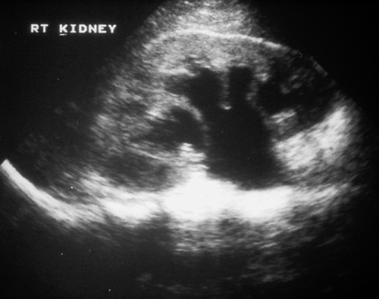
Hydronephrosis
Hydronephrosis is a ____________ of the renal ___________ and ___________ caused by _________ _________.
Hydronephrosis makes kidneys susceptible to ___________, ___________ __________, and ___________.
Hydronephrosis commonly occurs in ___________ patients, is more common on the ___________ side, and resolves after _____________.

Slide 13
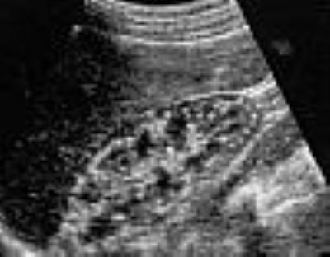
Lithiasis
Causes
Clinical symptoms
Sonographic appearance
Nephrolithiasis
Urolithiasis
Bladder calculi
Nephrocalcinosis
Cortical
Medullary

Slide 14
Infections
Upper urinary tract infections are usually the result of spread of _________ along the __________ from a __________ infection.
Acute, chronic, emphysematous, and xanthogranulomatous pyelonephritis
Fungal infections
Schistosomiasis
Tuberculosis
Malakoplakia
Cystitis

