Slide 1
Adult urinary system and adrenal gland pathologies

Slide 2
What pathology is seen in these images? At what age does this pathology typically present? What complications may be seen with this disease?

Slide 3
What condition is seen in these images? Describe the kidney seen in the images. Is this condition typically seen unilaterally or bilaterally? Are there any associated complications?

Slide 4
Describe the mass defined by the arrows. What is the most likely diagnosis? What disorder is associated with multiple masses of this type?

Slide 5
Describe the lesion shown in this image. What are some possible diagnoses? What further testing could be done to confirm the diagnosis?

Slide 6
What pathology is the arrow pointing to? What symptoms are commonly associated with this pathology? How could color Doppler help with this pathology?

Slide 7
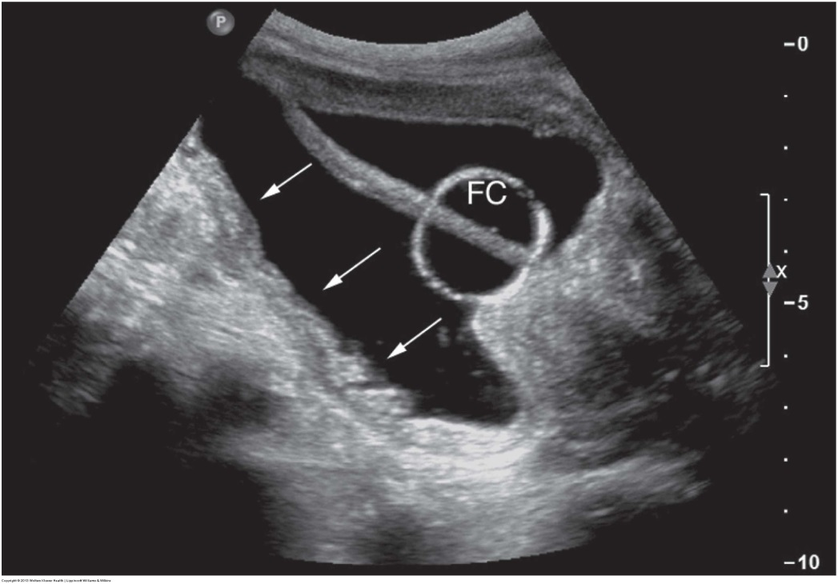
What structure is seen within the urinary bladder in these images? Are these normal images? Why or why not?

Slide 8
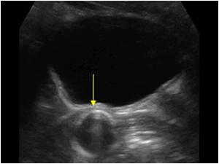
Where is the Foley?
Notes:
In the vaginal canal.
I have also seen them in prostate glands. Take note of whether or not your patient has a foley bag on their bed…. If they do, you should see the bulb within the bladder.

Slide 9
What are the arrows pointing to? Does this structure appear normal? What can cause thickening of the bladder wall?

Slide 10
What is the arrow pointing to in these images? List two predisposing factors for this pathology. What complications may occur?

Slide 11
Describe what is seen in this image. What is the likely diagnosis? What could mimic this pathology?

Slide 12
A 42 year old man presents with severe right flank pain and hematuria. He has a history of bilateral kidney stones. What is seen in this image of the right kidney? If a kidney stone is causing obstruction at the right ureteropelvic junction, what structure(s) will be dilated? What if the stone is at the right uretovesical junction?

Slide 13
A 58 year old man presents with gross hematuria and mild left flank discomfort. Describe what is seen in this image. What is the most likely diagnosis? Describe other possible sonographic appearances of this pathology.

Slide 14
A 26 year old woman presents with a recent history of a lower urinary tract infection with symptoms of urinary frequency and dysuria. What do you see in this image? How does this pathology predispose the patient to UTIs?

Slide 15
Describe the mass seen between the calipers in this image. This mass was diagnosed as an adenoma. Are adrenal adenomas typically symptomatic and, if so, what symptoms do they cause?

Slide 16
A 57 year old patient with a history of lung cancer presents for an abdominal ultrasound. Describe the mass seen in these images. How is the mass distinguished from a hepatic or renal mass? Where is the mass located in relation to the right kidney? Where else in the abdomen would you focus your exam after identifying this mass?

Slide 17
Describe the mass indicated by the arrows in this transverse image. Describe the location of the mass in reference to the right kidney. What is the most likely diagnosis?

Slide 18
Pediatric urinary system and adrenal gland pathologies

Slide 19
What pathology is seen in this image of the right kidney? What are the most common causes of this pathology in infants and children?

Slide 20
Describe the appearance of the kidneys in these images obtained from a neonate. What pathology is seen? What is this condition also referred to as? What liver condition is associated with this renal pathology?

Slide 21
A 2 week old infant presents for a renal sonogram to follow-up an abnormality seen on a prenatal sonogram. This image was taken in the right upper quadrant. The left kidney and bladder appear normal. What is the likely diagnosis?

Slide 22
An infant presents for a renal sonogram. A duplicated collecting system is seen in the right kidney. The left kidney appears normal. The upper pole collecting system on the right is dilated. This is an image of the urinary bladder. What are the arrows pointing to?

Slide 23
A 3 year old boy presents with an enlarging palpable mass in the right upper quadrant. A large, solid mass is seen on the right kidney. Very little normal renal tissue is seen in the upper pole. Describe the mass. What is the most likely diagnosis? List the congenital malformations associated with this tumor.

Slide 24
A 2 day old premature newborn has clinical symptoms of anemia and jaundice. An abdominal sonogram is ordered. The only abnormal finding is a complex mass superior to the right kidney. What is the most likely diagnosis, given the patient’s age and symptoms? How would you expect this mass to change if a follow-up sonogram is performed in a few weeks?

